Slide 1
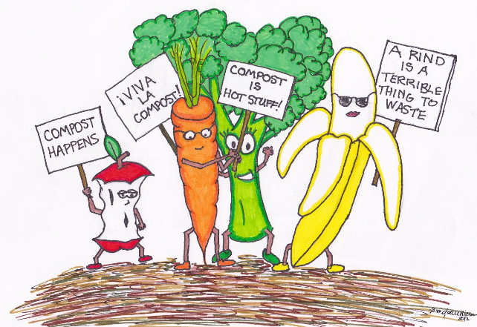
What creates Compost?
Composting helps the environment by
Reducing the waste volume
Produce compost that helps soil quality
Eliminates bad organisms
Add nutrients to soil
Compost is created by
decomposers eating organic material
They produce “left overs”and give off energy

Slide 2
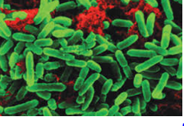
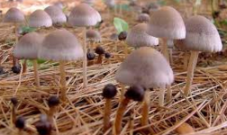
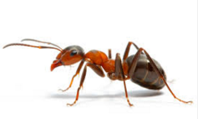
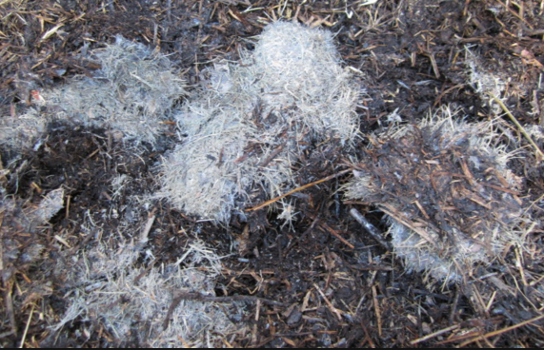
We need decomposers to convert organic matter

Slide 3
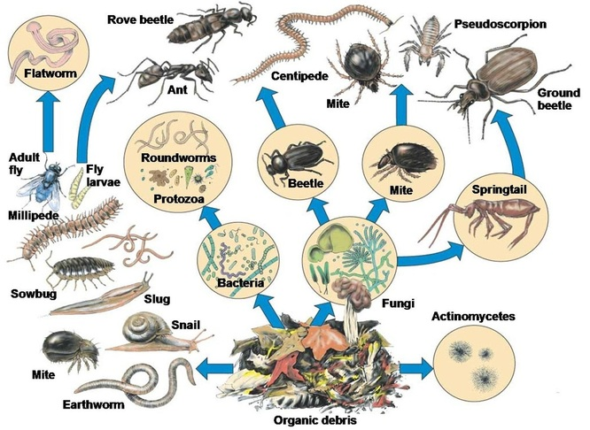
Decomposers – Cool vs Hot
Hot
Hot
Only some fungi, bacteria and microbes are hot decomposers,
the rest are cool

Slide 4
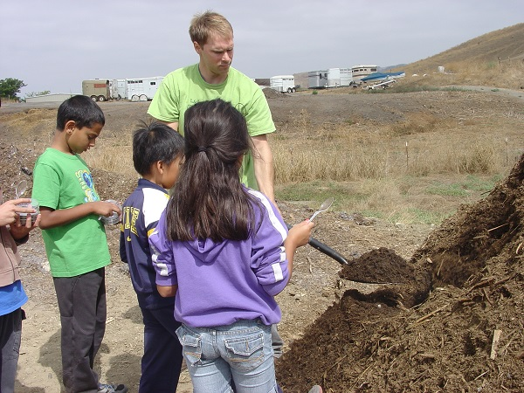
Composting Basics
2 major types of composting (cool and hot)
Cool takes a long time and requires many organisms
Thermophilic (hot) up to temperatures of 70 degrees Celsius (140 Fahrenheit)

Slide 5
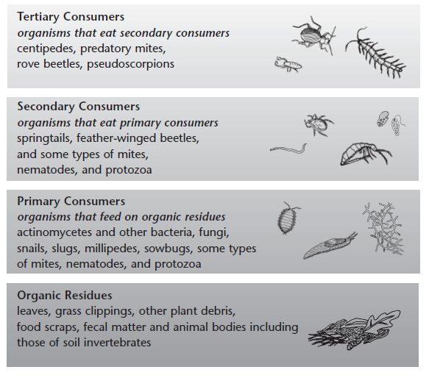
Food chain in the compost pile!
Top of compost food chain
Bottom of compost food chain

