Slide 1
HUMAN IMPACT FROM
CLIMATE CHANGE
The importance of water and water resources
How people in the past controlled the water
Modern control of water

Slide 2
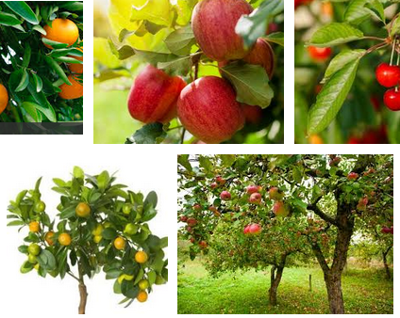
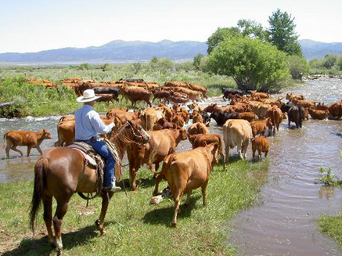
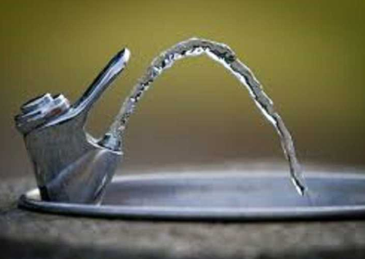
People need access to fresh water to live. Plants and animals also need fresh water to live.

Slide 3
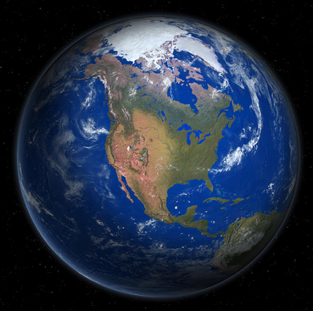
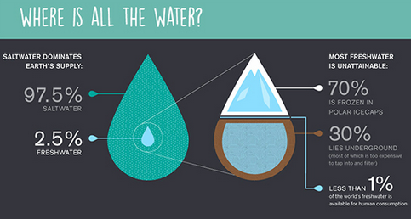
Though Earth is the “water planet”, almost all of Earth’s water is salt water and less than 1% is accessible fresh water. Water is a very precious resource.

Slide 4
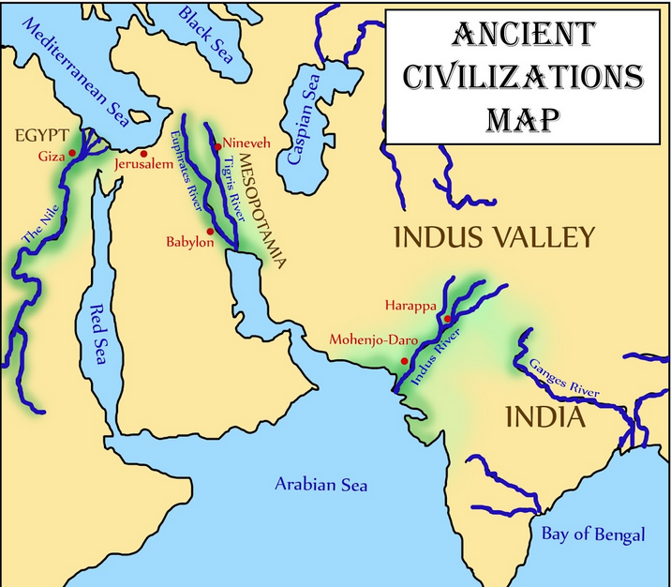
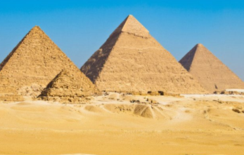
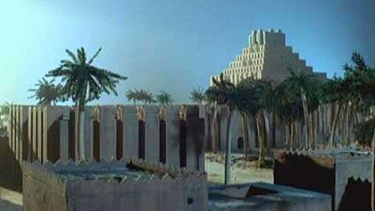
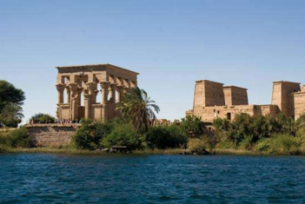
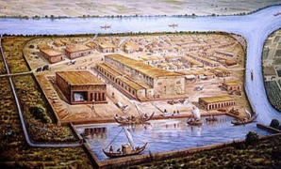
Cities need lots of water. Most of the earliest complex civilizations developed along river valleys

Slide 5
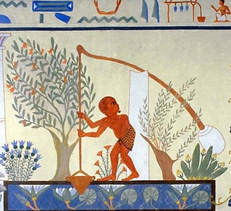
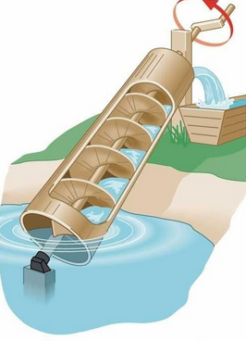
As ancient civilizations grew, people developed water control systems to store and transport water for drinking and watering crops as well as storage to prepare for possible droughts.
Ancient Egyptian methods to move water from the Nile River to their fields.

Slide 6
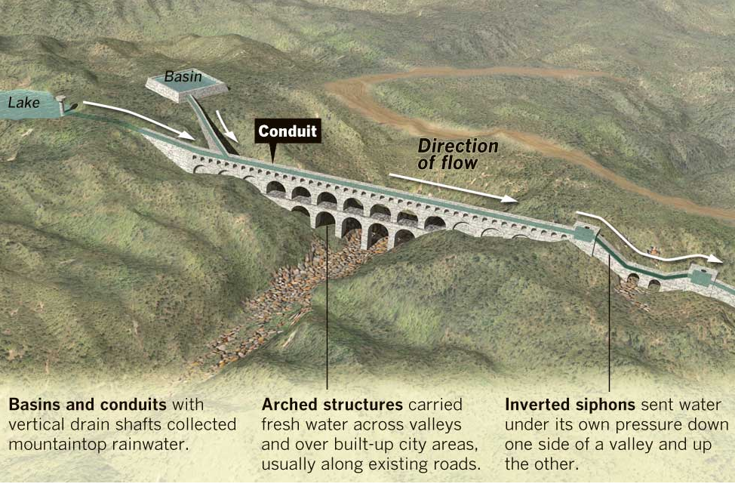
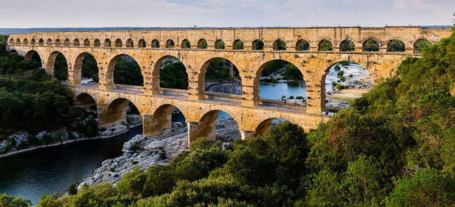
AQUEDUCTS As their cities got larger, ancient Romans made aqueducts to transport water. Some were 50 miles long.
They also collected mountain rainwater in large storage basins so it wouldn’t be wasted

Slide 7
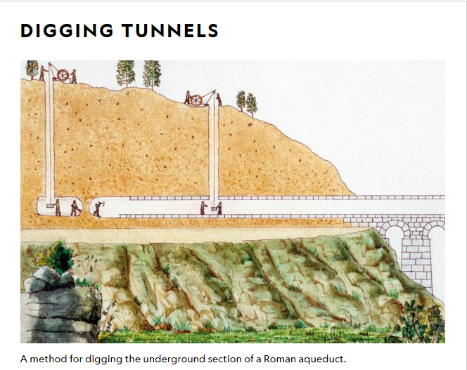
Aqueduct engineering could be quite complex. They could go over valleys and some had sections that would go through tunnels made through solid rock.

Slide 8
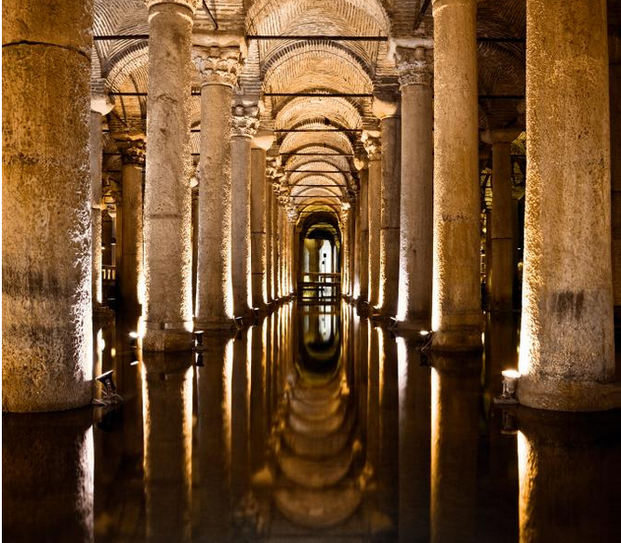
CISTERNS (UNDERGROUND TANKS) They also used immense underground storage tanks in the cities. Some of the ancient Roman cisterns could hold over 3 million cubic feet of water.

Slide 9
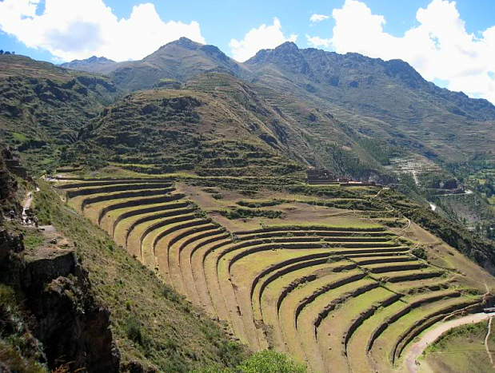
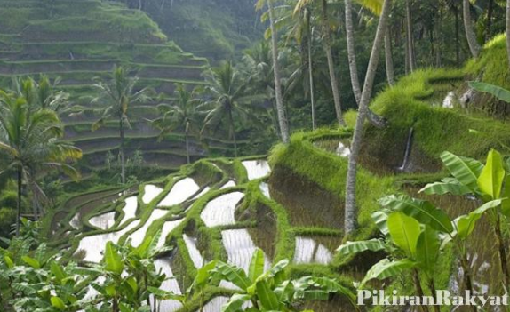
Ancient peoples also used TERRACES. In many regions, land is too steep to farm. People made terraces to create level fields and to preserve water and prevent erosion. This is still used today.

Slide 10
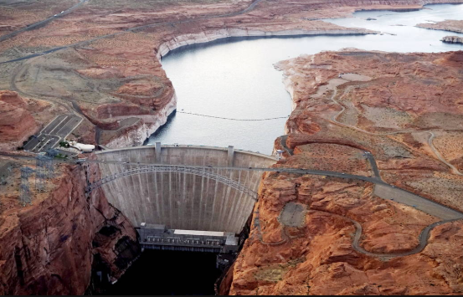
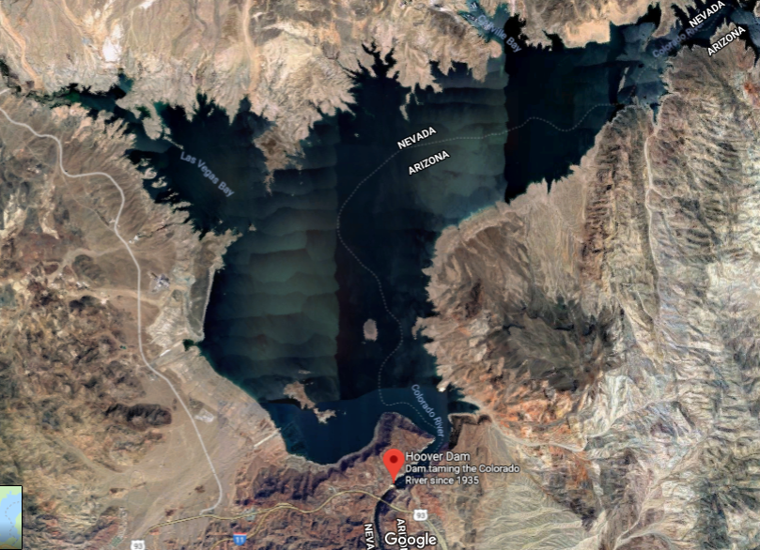
DAMS AND RESERVOIRS -- In modern times, we have larger cities and an even greater need to control water. We make large dams which stops the flow of water producing reservoirs (man-made lakes) that store vast amounts of water.
Hoover dam on the Colorado River produced Lake Mead.

Slide 11
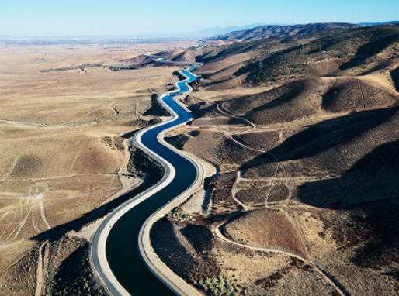
Aqueducts to transport water are still critical. California has the largest aqueduct in the world, it is over 700 miles long. We need to transport water since most precipitation is in the mountains.

Slide 12
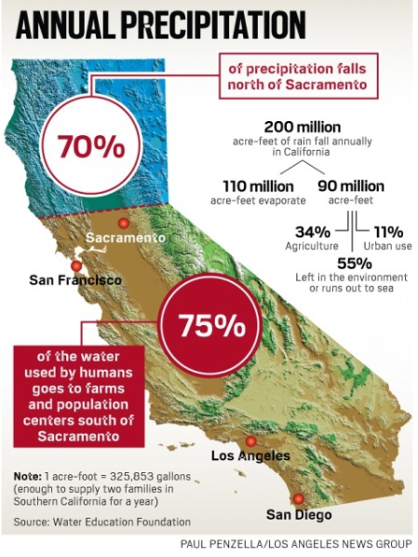
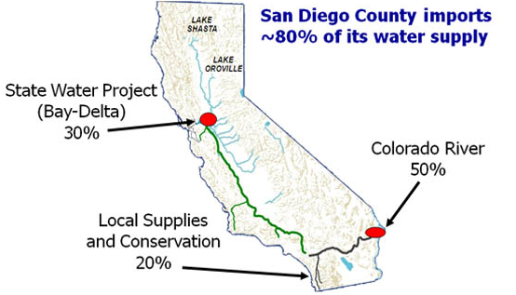
Most big cities in California are dependent on water transported from other regions.

Slide 13
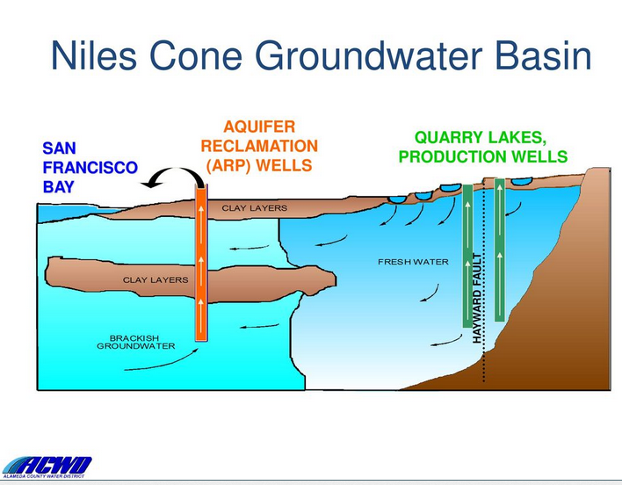
Fremont gets water from 3 main sources.
1. Wells pump groundwater from underneath Fremont

Slide 14
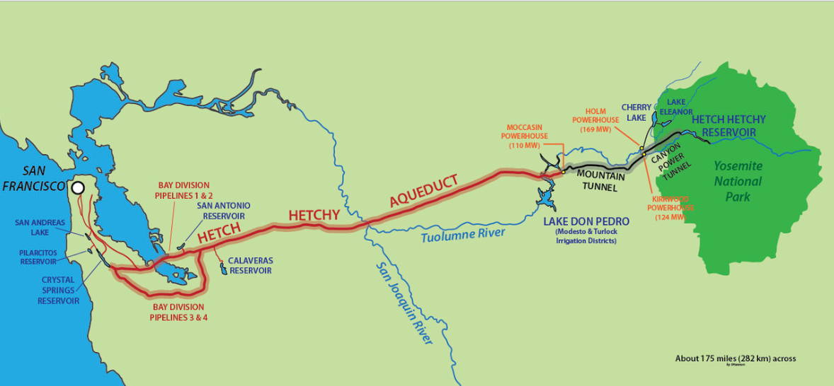
2. Some of our water is transported via aqueducts and pipes from the Hetch Hetchy reservoirs in the mountains near Yosemite National Park, 160 miles! This system also supplies San Francisco.

Slide 15
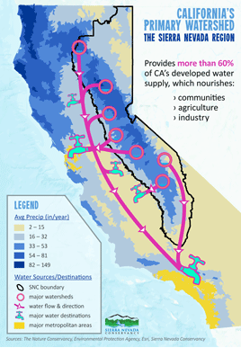
3. We also get water from the main California aqueduct system that comes from the Sierra Nevada mountains.
Even if we are not in a drought, water is a very precious resource.
We should always protect our water!

Slide 16
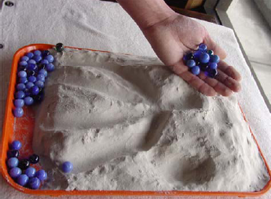
Now you create a landscape to manage water! First, create a watershed with water moving down the landscape Use marbles to test your design.

Slide 17
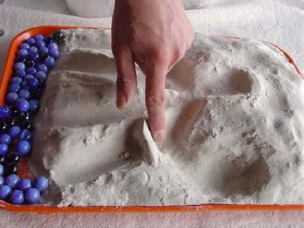
Next, prepare for drought or control for erosion. Build canals, dams, reservoirs or terraces to control the water. Use marbles to prove water goes where you wanted.

Slide 18
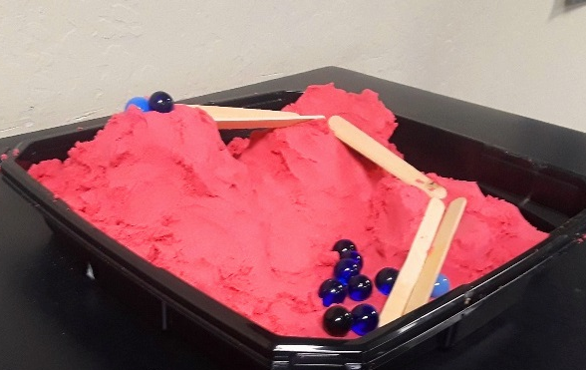
Finally, create more complex control of water. Use popsicle sticks to make aqueducts or tunnels that transport water from mountain valleys to cities. Test your design with marbles.

