Slide 1
ELEMENTS AND COMPOUNDS
OVERVIEW OF
PERIODIC TABLE

Slide 2
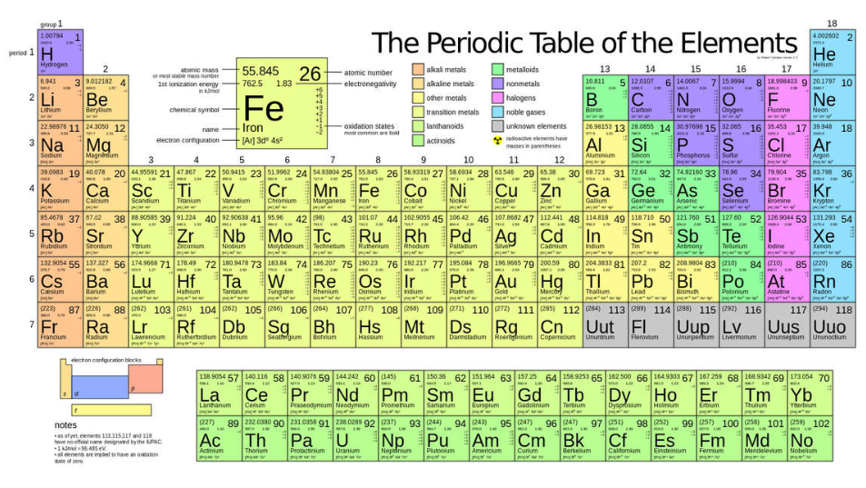
What is the Periodic Table
A way to organize elements known in the Universe
A way to predict if new elements can be found naturally or produced artificially

Slide 3
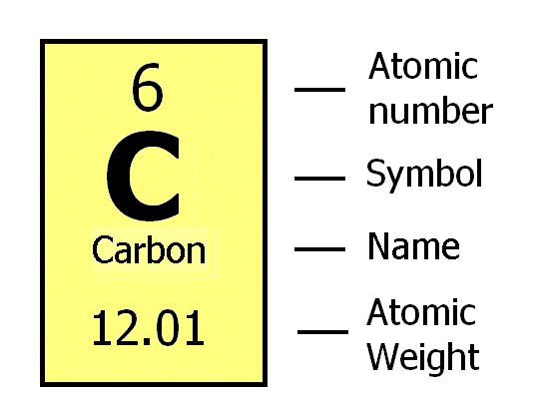
Reading the Element on the
Periodic Table
Notes:
Atomic number = the number of protons in the nucleus of an atom, which determines the chemical properties of an element and its place in the periodic table.
Atomic Weight – for elementary definition number of protons and neutrons

Slide 4
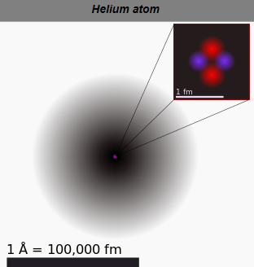
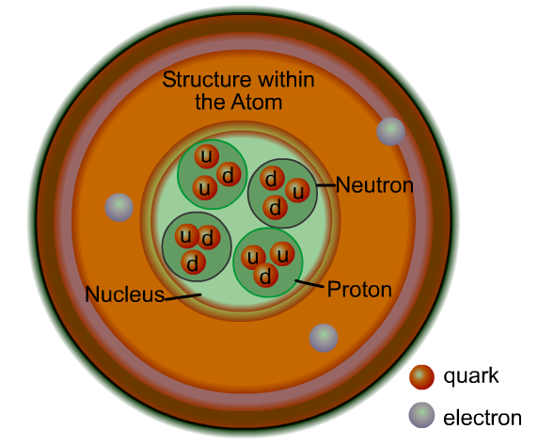
Basic Building Block of Matter

Slide 5
Chemistry Concepts
Element cannot be chemically broken down into simpler substances and are primary constituents of matter
Molecule is a group of two or more atoms linked together by sharing electrons in a chemical bond
Ion is an atom or molecule with a net electric charge due to the loss or gain of one or more electrons
Compound is a thing that is composed of two or more separate elements

Slide 6
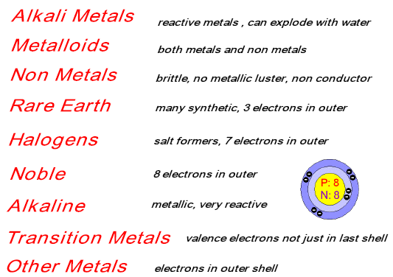

Slide 7
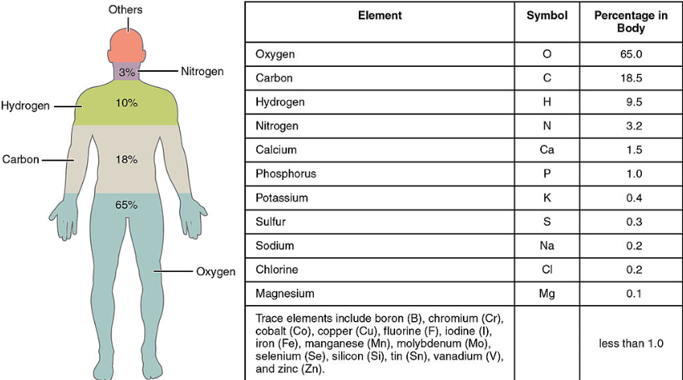
Elements in the body

Slide 8
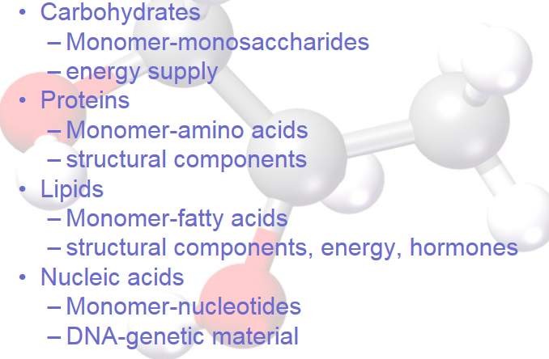
Major Groups of Compounds
Human Body

Slide 9
Review of States of Matter
Solid
Liquid
Gas
Plasma
Bose-Einstein Condensate

