Slide 1
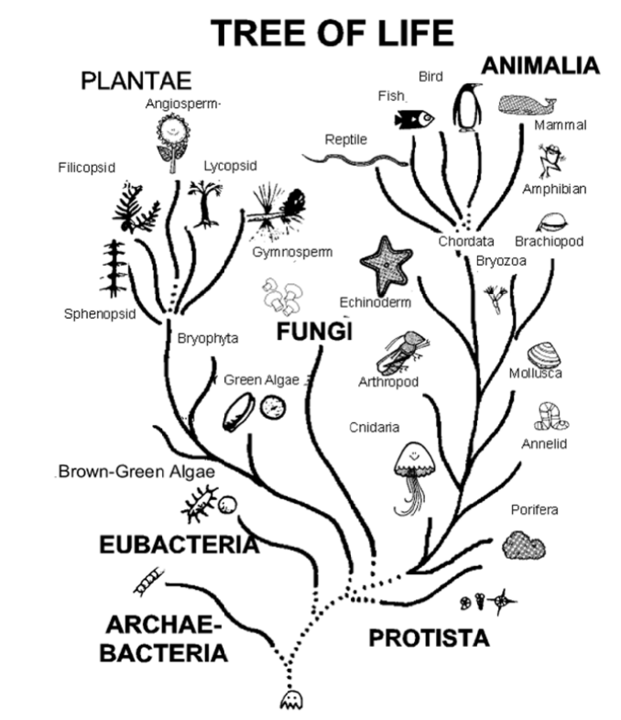
Fungi is a separate Kingdom

Slide 2
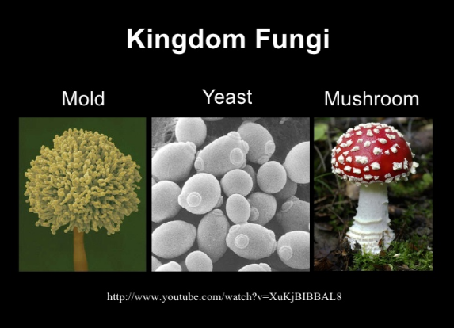
Molds are a type of fungi

Slide 3
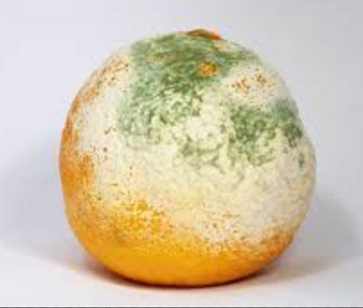
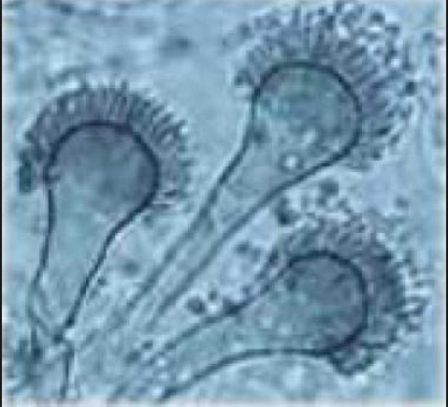
Molds – Fungi with a Hyphae
Multicellular Fungi, hyphae make mold look “fuzzy”

Slide 4
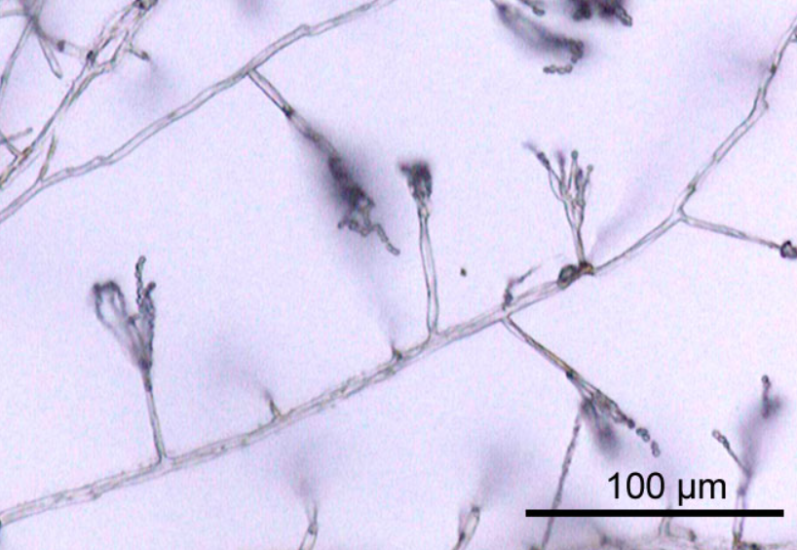
Penicillin is a Mold
Under a microscope hyphae of penicillin

Slide 5
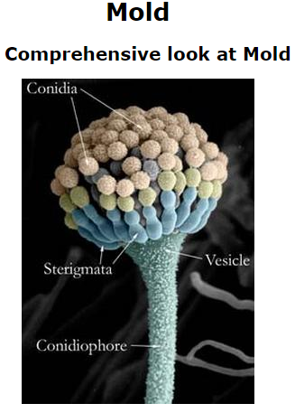
Molds
Molds are nature's super "recyclers", feeding on dead and decaying organic material such as trees and plants.
They put out spores to reproduce. Mold spores are in the air all around us.
When the conditions are right, the spores grow.
Molds like warm, moist conditions.

Slide 6
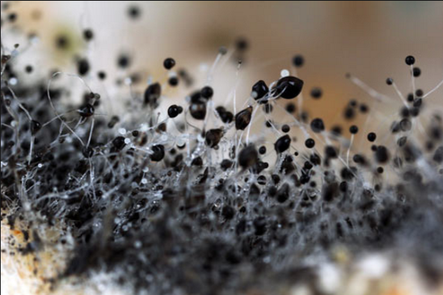
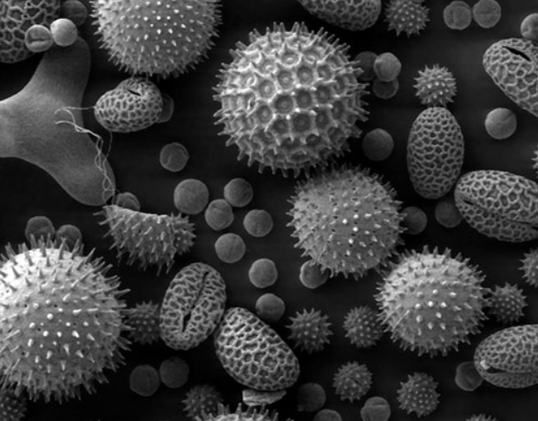
Spores
A spore is part of the life cycle of fungi; some bacteria and algae.
Mold spores are sometimes round balls at the end of the hairy filaments.
Spores are microscopic

Slide 7
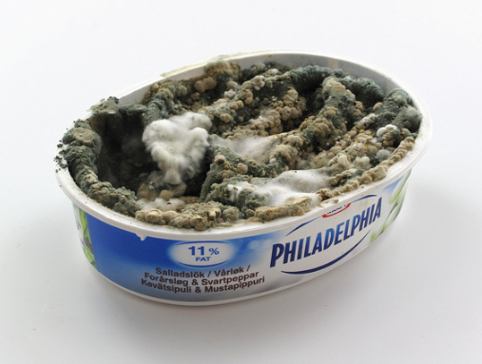
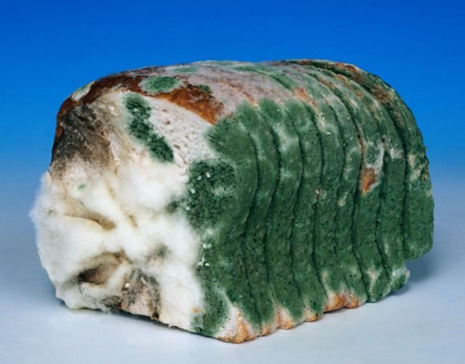
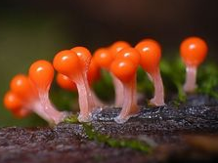
Mold have many colors, but like moist and warm areas to grow.

Slide 8
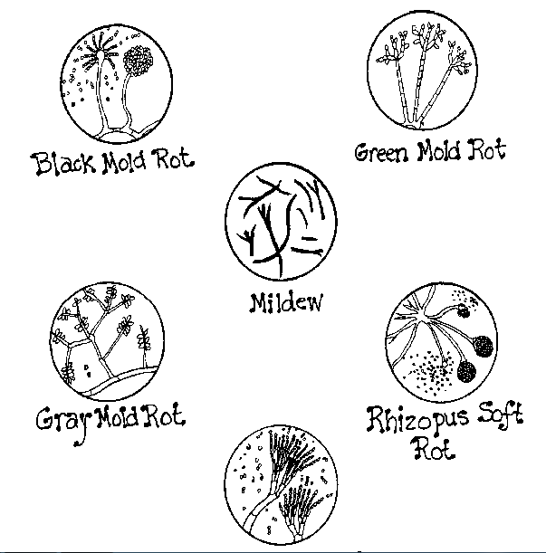
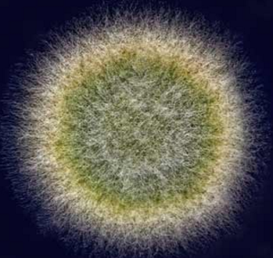
Molds can have different structures and often look hairy or fuzzy

Slide 9
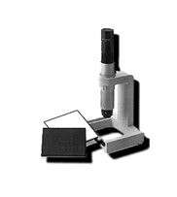
How to use a microscope
Review the microscope (remember with the Swift GH the objective needs to be 3 inches away from the specimen)
They are set to focus already.
Don’t lean on them or touch them.
Ask for help if they get out of focus.
Have a partner hold a flashlight on them so you can see better.

