Slide 1
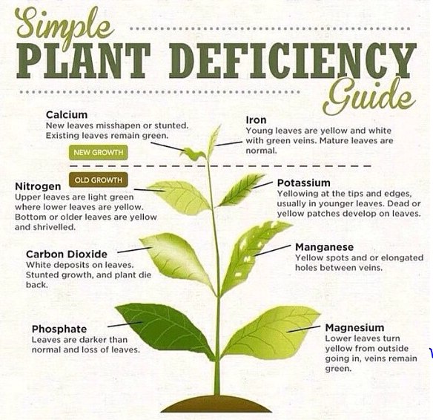
What happens to plants that don’t get enough nutrients?

Slide 2
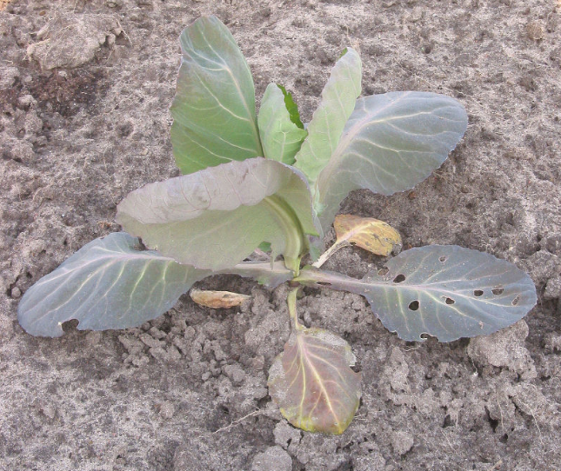
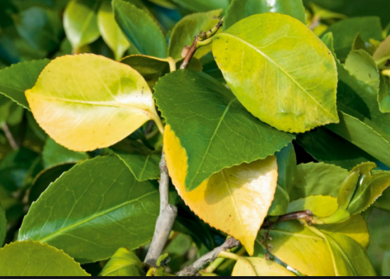
Low Nitrogen (N)
Symptoms include poor plant growth, and leaves that are pale green or yellow because they are unable to make sufficient chlorophyll.

Slide 3
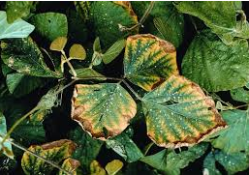
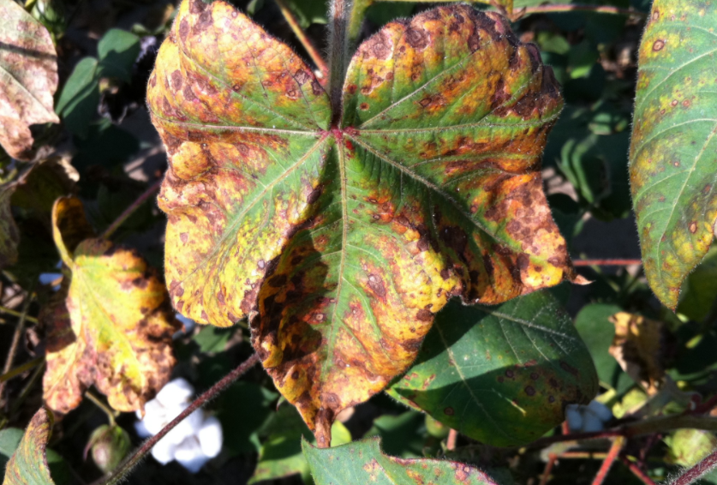
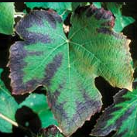
Low Potassium (K)
symptoms include brown scorching and curling of leaf tips, yellowing between leaf veins and purple spots. Reduced growth, root development, and seed and fruit.

Slide 4
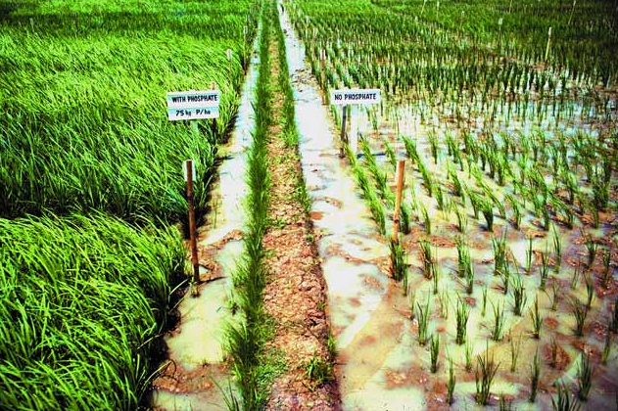
Low Phosphorus (P)
Plants deficient in phosphorus don’t grow well (so are smaller). Leaves may have an abnormal dark-green or a reddish-purple color.

