Slide 1
Soil Description

Slide 2
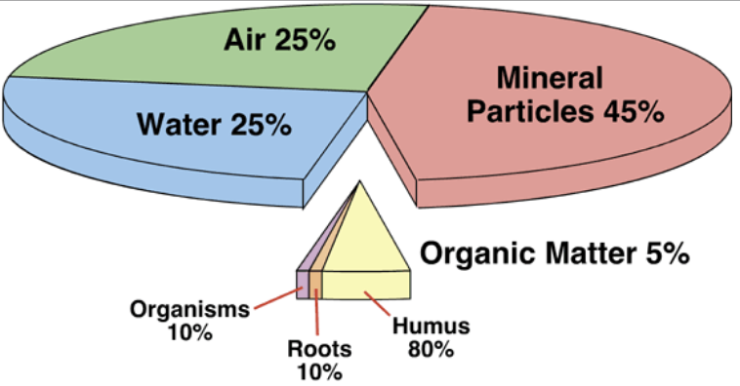
Soil is composed of minerals, air water and organic matter
The above is the best ratio for plants.
Organic matter is a small but critical part of soil.

Slide 3
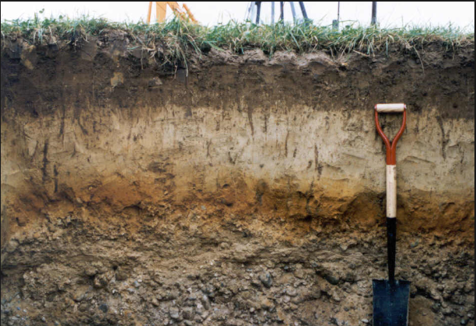
Soil has layers-- top layers have more organic matter bottom layer has little to no organic matter.

Slide 4
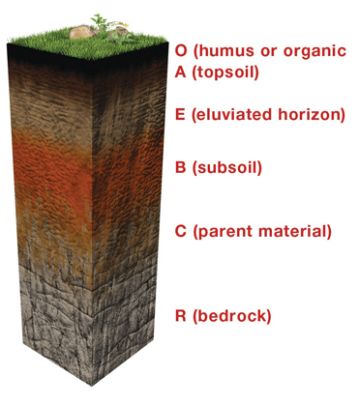
Naming soil layers
O layer– layer of organic material on top
A layer -- topsoil has more organic material, needed for plants to grow
B layer – subsoil
Some organic material
C layer – parent material
Just eroded bedrock, almost no organic material

Slide 5
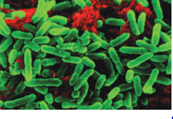
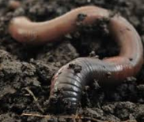
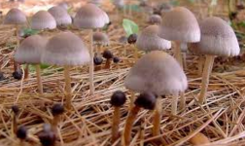
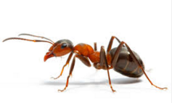
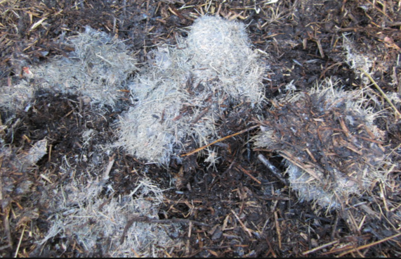
Decomposers are needed to convert organic matter on the surface to a form plants can use

Slide 6
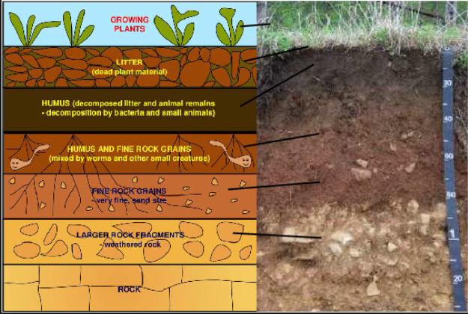
Can you name the soil layers?

Slide 7
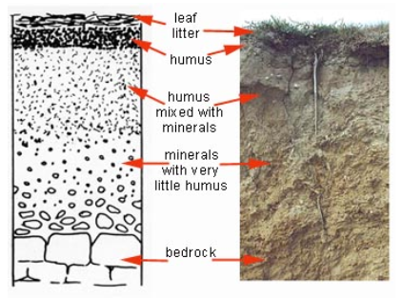
Your job is to look at 8 soil samples and try to figure out what layer a soil sample comes from.
O
A
B
C

Slide 8
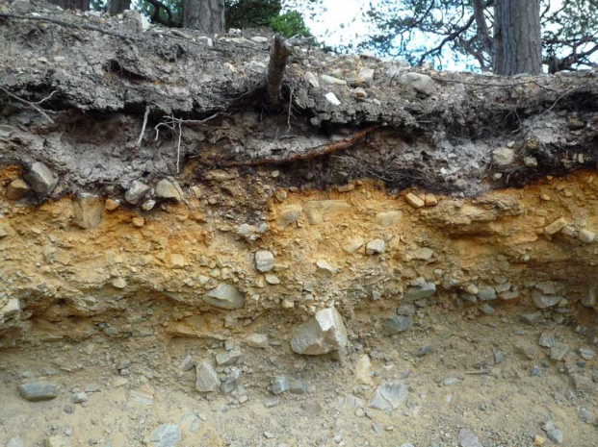
soils can also be described by color, particle size and if it is magnetic

