Slide 1
Oceans and Atmosphere
Oceans are the envelope of water
Atmosphere is envelope of air
Their interaction creates weather
Earth Movement on axis causes Coriolis Motion
Solar radiation – temperature differences from land, water, and air

Slide 2
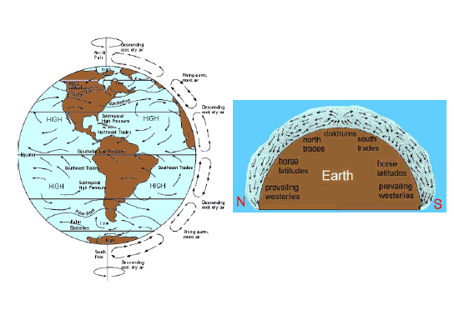
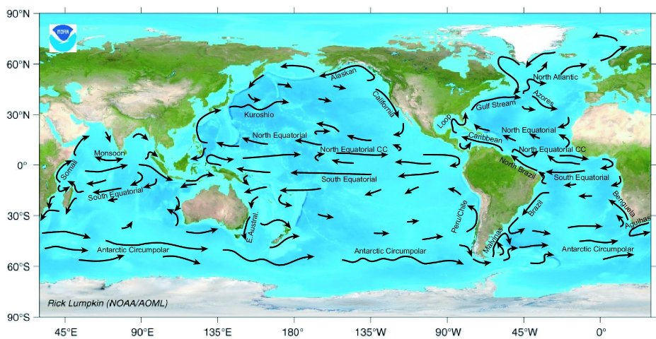
Coriolis Effect – Rotation on Axis affects oceans and atmosphere

Slide 3
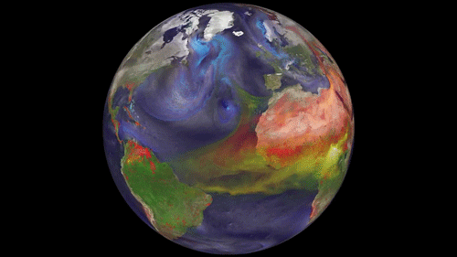
Atmospheric Currents

Slide 4
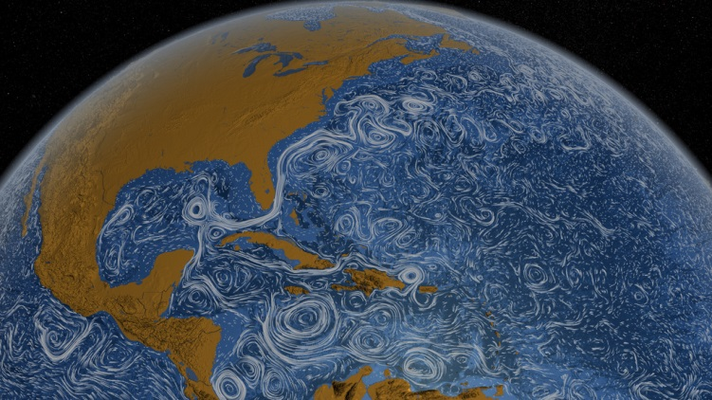
Surface Currents (NASA)

Slide 5
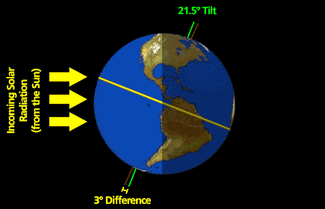
Solar Radiation – Driving Force
Misconception: heat is directly from the sun

Slide 6
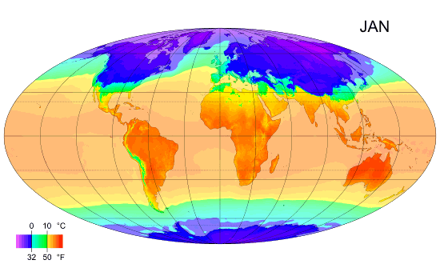
Temperature variations

Slide 7
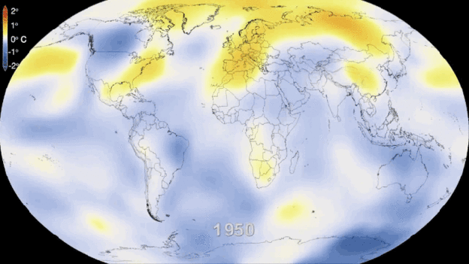
Temperature change over 63 years

Slide 8
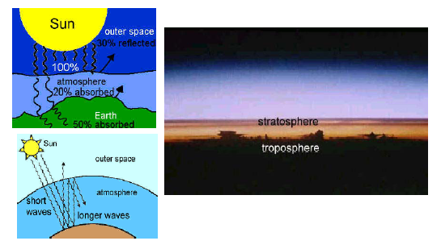
Atmosphere Changes

Slide 9
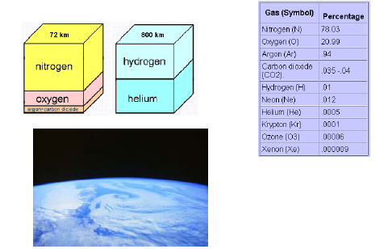
Atmosphere Changes

Slide 10
