Slide 1
HUMAN IMPACT FROM CLIMATE CHANGE
The importance of water and water resources
Salt water resources vs. fresh water
How people in the past controlled the water

Slide 2
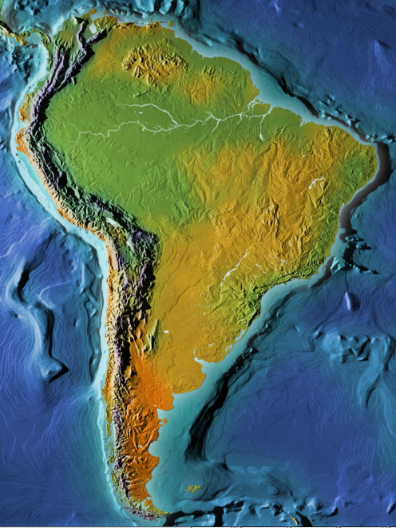
Wet and green
Dry and brown
Understanding geography, water sources and climate is critical to understand human development in the past and today.
In South American, the Andes Mountains on the west stopped the movement of clouds from the east. East of the mountains it is wet. West of the Andes it is extremely dry.
Notes:
One of the keys to understanding the development of complex societies in south america is to understand geography, the currents and the natural long term fluctuations of rainfall.

Slide 3
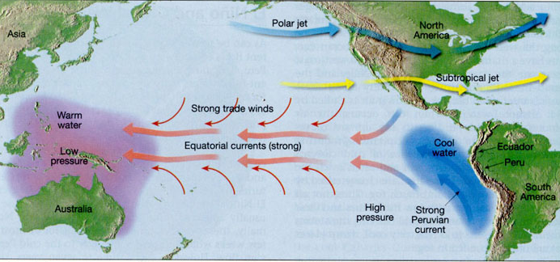
Despite the dryness, the west coast of Peru could farm along river valleys and could find rich ocean resources from upwelling.
Upwelling is deep nutrient rich water coming to the surface. The upwelling off the western coasts of Ecuador and Peru was due to wind movement and movement of the earth and the continents.

Slide 4
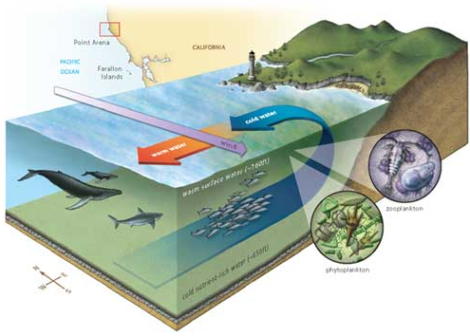
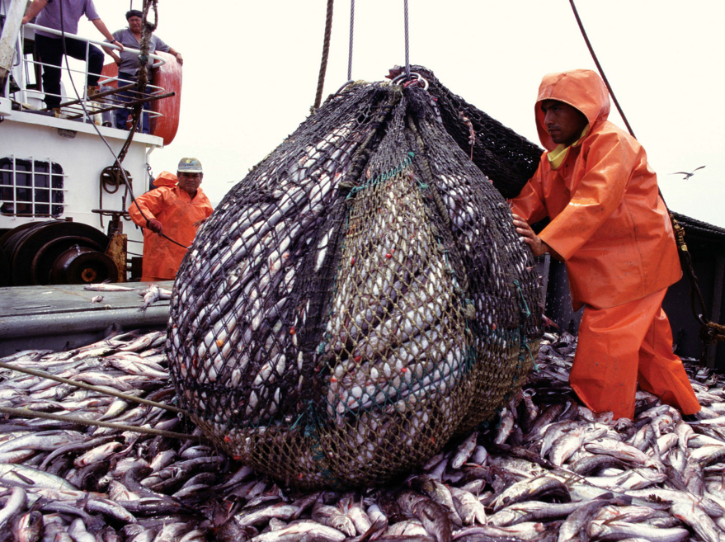
Nutrient rich water from the upwelling provides food for lots of fish.
Fish provides resources for humans now and in the past

Slide 5
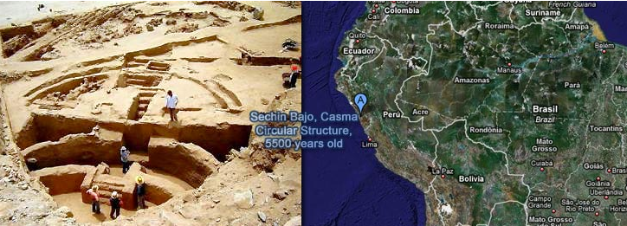
The earliest complex societies developed in South America along the coast. To have a complex society, there needs to be a surplus of food.
Surplus for these early complex societies came from the sea so the biggest sites were close to the coast.
Sechin Bajo ~3500 BC --

Slide 6
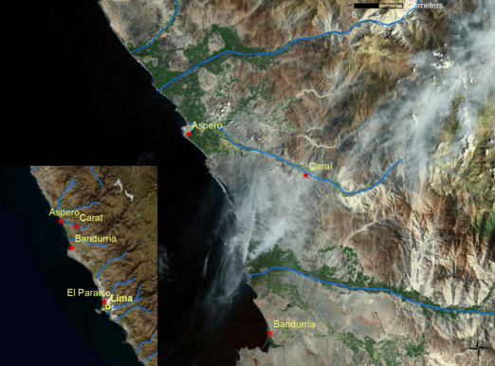
The ocean provided a lot of food, but people had to live near fresh water for drinking. Fresh water in coastal Peru could only be found near river valleys which brought water from the mountains.

Slide 7
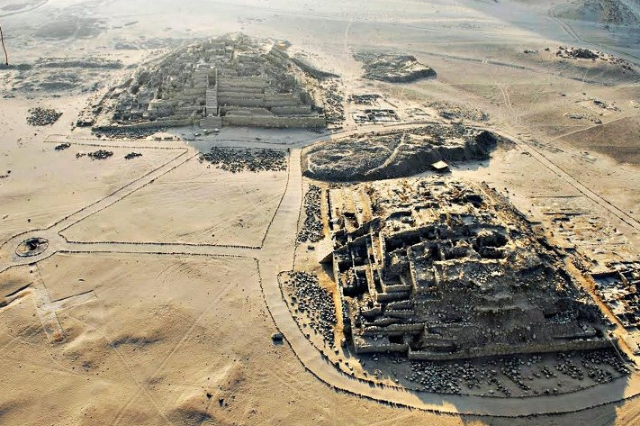
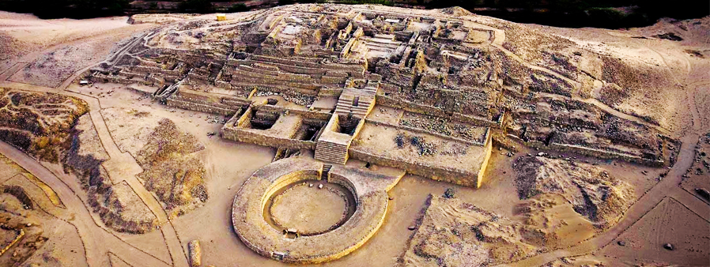
Caral
3000 BC
Complex of pyramids -- similar in time to earliest pyramids of Egypt
Largest is size of 4 football fields

Slide 8
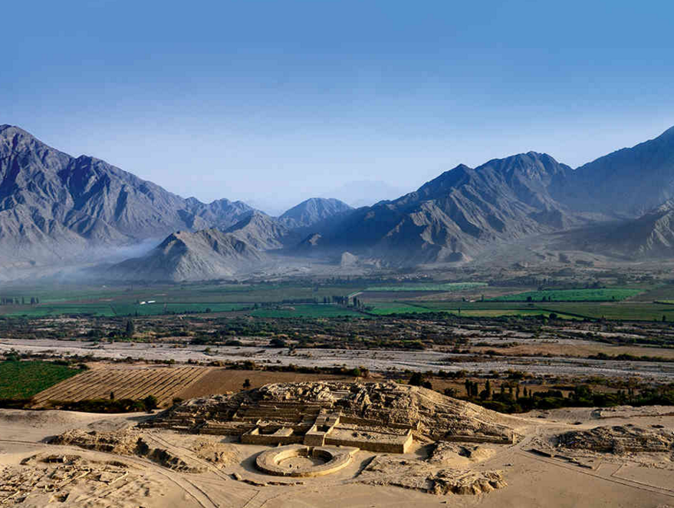
Caral got their fresh water from a nearby river

Slide 9
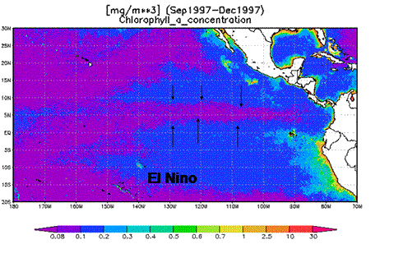
During El Nino not only are there less fish in the coastal waters but also the change in wind patterns moves warm ocean water toward the land causing strong rains.
We can see extreme El Nino events in archaeology by sites that are covered or partially destroyed by the torrential waters.

Slide 10
Climate change can cause disastrous floods or long term droughts
People in the past would manage water to avoid disaster.

Slide 11
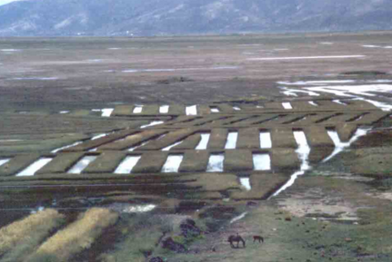
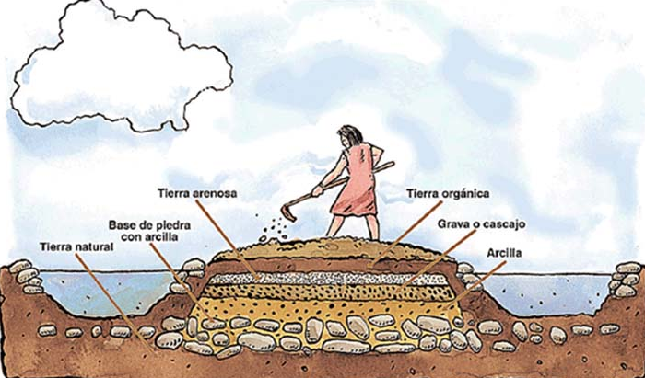
ENGINEERING AND WATER
Native South Americans created raised fields to get more water to their fields
Raised fields provided water to crops but also provided a micro environment for fish and birds and other organisms to live. The muck produced in the canals would be used as natural fertilizer for the crops. Water would absorb energy from sun during the day and would keep the raised fields from freezing at night.

Slide 12
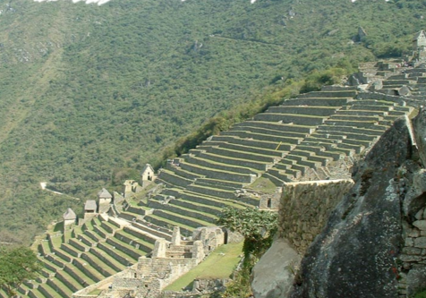
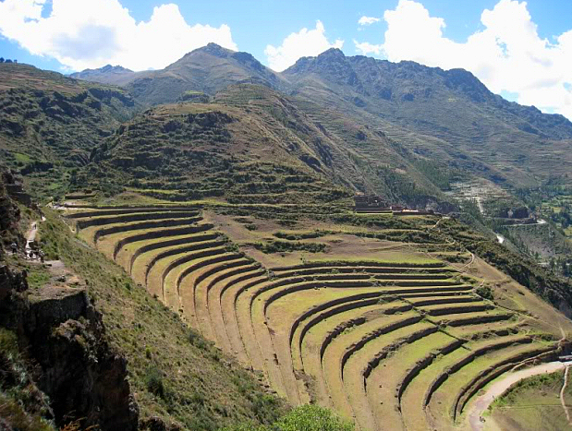
Much of the Andes land is too steep to farm. People put terraces on fields to create level fields to control water for the crops and to prevent erosion.

Slide 13
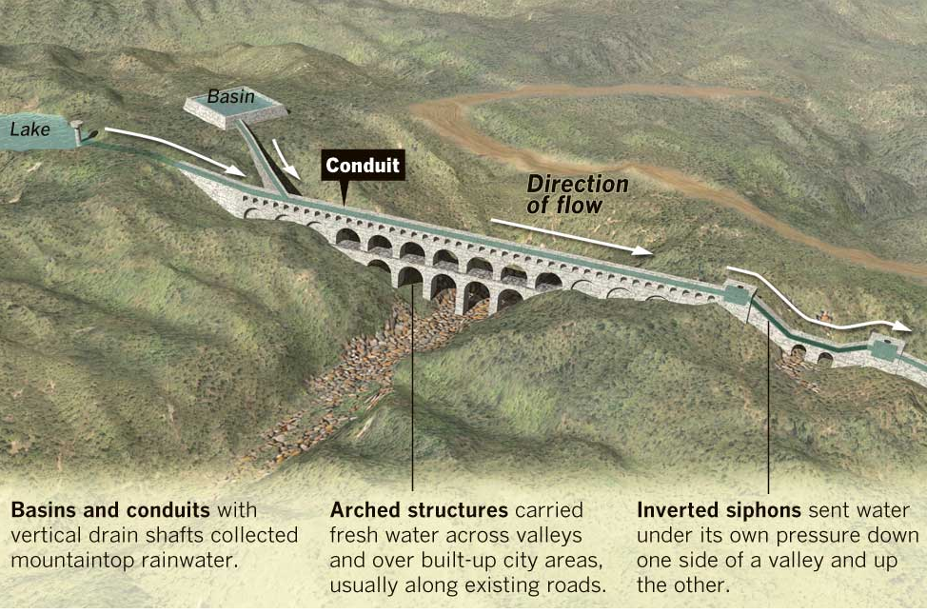
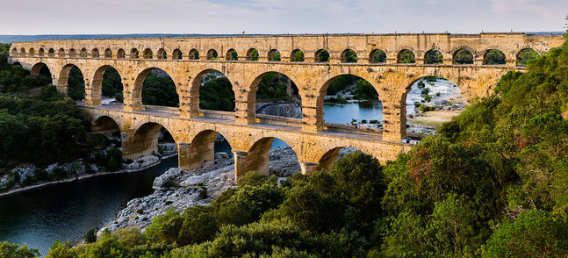
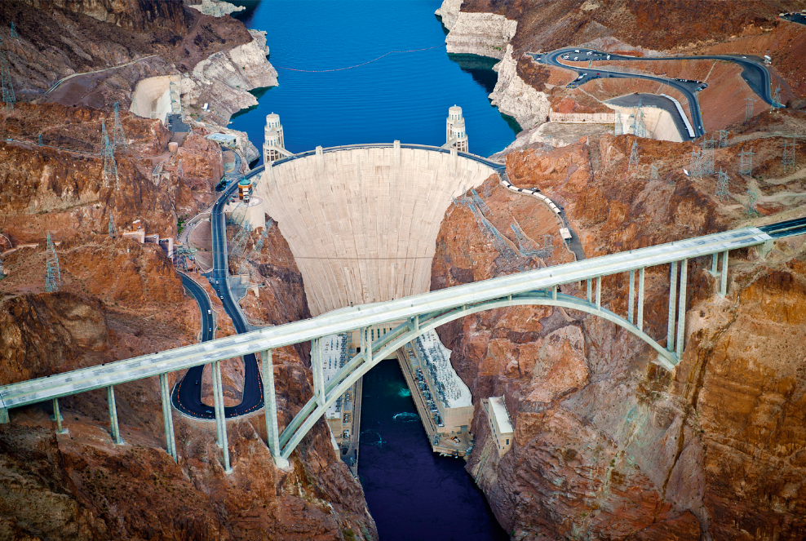
Ancient Romans made aqueducts to transport water
We make large dams and reservoirs
(Hoover dam)

Slide 14
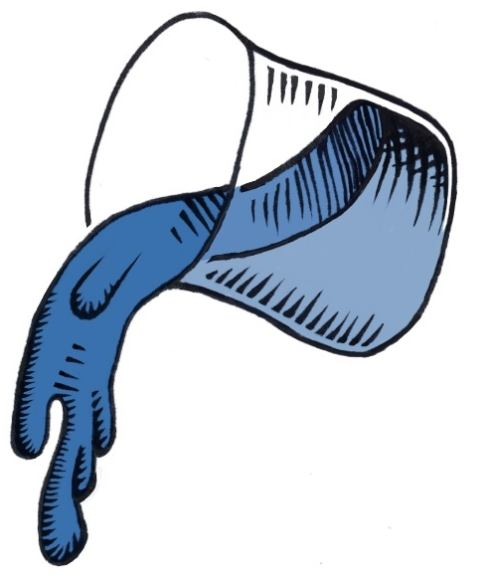
To move and control water people need to work with the principle of gravity.
Water always flows down.

Slide 15
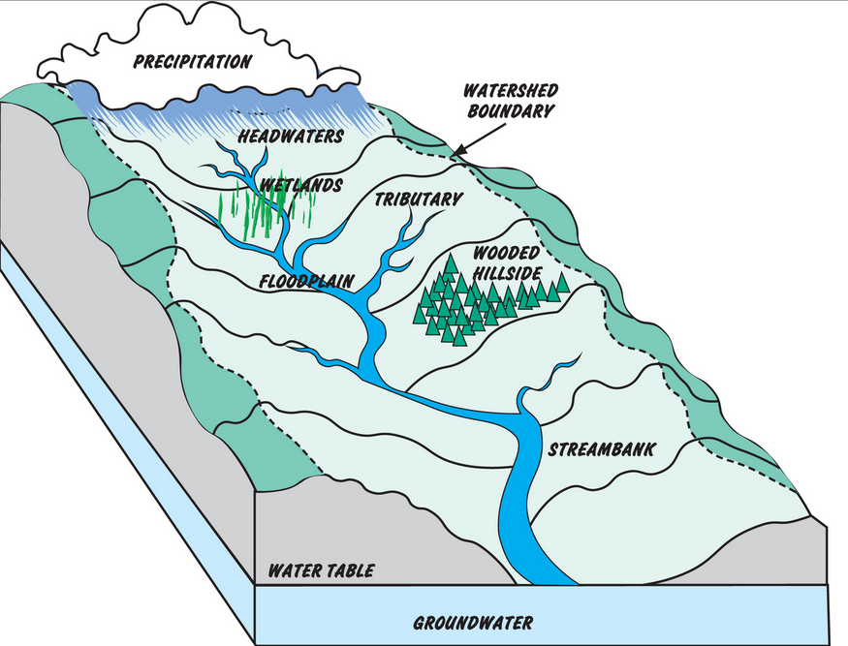
Only the precipitation falling on the light green area (purple arrows) would flow to the river in the center.

Slide 16
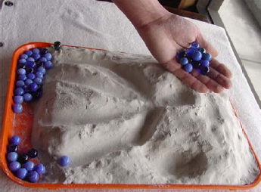
Now you create a landscape! Show how water moves on your landscape using marbles.

Slide 17
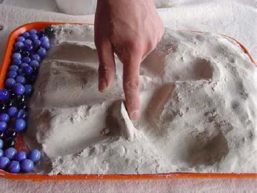
Next, prepare for drought or control for erosion. Build canals, dams, reservoirs, terraces or raised fields to control the water. Use marbles to prove water goes where you wanted.

