Slide 1
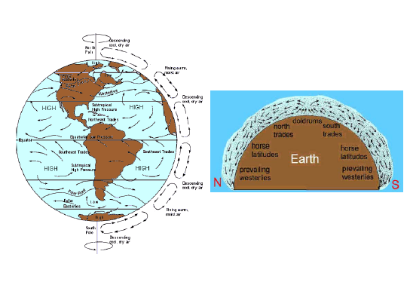
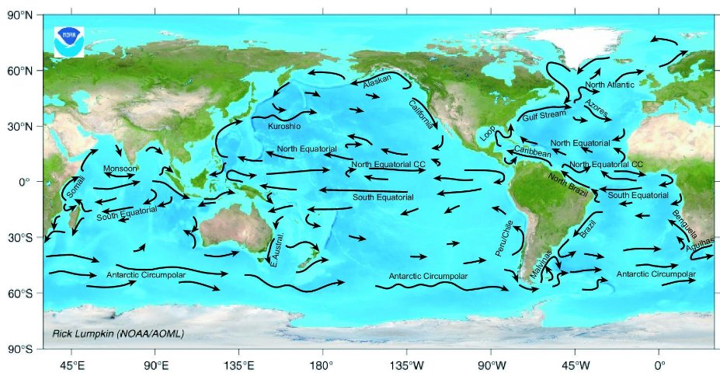
Ocean Movements
Rotating Earth influences basic motion of ocean and atmospheric currents (Coriolis Effect)

Slide 2
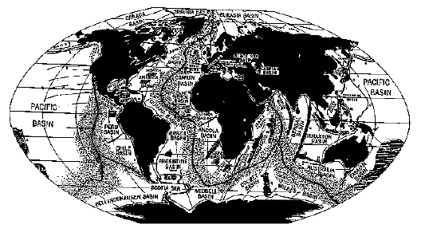
Bathymetry (barrier for water) Topography (barrier for air)
What are some barriers underwater that would change the direction of water currents?

Slide 3
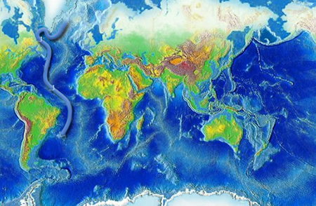
Thermohaline Circulation the large-scale ocean circulation that is driven by differences in water density in the oceans created by surface heat and cold depths and fresh water (ice melt or river run-off) to salt water

Slide 4
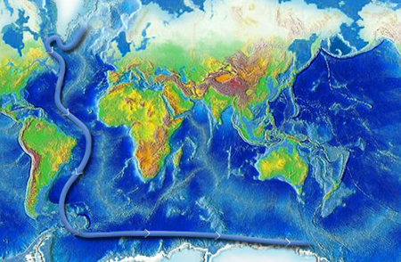
Differences in density create slow moving water currents

Slide 5
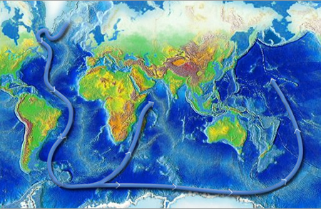
These currents are created by density difference but change course depending on underwater mountains

Slide 6
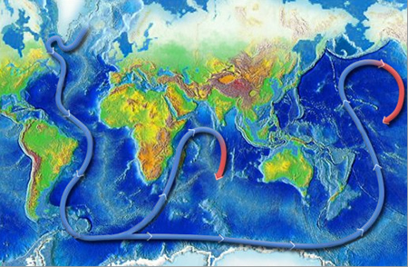
As the currents return they get warmer near the surface

Slide 7
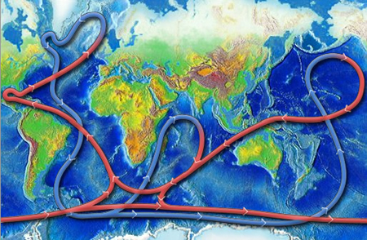
The whole cycle takes 1,000 years to complete

Slide 8
density
Which is denser? Cold water or warm water.?
Which is denser? Salty water or Fresh water?
Which kinds will sink?

Slide 9
Since 2000, solar radiation absorption in the Arctic has increased 5%. In this image, red represents absorption increase, while blue represents solar ice decrease.

Slide 10
Ice has decreased but……

Slide 11
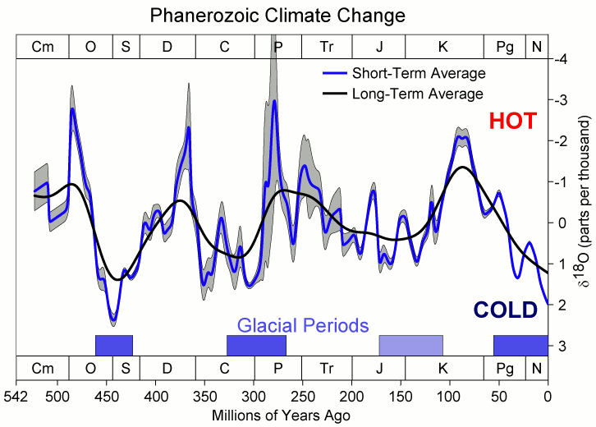
Ice through Time

