Slide 1
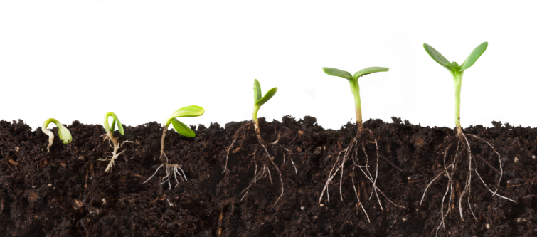
What makes up healthy soil?

Slide 2
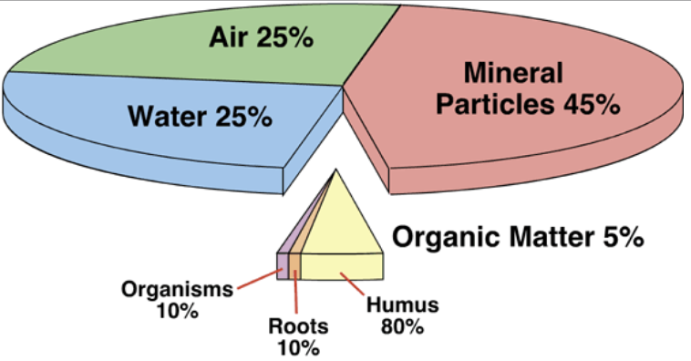
Healthy soil is a mix of minerals, air, water and organic material (compost)
COMPOST
The above is the best ratio for plants.
Organic matter is a small but critical part of soil.

Slide 3
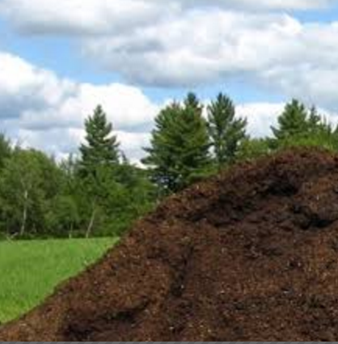
Compost is critical for healthy soil
But …do you think plants will be healthy if we planted them in ONLY compost?

Slide 4
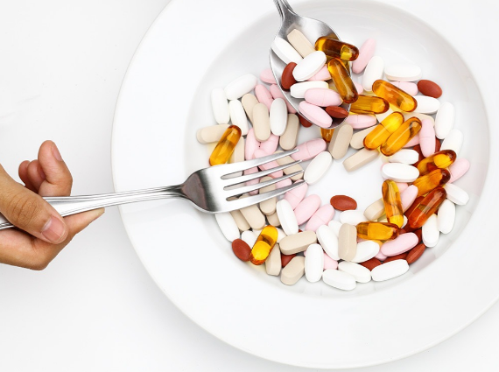
Turns out: NO!
Plants do not grow well if planted in ONLY compost
If you ate ONLY vitamins would you be healthy?
Too many vitamins can make you sick!

Slide 5
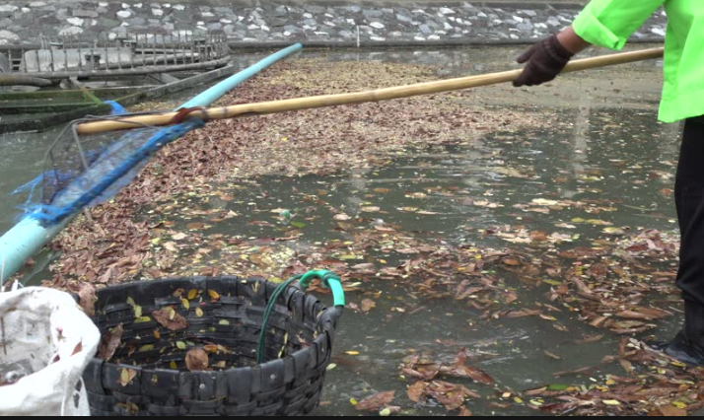
Plus, compost is lighter weight than soil minerals and tends to float. Compost doesn’t hold plant roots in place.

Slide 6
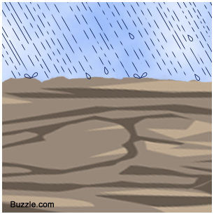
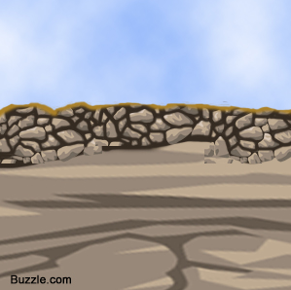
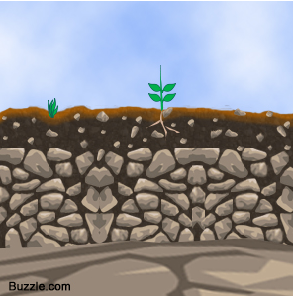
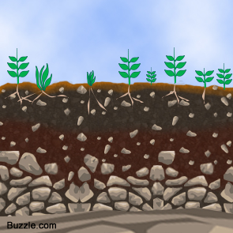
Soil starts with hard rock that breaks down, small plants grow and add organic matter that supports larger plants
—it takes a LONG time to form soil

Slide 7
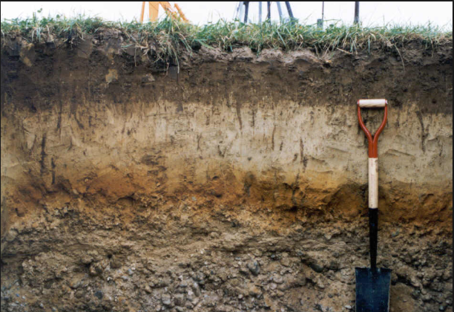
Soil has layers-- top layers have more organic matter bottom layer has little to no organic matter.

Slide 8
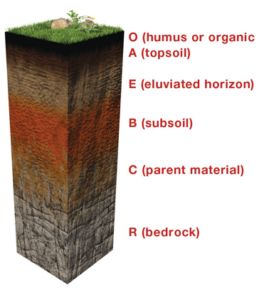
Mature soil layers are defined by amount of organic material
O – layer of organic material on top of soil (dead leaves etc)
A -- topsoil - lots of organic matter plus minerals (clay, sand and silt)
B – subsoil – parent material and some organic material
C – parent material (eroded bedrock), almost no organic material
R -- is just rock (called bedrock)

Slide 9
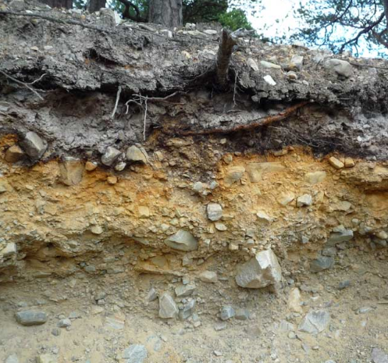
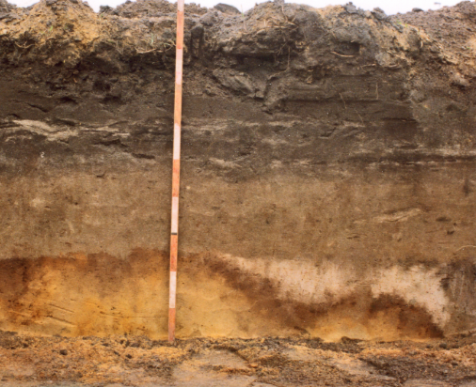
Soils can also be described by mineral type, color, particle size and if the minerals are magnetic
Examples of soil profile of coarse and fine soils. Where is the darkest layer in each? Why is it so dark?

Slide 10
Three experiments today
1. Test density of rock, soil and compost. Compare which sinks or floats: sand, soil or compost
2. Identify which layer a soil sample came from by soil characteristics.
3. Can you find any magnetic particles in soils?

