Slide 1
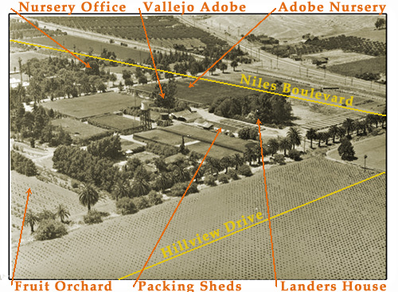
California Nursery Historical Park

Slide 2
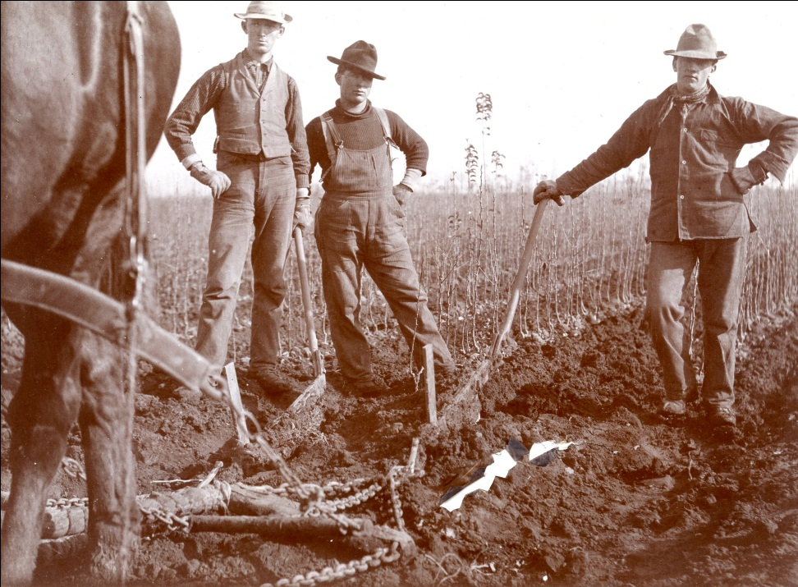
Agriculture and horticulture
the evolution of both fields
scientific aspects
hands-on exhibits
ability for community service/service learning

Slide 3
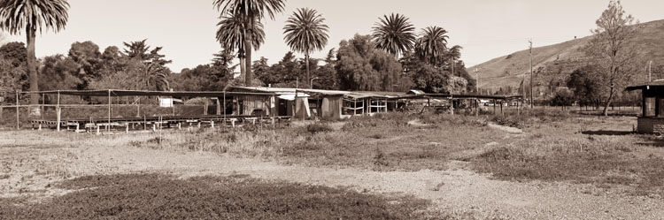
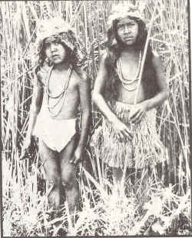
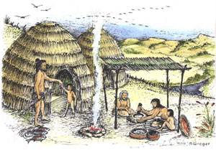
Native Americans - Ohlone
Ideal for fishing from Alameda Creek (salmon would have provided abundant food)
Fertile area for oaks which was Ohlone food staple
Ideal weather conditions in area
horticulture or agriculture

Slide 4
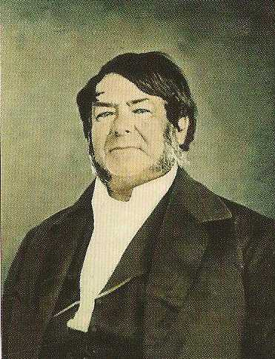
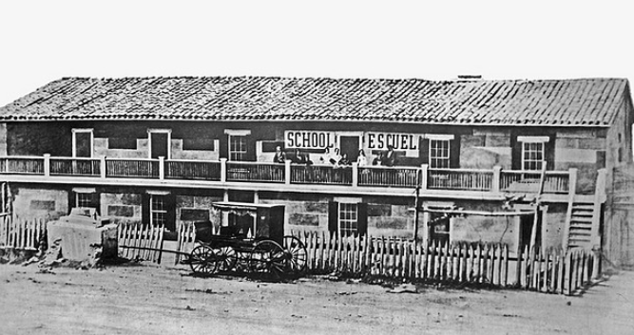
Jose de Jesus Vallejo
Older brother of General Mariano Vallejo
1859 wealthiest man in Alameda County
Owned flour mill (Vallejo Mill)
Owned 17,724 acres sold 10,000 acres to Jonas Clark

Slide 5
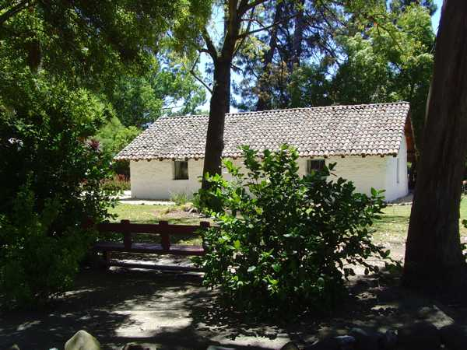
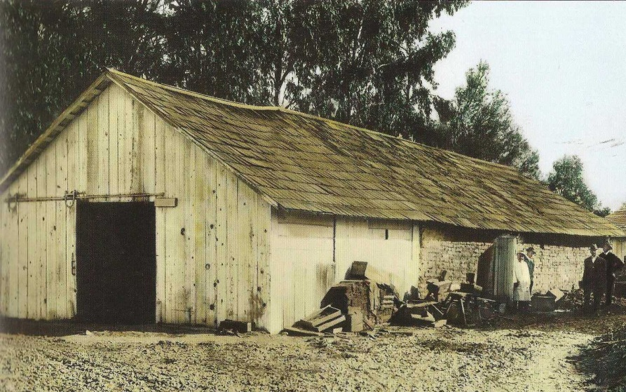
Vallejo Adobe
Built in 1830-40
Part of Don Jose de Jesus Vallejo land grant “The Rancho de la Alameda”
Renovated in 1930’s as a “tea house” for potential nursery clients (Reimers)
Other functions fumigation house for trees, grain storage, bunk house for vaqueros

Slide 6
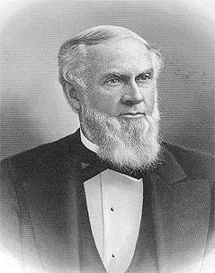
Jonas G. Clark
SF furniture merchant and capitalist (land speculator)
Purchased 1862-1881 over 11,148 acres of Niles
Founder of Clark University (ivy league school back Mass.)

Slide 7
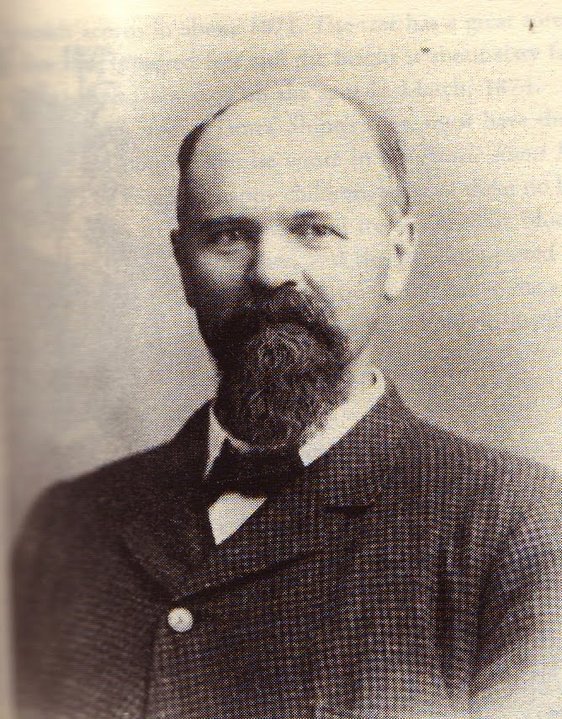
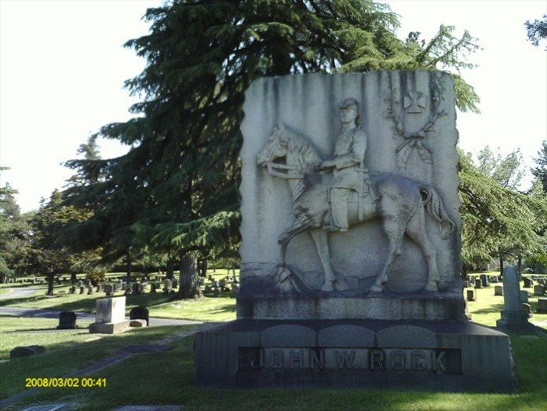
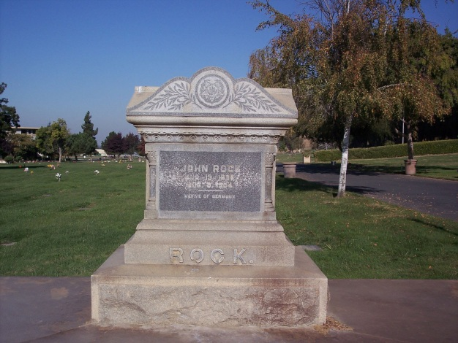
John Rock
Civil War hero
Free Mason
With Richard D. Fox purchased 463 acres from Clark
Established California Nursery (experimental fruit tree nursery)
Worked with Luther Burbank

Slide 8
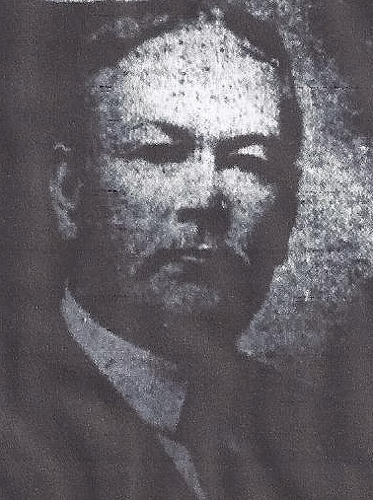
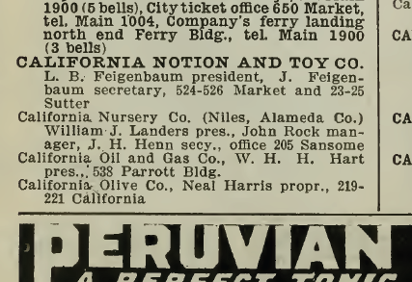
William J. Landers
Worked with Rock as investor, but then purchased before Rock’s death; died in Feb., 1908
Insurance broker
Built summer home (Maybeck Cottage)
Board of directors included Luther Burbank, Meek

Slide 9
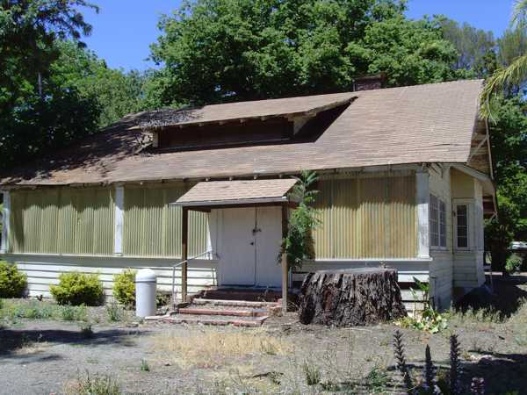
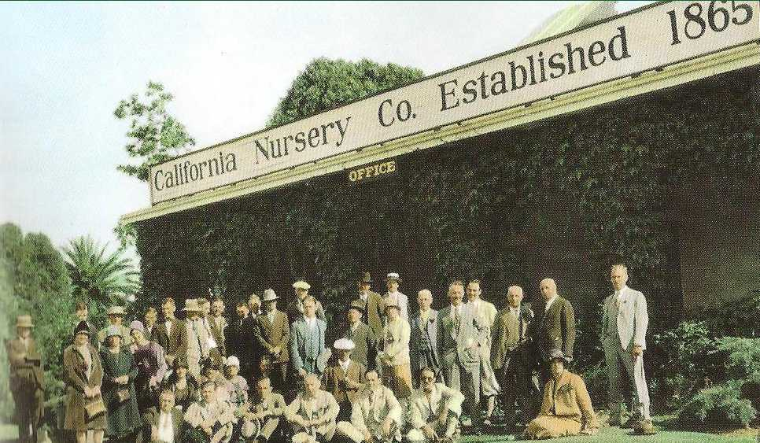
Maybeck (office and cottage)
Both buildings were probably designed by either Bernard Maybeck or his firm (including Julia Morgan) which after the 1906 earthquake did several designs in the south bay. The style of both buildings reflects the “Arts and Craft” movement in architect at that time. Frances Roeding reflected in a letter written in 1974 that Maybeck’s daughter had felt these were most likely designed by her father. Recollections of James R. Whipple, Alameda Cty Historian (?) to Mrs. Roeding verified claim. Need to find confirmation documents. Sandoval,1985 also reported this was a Maybeck siting Mr. Whipple

Slide 10
California Nursery Building

Slide 11
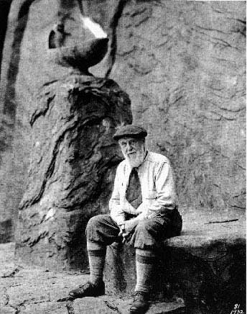
Bernard Maybeck
1862-1957
American architect in Arts and Craft Movement
Palace of Fine Arts
Taught at UCB
Mentor to Julia Morgan

Slide 12
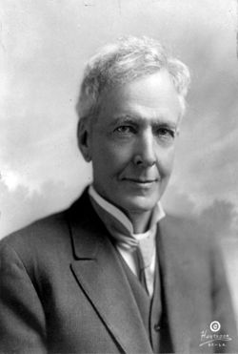
Luther Burbank
Botanist
President of Board of Directors in late 1890’s
Patents exclusive rights with California Nursery

Slide 13
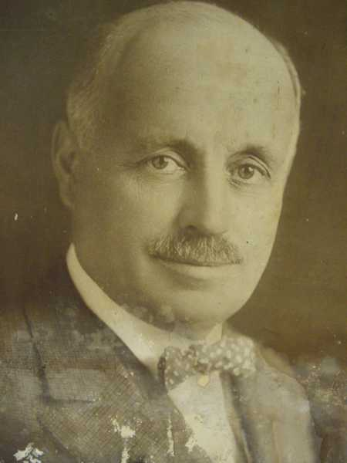
George Roeding Sr.
Purchased California Nursery in 1917 from Landers’ estate
UC Regents
Several documents on figs
USDA commissioner
World War I, discovered peach pit effective way for gas masks
Innovator of exports, imports, expansion of nursery retail stores

Slide 14
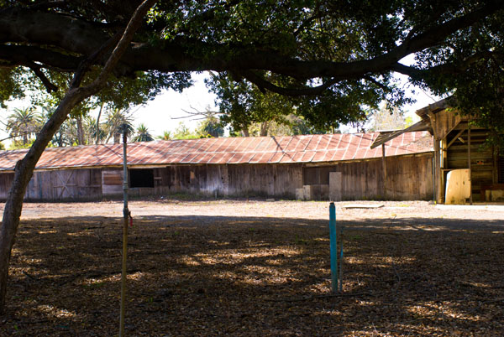
Packing shed
Developed new ways to transport trees
Tied into rail system

Slide 15
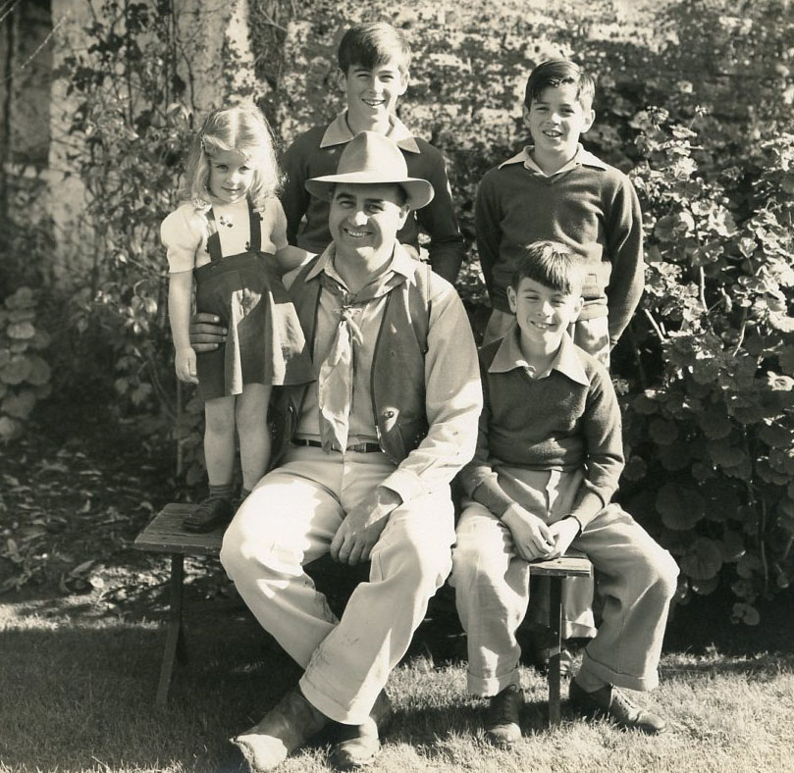
George Roeding Jr.
Developed retail stores
Master marketing
Perserved area
City of Fremont Recreation Commission
East Bay Regional Parks

Slide 16
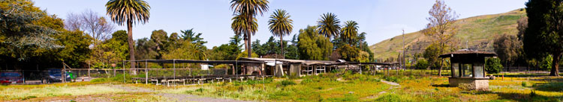
Garden Store
One of first designs for retail nursery
Reimer’s landscaping with California Nursery (Adobe look which became trademark for California Nursery)

Slide 17
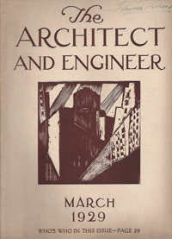
Johannes and Frederick Reimers
Designed garden around the Adobe (Johannes – son)
Frederick designed adobe structure (father)
Did landscape design with California Nursery Company (Johannes)

Slide 18
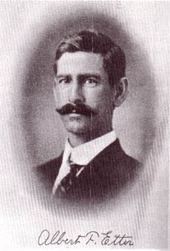
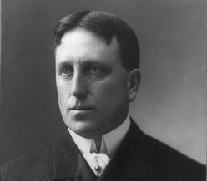
Other famous people
Thomas Edison
Albert Etter
Phobe Hearst
Randolph Hearst
Leland Stanford
McLaren (Golden Gate Park)
and more…..

Slide 19
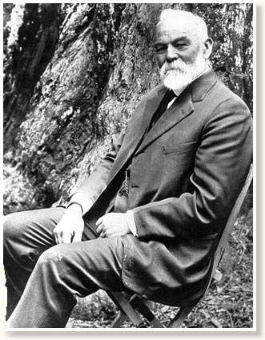
Andrew P. Hill
Photographer
Saved Big Basin
Took pictures of California Nursery (about 100 in collection)

Slide 20
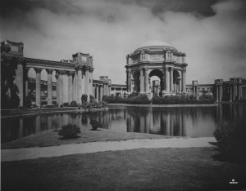
Gabriel Moulin
Famous SF Photographer (1872-1945)
Hired by California Nursery Company

Slide 21
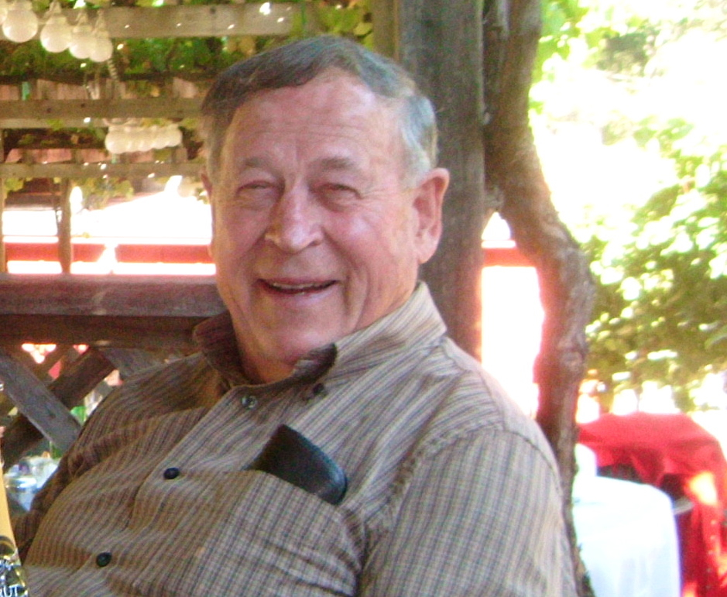
Bruce Roeding
Owner of California Nursery Company (small mail order business)
Owner of historical documents

Slide 22
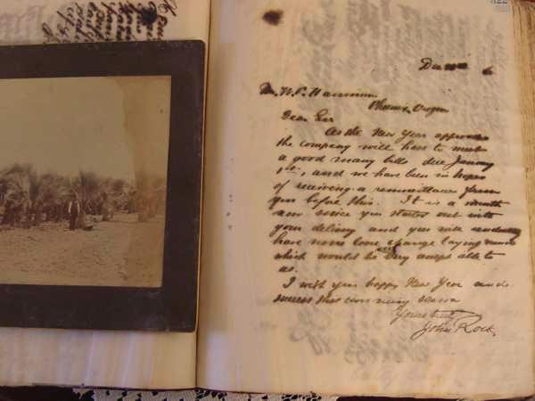
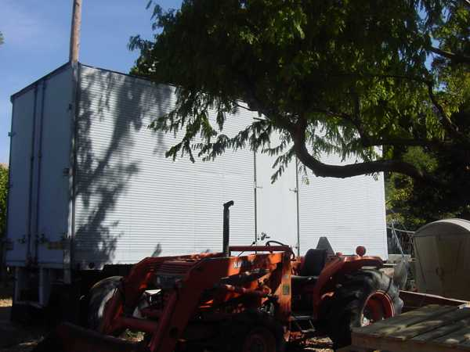
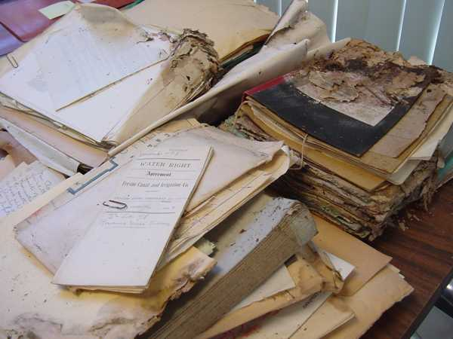
Material from containers and sheds that Roedings saved in 1972

Slide 23
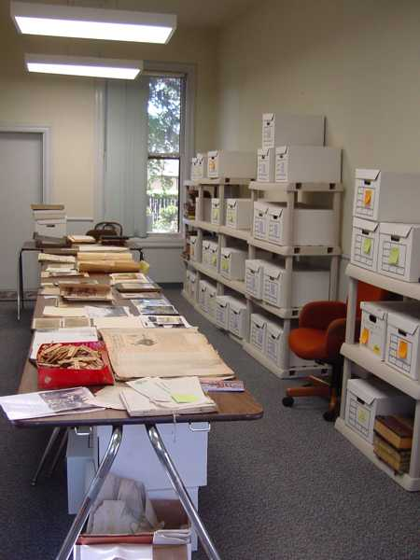
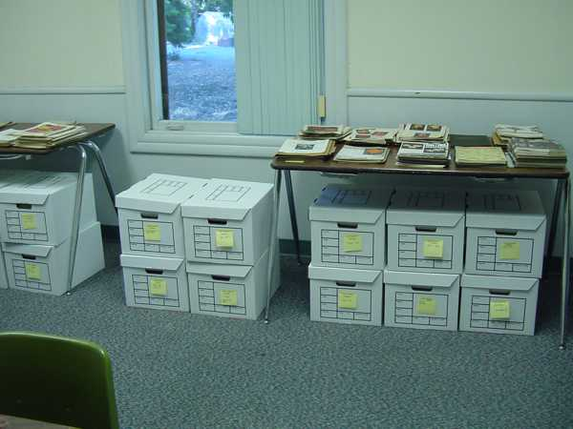
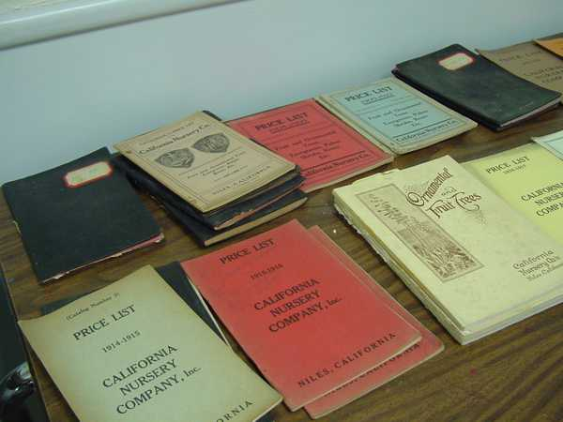
Stabilizing and sorting materials

Slide 24
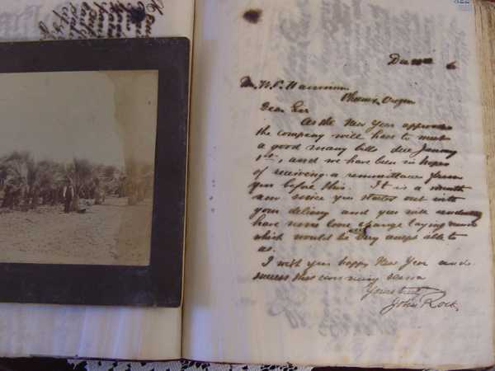
Letter books preserved since late 1880’s (Rock, Lander, Roeding)

Slide 25
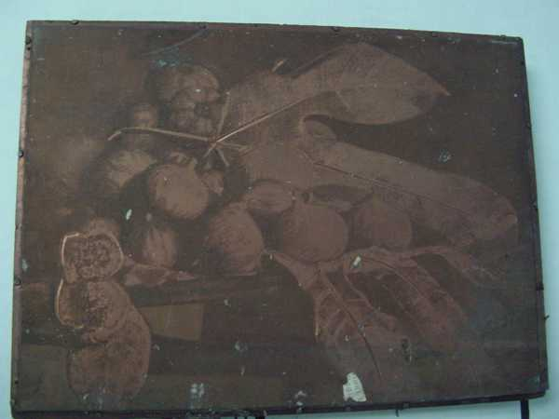
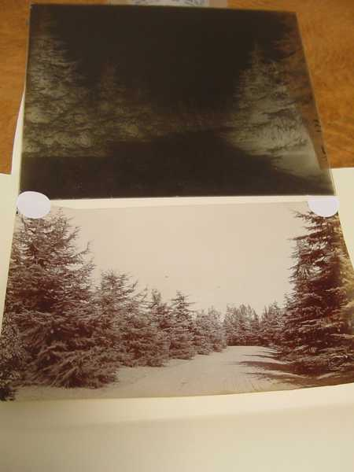
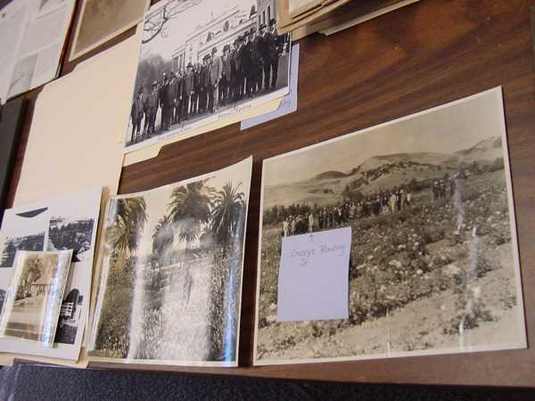
Photographic images

Slide 26
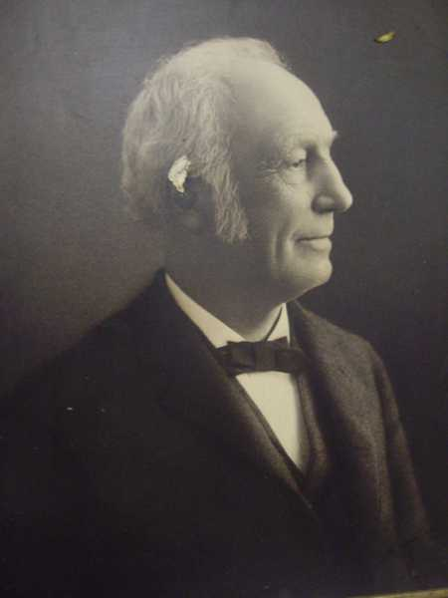
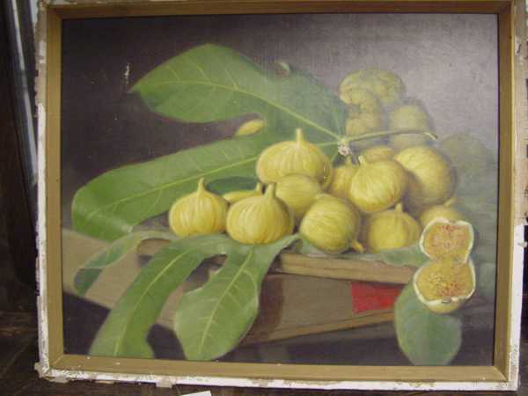
Paintings and Protraits

Slide 27
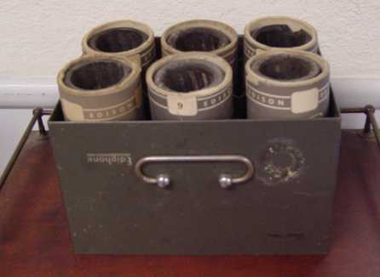
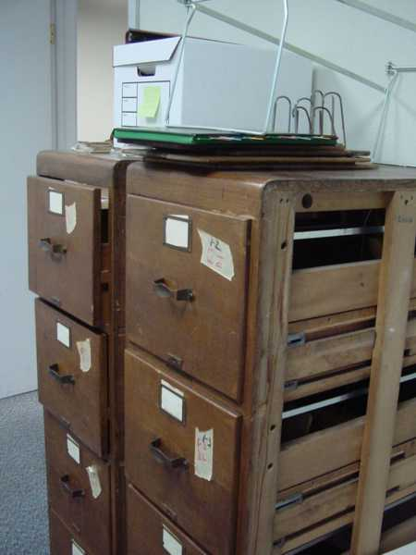
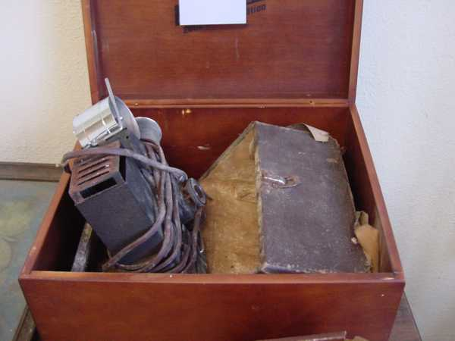
Artifacts of California Nursery

Slide 28
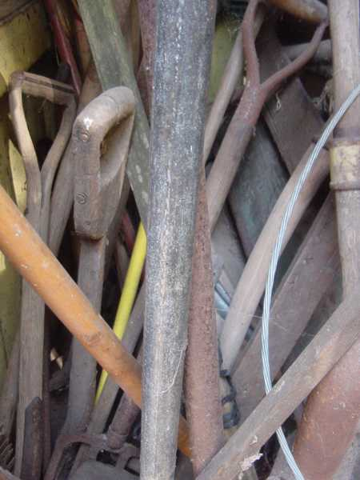
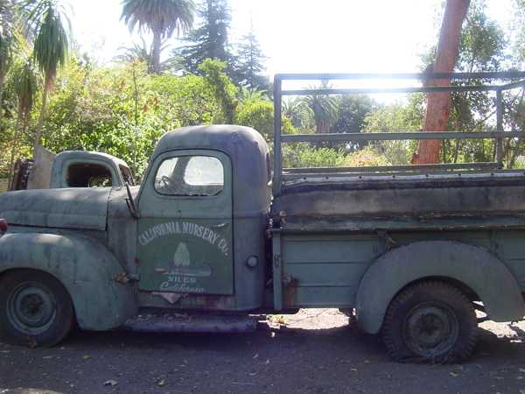
Artifacts of California Nursery

Slide 29
How can you help
donations of old tools or equipment that we might be able to use with community service
spread the word
if you need workers, we have been training interns
pvc pipes, irrigation stuff, etc
MSN is a non profit, so tax deductible

Slide 30
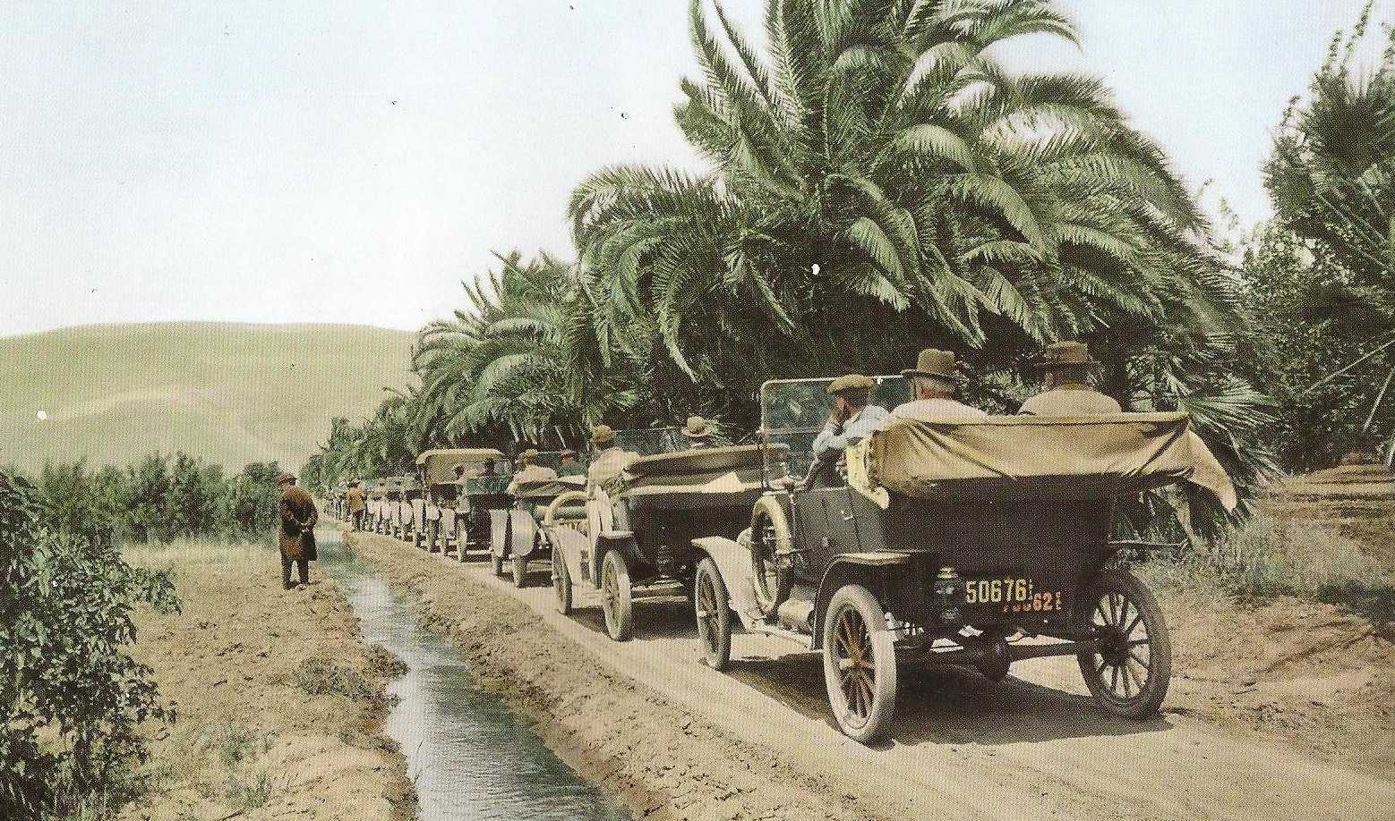
initial cost can be in the range of $100,000 per year which would allow community to be part of transformation, revenue could reach $1000 per day within 3 years which would cover operation costs

