Slide 1
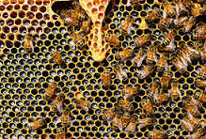
Mattos Science Magnet
Docent Program
Third Grade
Lesson 6. Insect Engineers
Math Science Nucleus © 2024

Slide 2
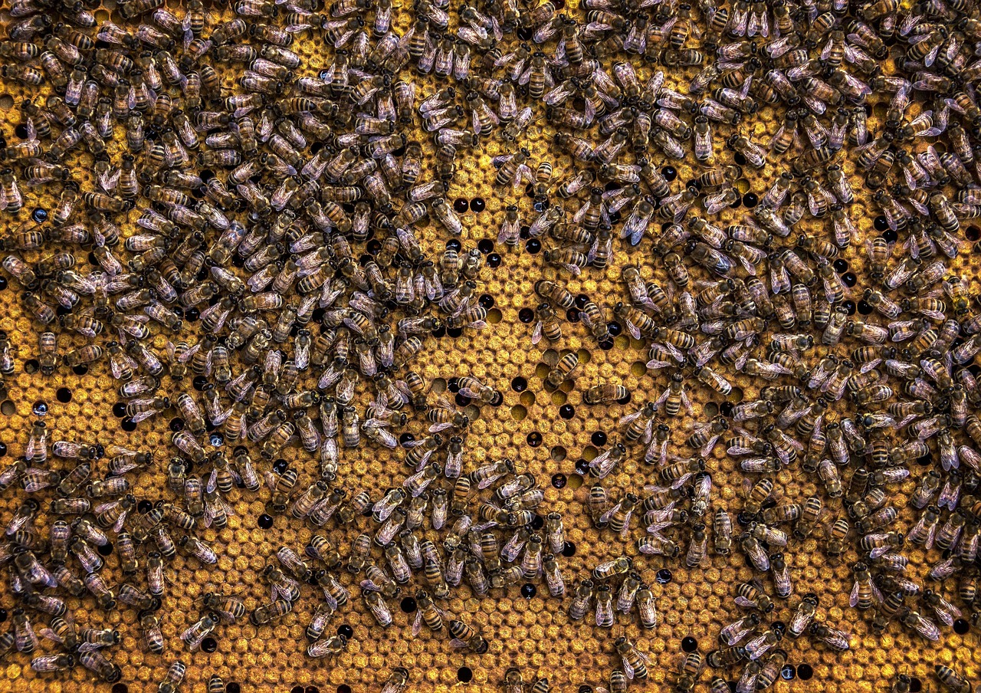
Insect Engineers
Various types of insects make amazing homes for a large group.
Bees and wasps spend a lot of effort making and maintaining their hive
LET’S BRAINSTORM: What are some benefits of a hive for bees or wasps?
Notes:
Options for answers: hives help the colony process and store food, raise and feed their larva and provide a safe environment for metamorphosis, shelter from cold, rain, snow, etc.

Slide 3
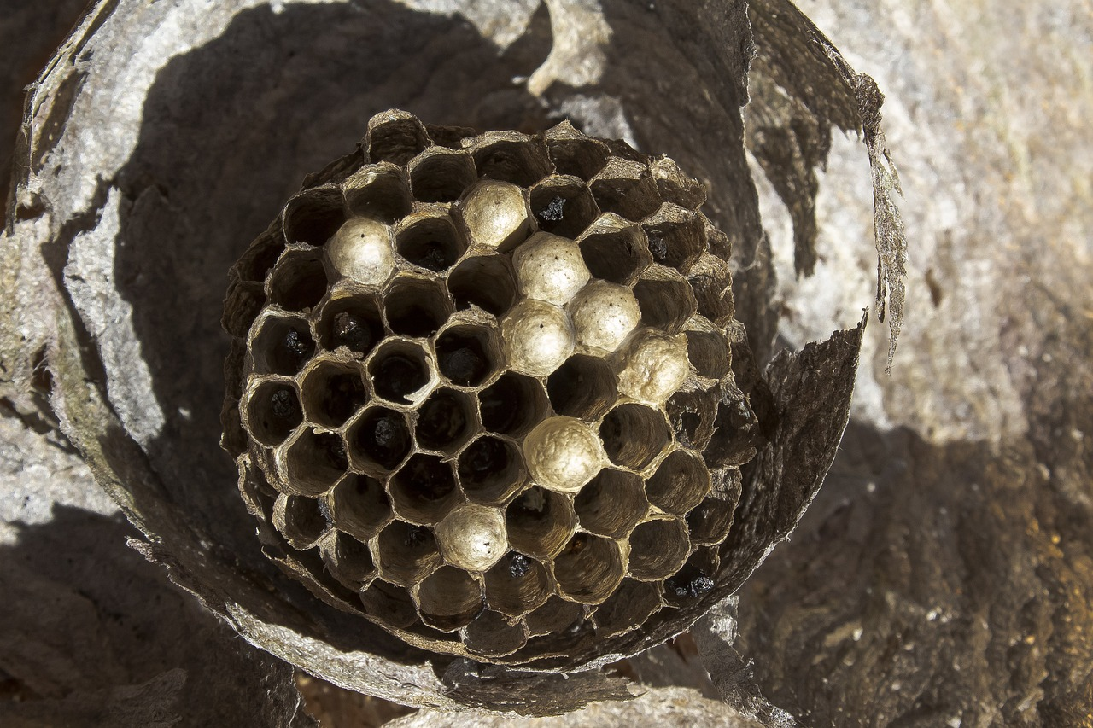
Activity #1 – Observe a wasp hive
Observe the wasp hive (no wasps are left!)
What shape do you think each compartment is?

Slide 4
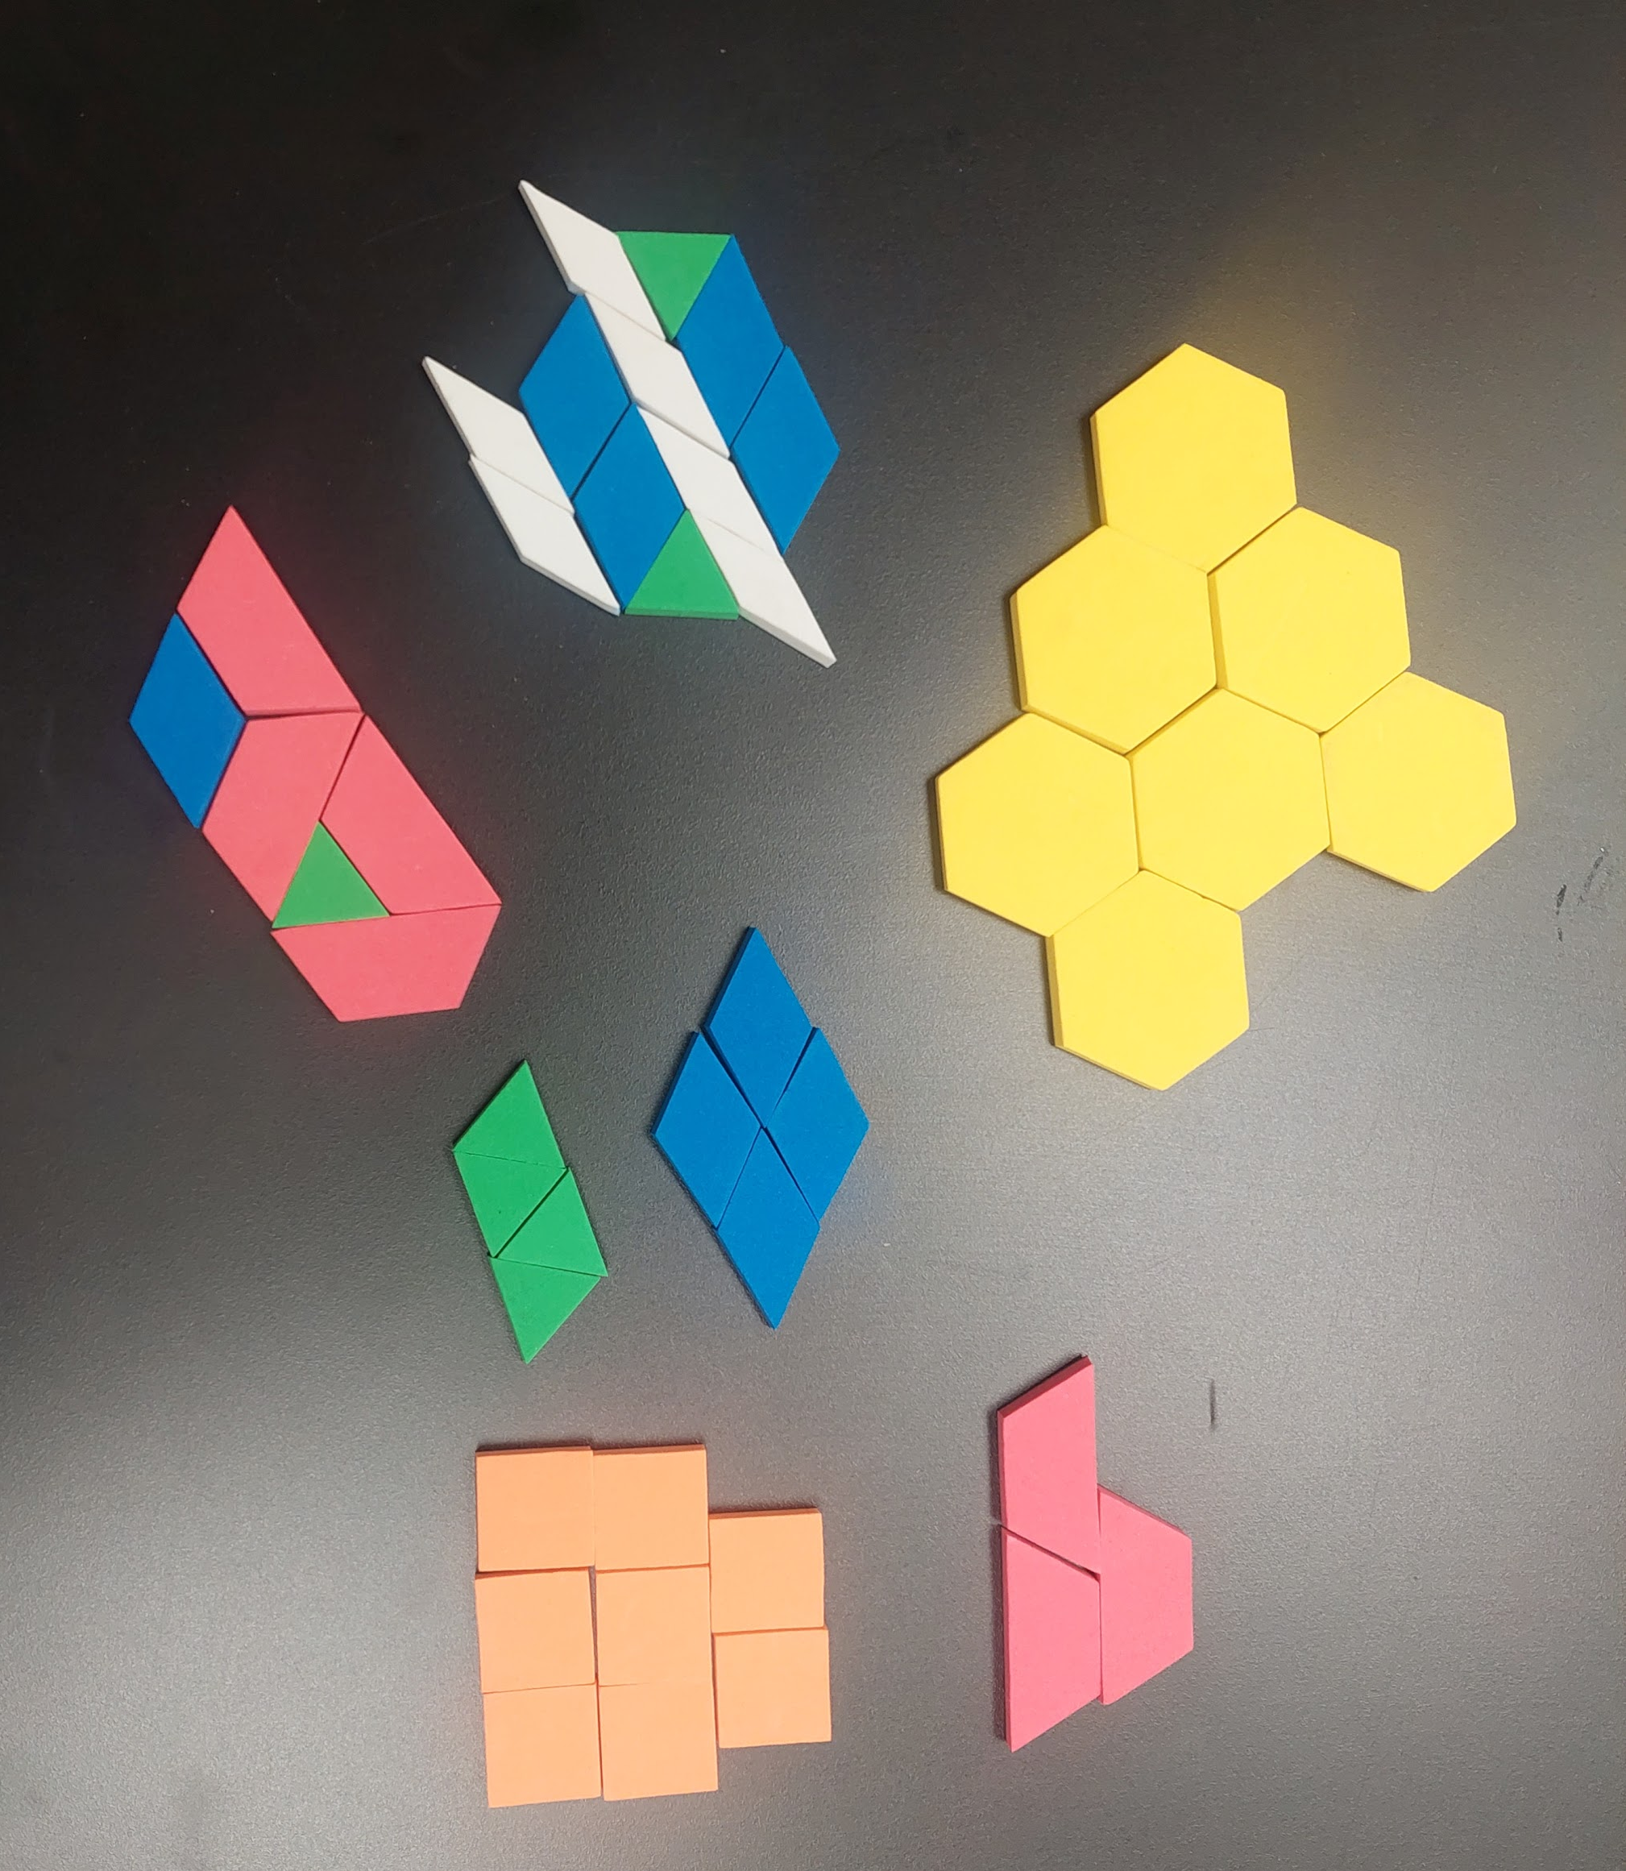
Activity #2 – Test Shapes
Use the shapes and see what is the best best patterns for making a hive.
You can use different color shapes or all the same.
After you make some patterns, now think like a bee! Which shapes would best fit a bee body and would be the easiest to make? Why?

Slide 5
Video – Beehives
Video on beehives and why a Hexagon shape works the best.
https://www.youtube.com/watch?v=F5rWmGe0HBI

Slide 6
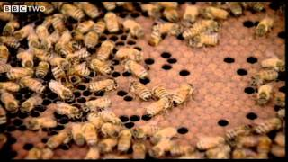

Slide 7
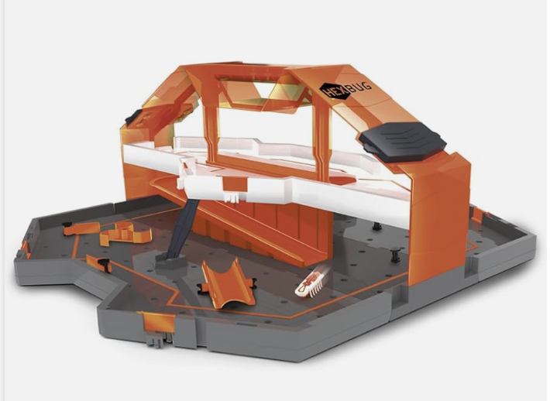
Activity #3a – Hexbug nanos
Investigate how insects explore their environment by touch
Hexbugs use touch to change direction and go around obstacles. This activity is a hexbug
“hive” with obstacles. Can you get your hexbug to move where you want in the hive?
PROCEDURE:
Teams of two or three will work together.
Your team will get to set up a track with obstacles and see how your hexbug reacts.

Slide 8
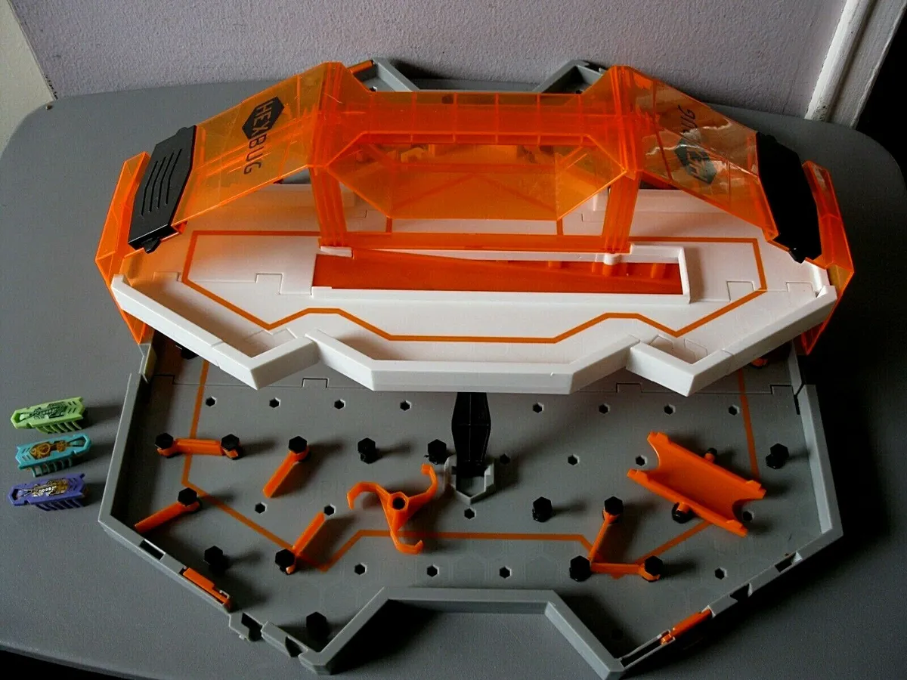
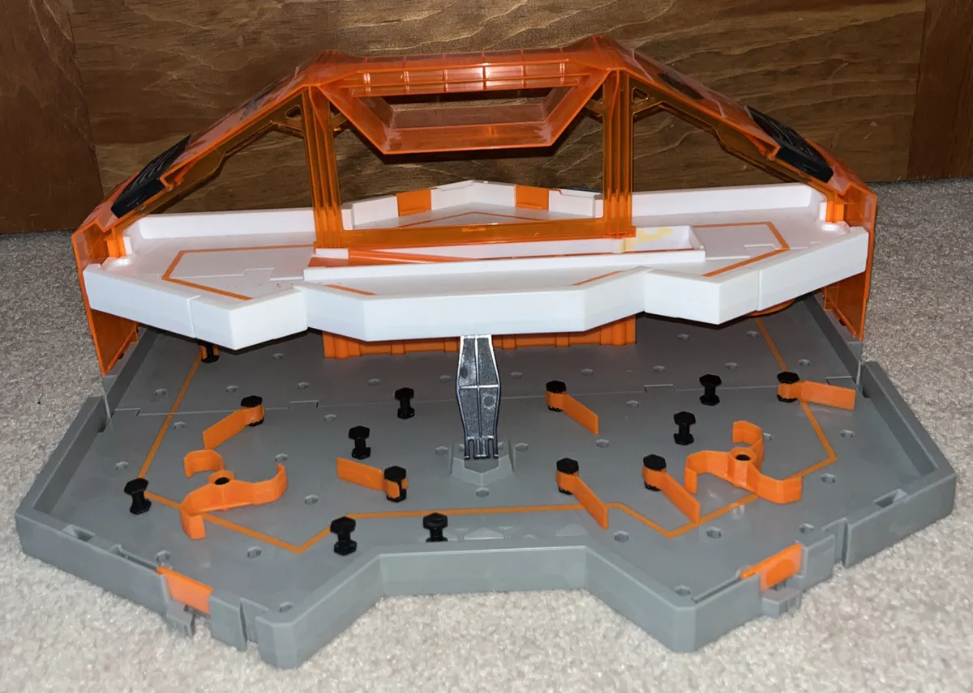
Activity #3b – Hexbug nanos
Open the case and set up the blocks to make a track and obstacles.DON’T FORCE THE BLOCKS! JUST GENTLY PUSH THEM INTO HOLES.

Slide 9
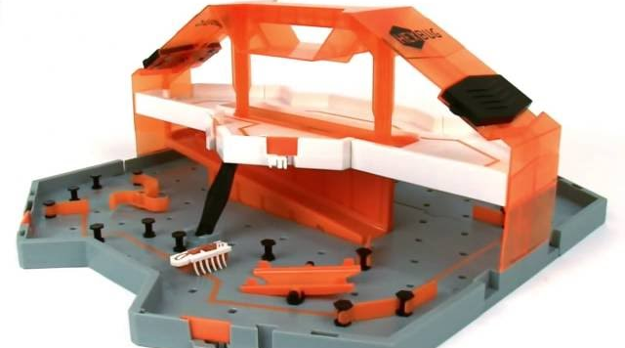
Activity #3c – Hexbug nanos
Once you track is set up, get a hexbug nano and turn it on starting it at the top and see if it goes where you wanted.
Take turns watching the hexbugs of each team.
Can you get it to go back up the ramp?

Slide 10
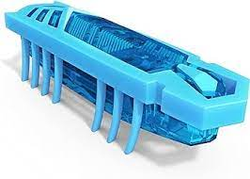
Activity #3 – Review the results
DISCUSS:
What happened to the hexbugs when they hit obstacles?
Did they do what you expected?
How is this similar to real insects you have seen this year?

Slide 11
Bigger hive!
Make a bigger hive by linking smaller hives and letting two or more hexbugs go at the same time.
What happens when they bump into each other?

