Slide 1
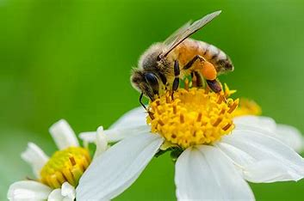
Mattos Science Magnet
Docent Program
Third grade
Lesson 5. Bees, Flies and Mimicry
Math Science Nucleus © 2024
Notes:
Students learn about bees and their importance to pollination. They also learn that many fly species look like bees (mimic) to take advantage of predators' wariness of getting stung. Activities include using UV light to see how flowers and pollen look to bees and playing a game to see if they can use clues about flies and bees to figure out which are real bees and which are mimics.

Slide 2
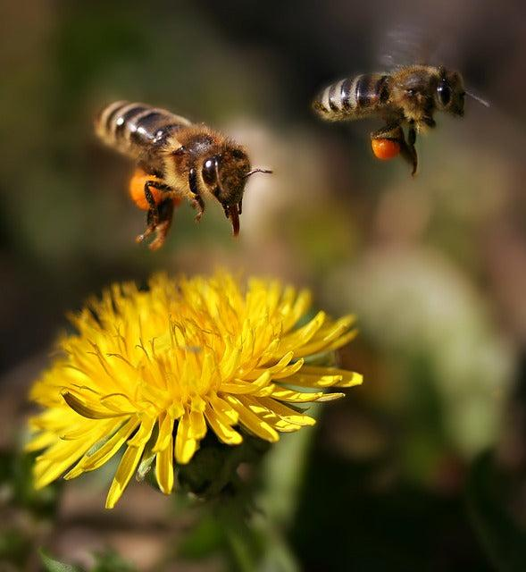
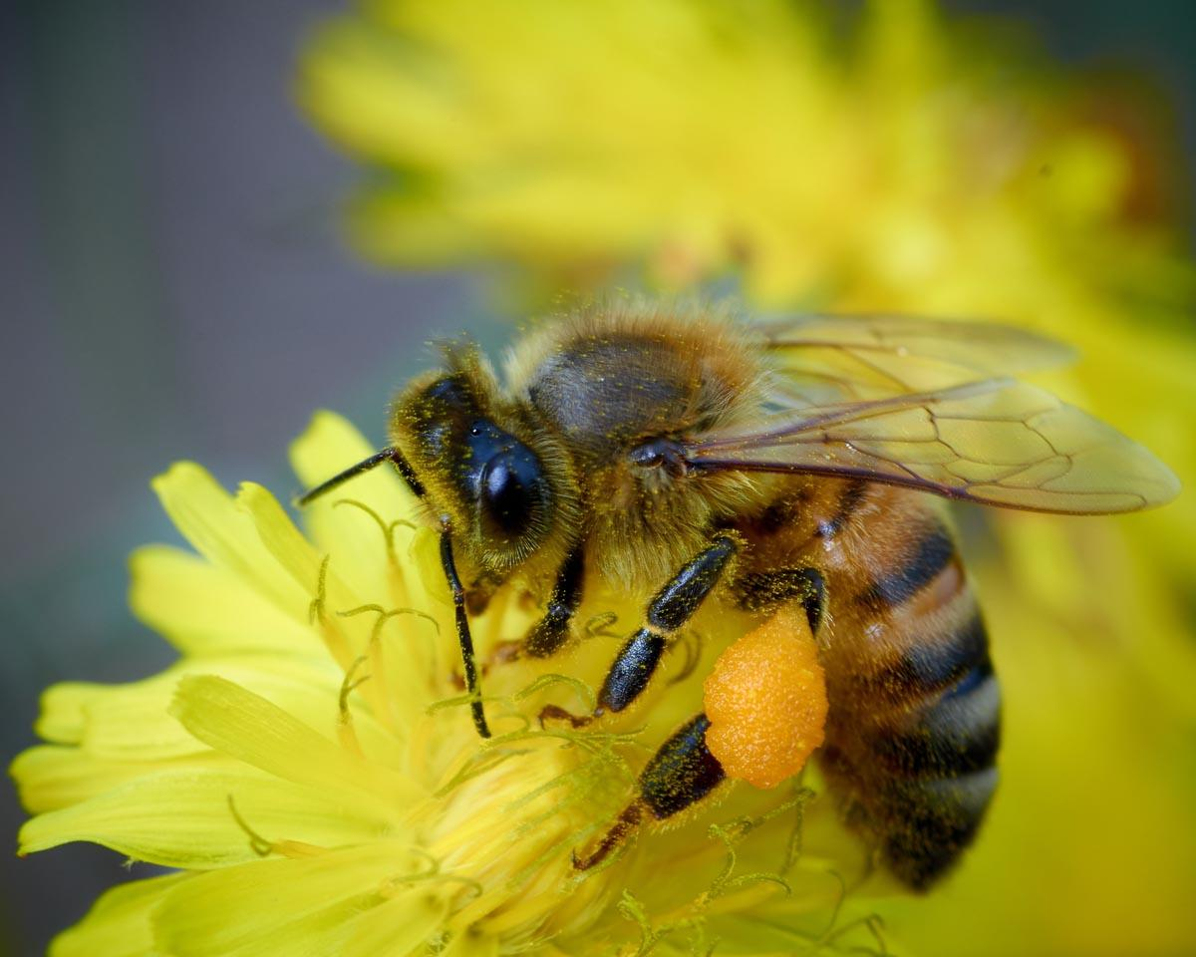
Bees
pollinators, eat nectar and pollen

Slide 3
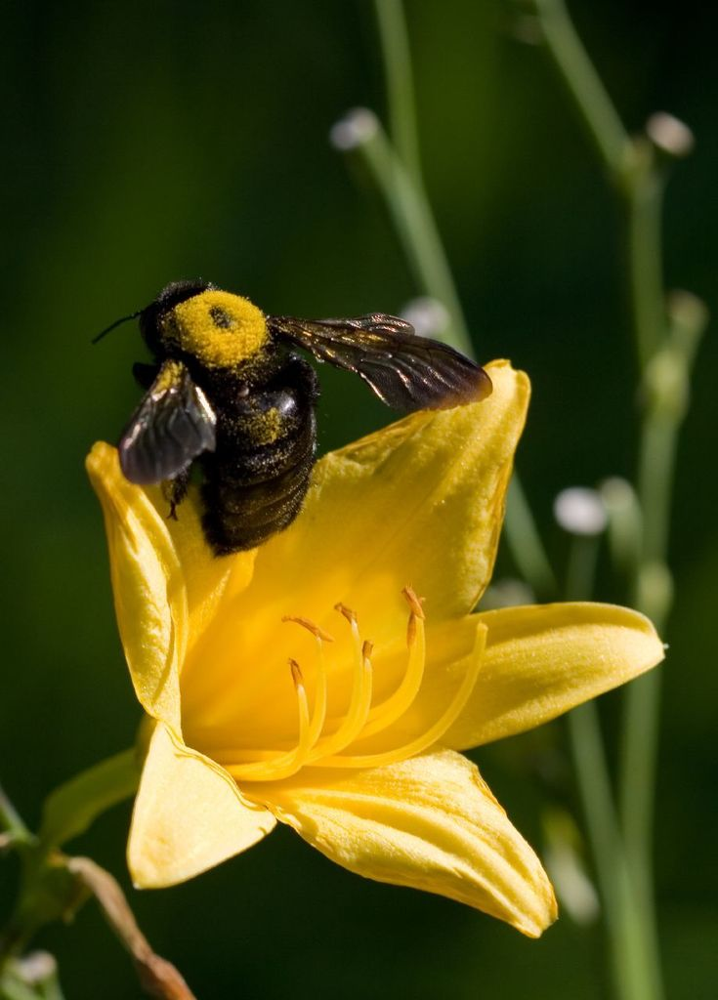
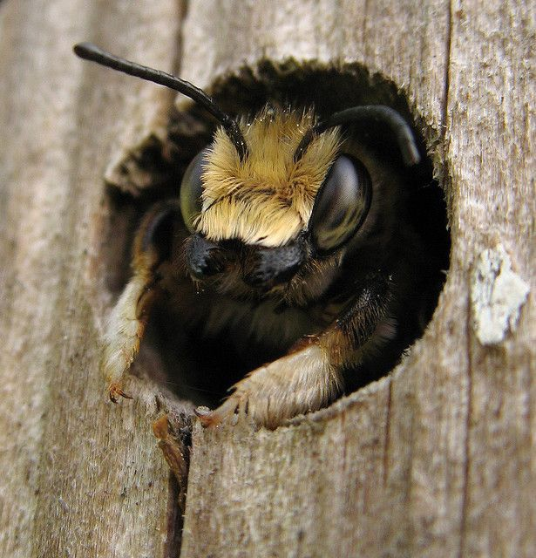
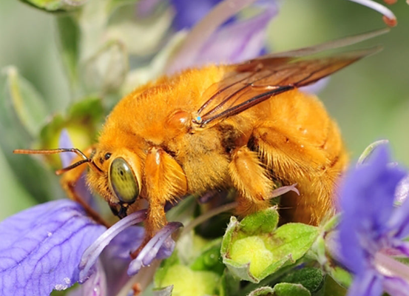
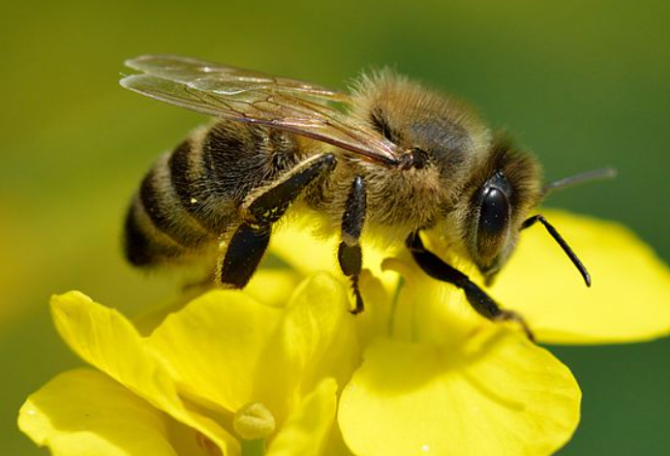
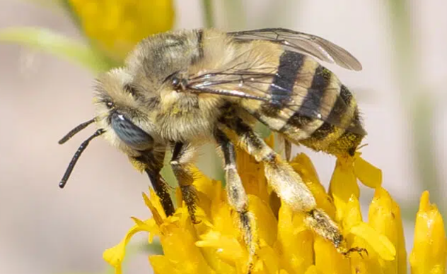
Not all bees are honey bees that produce hives. Some are solitary bees.
The top ones are solitary types.

Slide 4
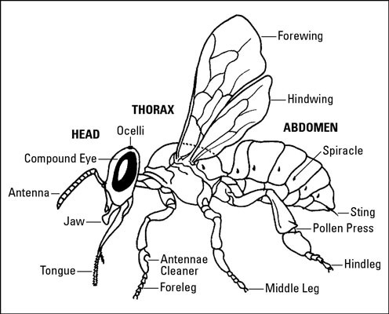
BEE
4 wings, long antenna, stinger

Slide 5
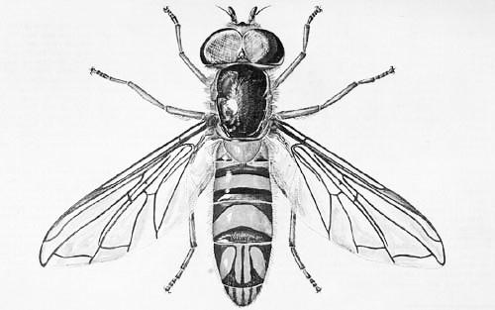
FLY
2 wings, short antenna, bigger eyes, no stinger

Slide 6
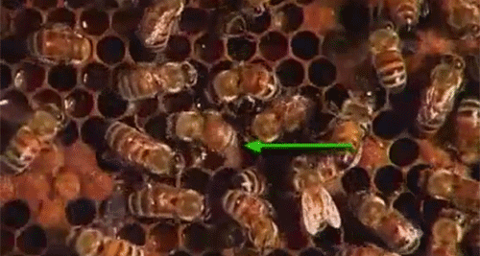
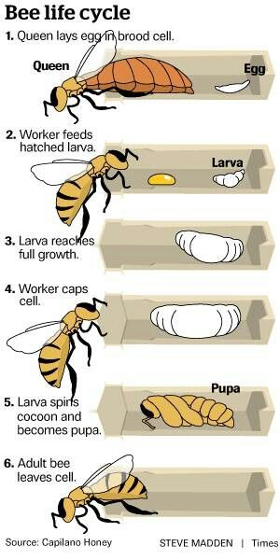
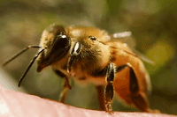
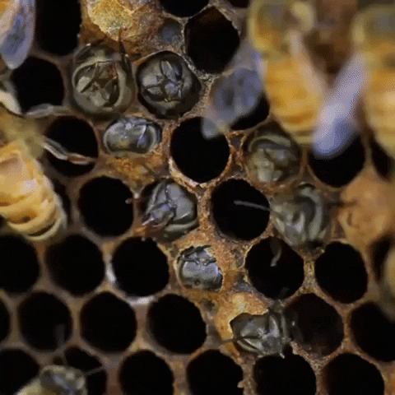
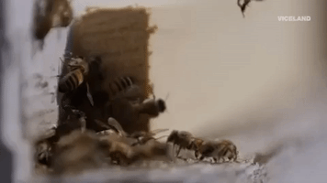
Activity 1 -- Life cycle of a bee sort models

Slide 7
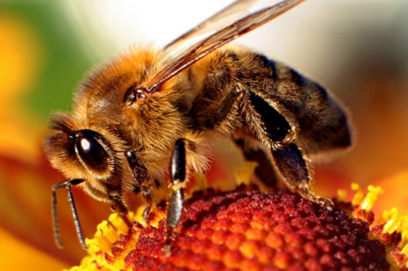
Mimicry
Bees and mimic flies
The imitating species is called the mimic, while the imitated species (protected by its toxicity or foul taste) is known as the model

Slide 8
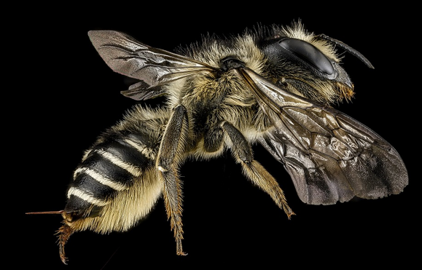
Do you get close to bees?
Why or why not?

Slide 9
Some flies mimic bees in color, shape and sound. Why would it help flies to look like bees?
Let’s look at characteristics so you can tell them apart.

Slide 10
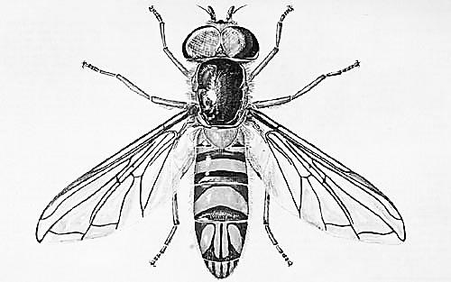
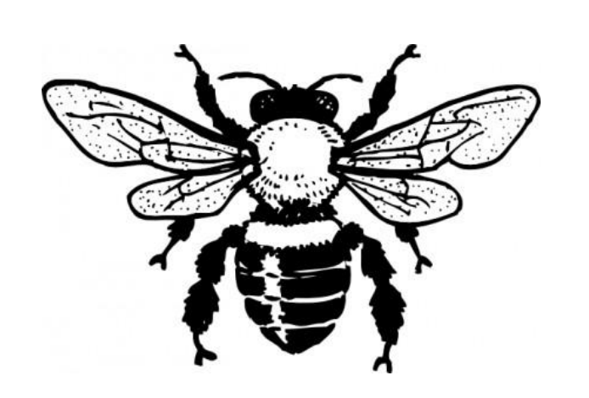
Activity 3 -- Worksheets
INSECT MIMICRY
Color the fly and the bee so they look similar
This is a _______________. It has ______ wings, bigger/smaller eyes, long/short antenna. Has/doesn’t have a stinger.
This is a _______________. It has ______ wings, bigger/smaller eyes, long/short antenna. Has/doesn’t have a stinger.

Slide 11
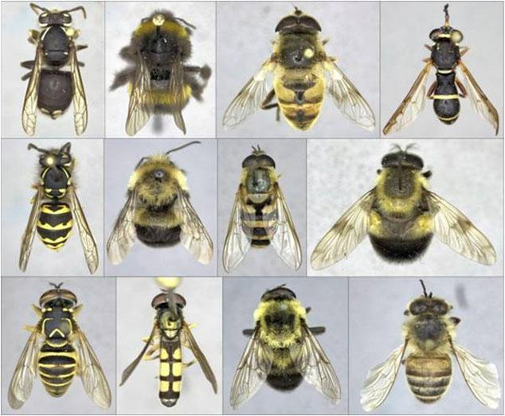
Activity 4 -- Use what you learned to find the 5 bees

Slide 12
The 5 bees are:

Slide 13
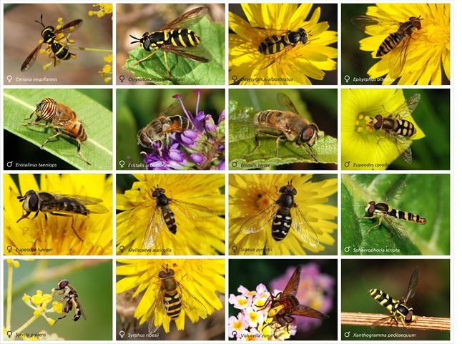
They are all mimic flies!!
Are these flies, bees or wasps?

Slide 14
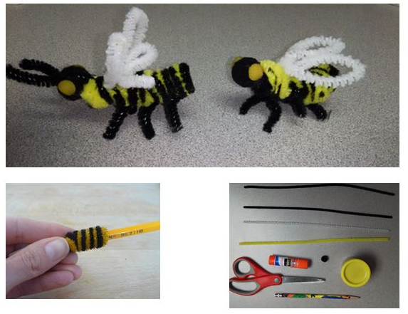
Make a bee and a fly

Slide 15
Review:
Bees are very important to us as pollinators and are amazing. We need to provide them with a good habitat and lots of flowers.
Bees can see parts of flowers differently than we do.
Some animals and plants mimic (copy) traits of dangerous animals or plants to protect themselves. Flies can look and sound like bees or wasps.

