Slide 1
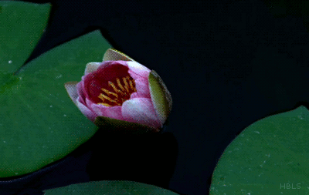
Mattos Science Magnet
Docent Program
Second Grade
Lesson 4. Designing a Pollinator Garden
Math Science Nucleus © 2024

Slide 2
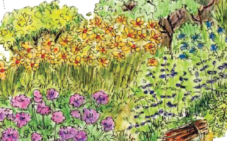
Pollinator Garden
How do you design?

Slide 3
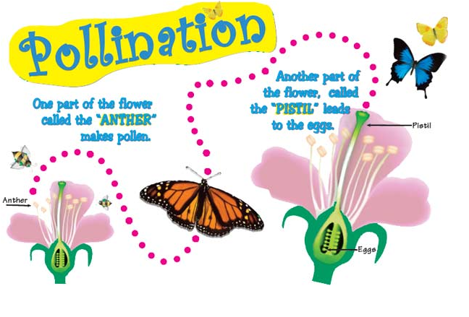
Pollination is the transfer of “pollen” to make seeds

Slide 4
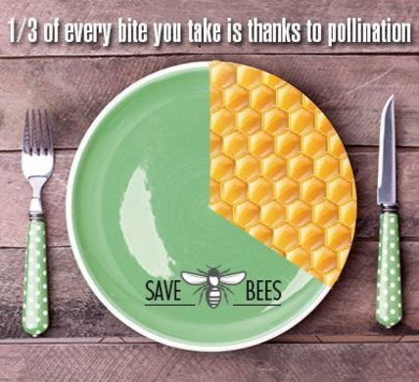
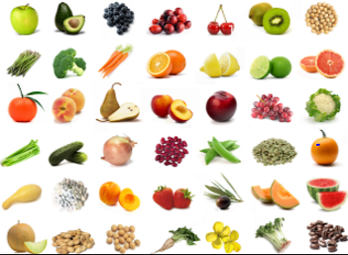
Why do we need pollinators?
Without pollinators we would not have a lot of our food!

Slide 5
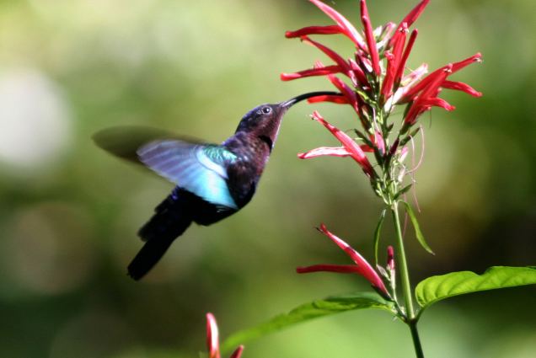
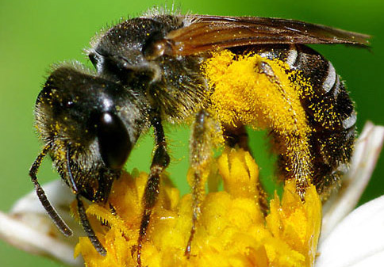
Flowers have both nectar (sugary liquid) and pollen.
Some organisms like bees eat nectar and pollen.
Some organisms like hummingbirds drink nectar (rich in sugar) and transfer pollen along the way.

Slide 6
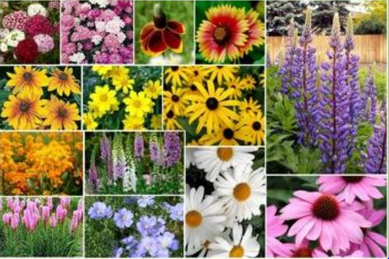
Pollinators like different shapes and colors of flowers
Bees prefer yellow, blue and purple flowers
Butterflies like flat flowers that are red, orange, yellow pink or blue
Hummingbirds like tube flowers with lots of nectar, especially red ones!
Bats like large light-colored flowers that smell like fruit that open at night

Slide 7
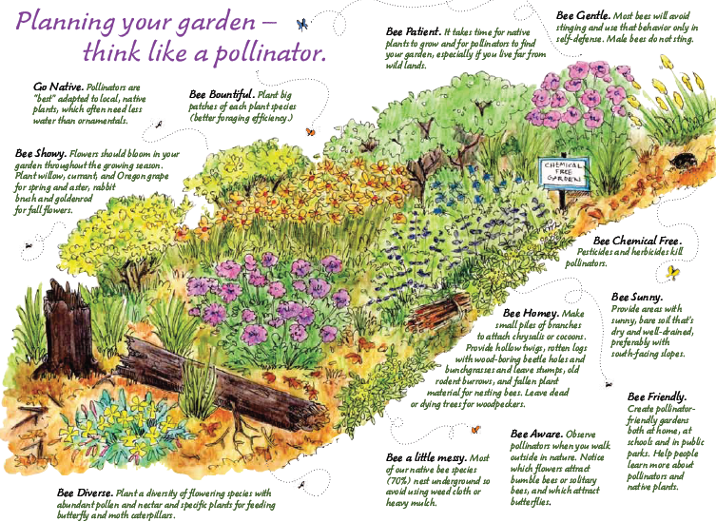

Slide 8
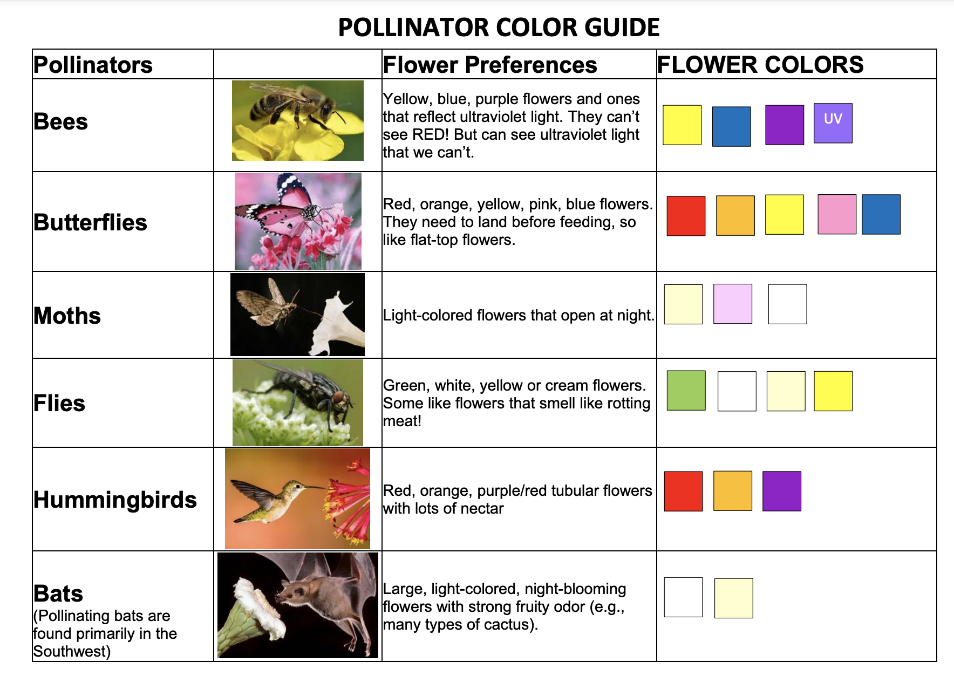
Use your pollinator guide to pick the pollinators you want to come to your garden

Slide 9
Experiment

Slide 10
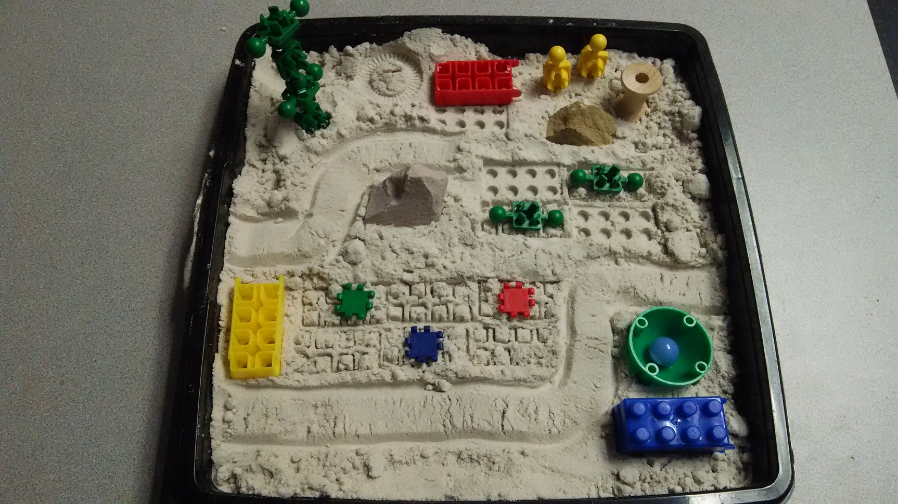
Design a pollinator garden
Materials: shape it, plastic items to make beds for flowers, walkways

