Slide 1
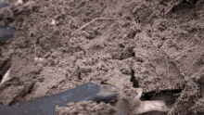
Mattos Science Magnet
Docent Program
Fourth Grade
Lesson 5. Soil
Math Science Nucleus © 2024

Slide 2
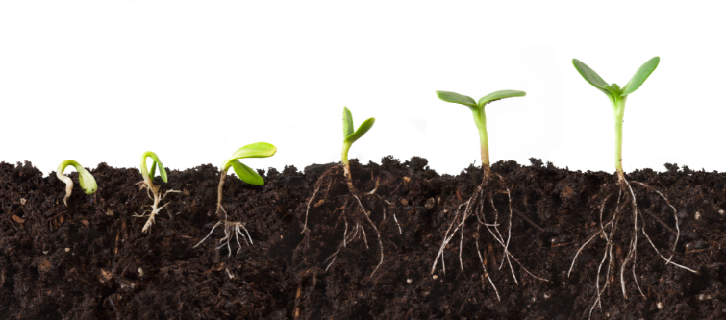
What makes up healthy soil?

Slide 3
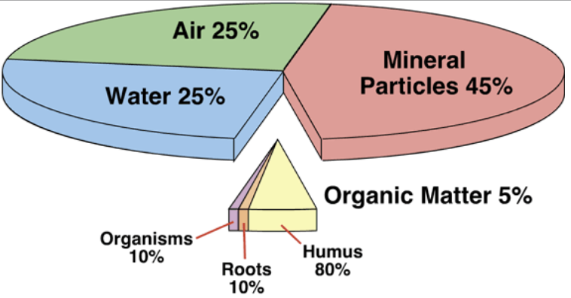
Healthy soil is a mix of minerals, air, water and organic material (compost)
COMPOST
The above is the best ratio for plants.
Organic matter is a small but critical part of soil.

Slide 4
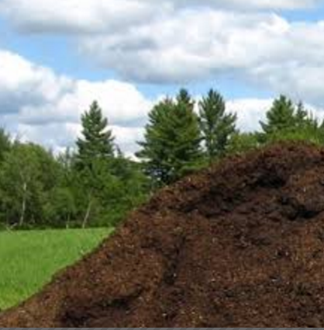
Compost is critical for healthy soil
But …do you think plants will be healthy if we planted them in ONLY compost?

Slide 5
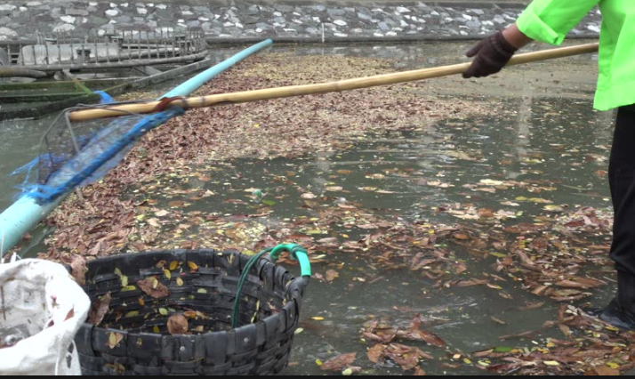
Plus, compost is lighter weight than soil minerals and tends to float. Compost doesn’t hold plant roots in place.

Slide 6
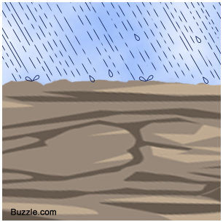
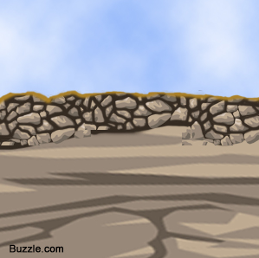
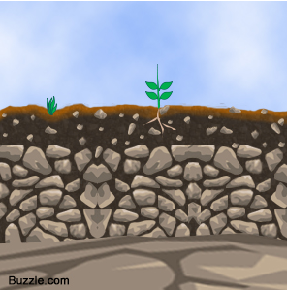
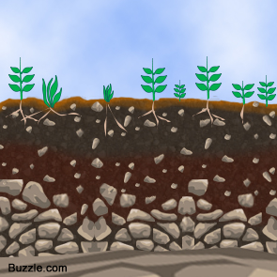
Soil starts with hard rock that breaks down, small plants grow and add organic matter that supports larger plants
—it takes a LONG time to form soil

Slide 7
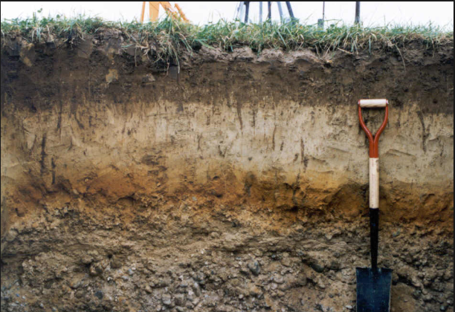
Soil has layers-- top layers have more organic matter bottom layer has little to no organic matter.

Slide 8
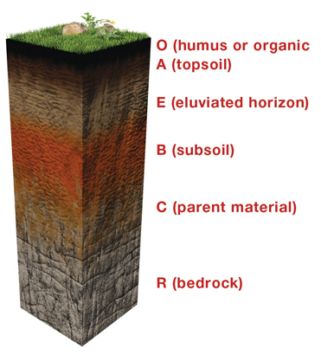
Mature soil layers are defined by amount of organic material
O – layer of organic material on top of soil (dead leaves etc)
A -- topsoil - lots of organic matter plus minerals (clay, sand and silt)
B – subsoil – parent material and some organic material
C – parent material (eroded bedrock), almost no organic material
R -- is just rock (called bedrock)

Slide 9
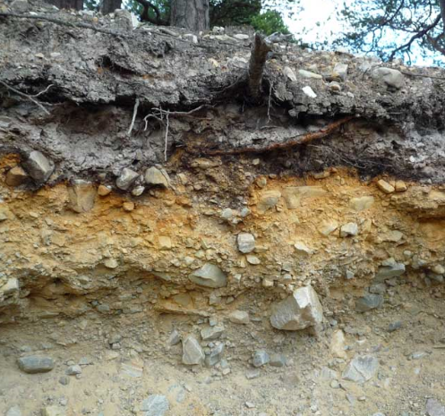
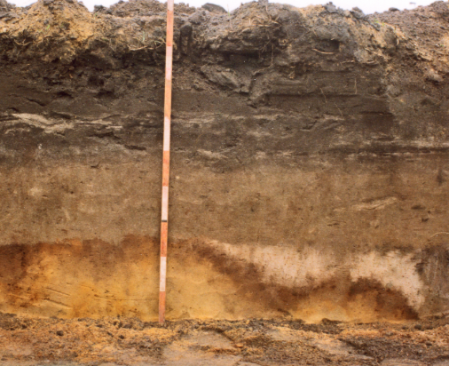
Soils can also be described by mineral type, color, particle size and if the minerals are magnetic
Examples of soil profile of coarse and fine soils. Where is the darkest layer in each? Why is it so dark?

Slide 10
Three experiments today
1. Test density of rock, soil and compost. Compare which sinks or floats: sand, soil or compost
2. Identify which layer a soil sample came from by soil characteristics.
3. Can you find any magnetic particles in soils?

Slide 11
3 Soil Experiments
LAB 1. Test density of rock, soil and compost by putting each in water. Compare which sinks or floats: sand, soil or compost
Lab 2. Identify which layer a soil sample came from by soil characteristics. If a bag has NO organics (leaves or sticks, etc.) it is from the C layer. If it has a lot it is from the A Layer.
LAB 3. Can you find any magnetic particles in soils? Use a magnet. If any particles move toward the magnet, some of the parent rock in your soil layer is magnetic.

Slide 12
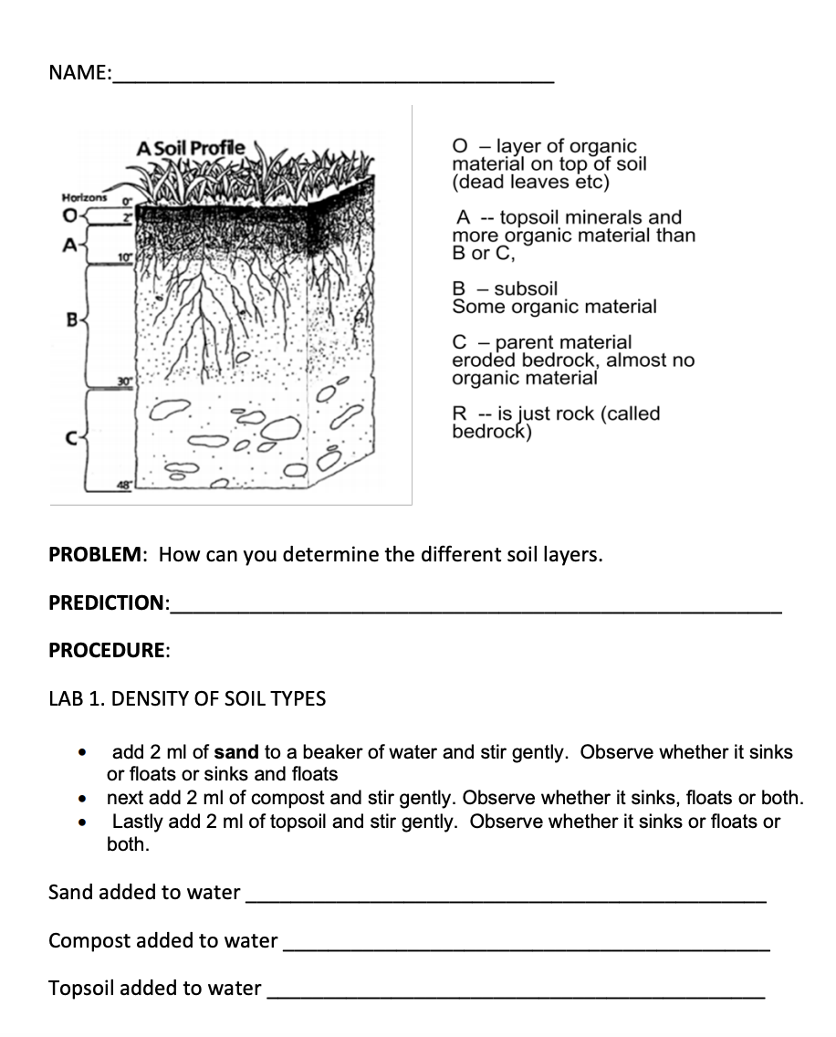
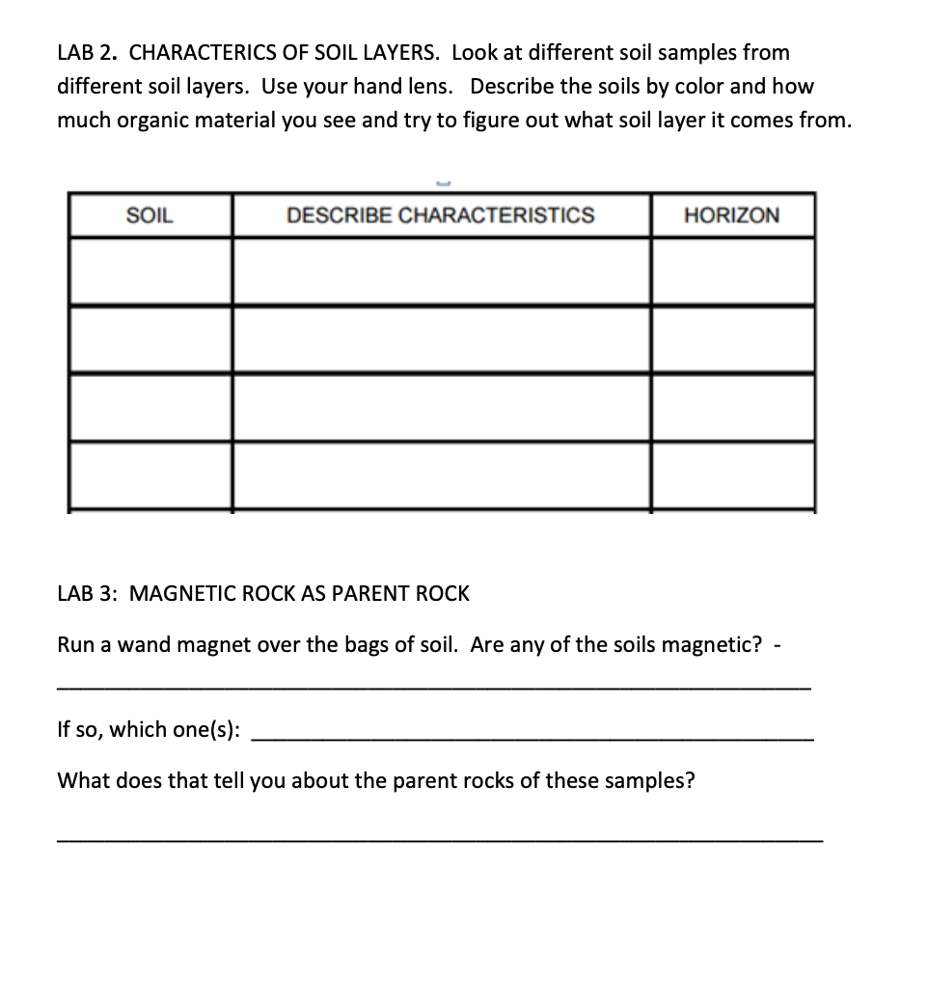
Fill in the worksheet as you do the three experiments

Slide 13
Docent Notes
https://www.msnucleus.org/membership/ngss/fourth_ngss/04soil.html
2. Activity--TESTING DENSITY BETWEEN MINERALS, COMPOST AND TOPSOIL. Tell students "first we are going to test the density of minerals, soil and compost." Have a beaker of water ready for teams of students. They will also need measuring spoons and three soil samples (can do 3 students together so two beakers per table)
· Students will add 5 ml of sand to the water and observe whether it sinks or floats and record it on their worksheet (it should sink). They can stir the mixture after they make their first observation.
· They should then add 5ml of compost (can be taken from the science garden) and record whether it floats (it should mostly float).
· Lastly they should add 5m of topsoil (can be taken from the garden) and record whether it sinks or floats (it should do both).
· Have them tell you their results
3. Activity: DETERMINING THE SOIL LAYER BY AMOUNT OF ORGANICS. Remove the water from the tables and give the students soil samples in bags. Student must leave the soil samples in the bags. Just observe through the plastic. They can use hand lens to make observations.
For each soil sample the students should
· describe the sample (does it have plant debris or animal remains in it? what color is it?)
· based on their observations and the key on the worksheet, hypothesize what soil layer the sample corresponds to (O, A, B or C)
· Have them tell you their results
They can then look at the soil from the school (in trays rather than bags). They can touch this soil. What layer do they think it is from and why?
4. Activity -- Students use a wand magnet over the outside of the soil sample bags to see if there is any that have magnetite, a magnetic mineral. If the soils have magnetite they will see small bits respond to the magnet. The presence of magnetite means that the parent rock may have been granitic. Magnetite erodes out of the rock and is left in the soil.

Slide 14
Answers
Bags labeled
1 = B Subsoil
2 = A Horizon Topsoil
3 = C Horizon Parent Bedrock
4 = C Horizon Parent Bedrock
5 = O Organic material that sits on top of soil

Slide 15
Bags labeled
1 = B Subsoil
2 = A Horizon Topsoil
3 = C Horizon (non-magnetic parent bedrock)
4 = C Horizon (magnetic parent bedrock)
5 = O Organic material that sits on top of soil

