Slide 1
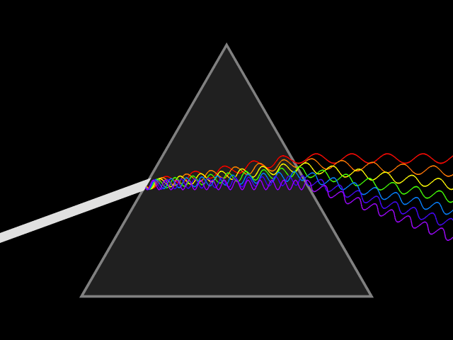
Mattos Science Magnet
Docent Program
First Grade
Lesson 3. Understanding Light using prisms
Math Science Nucleus © 2024

Slide 2
Light Magic - Storybook Link:
https://www.msnucleus.org/member/applied_light/light.html

Slide 3
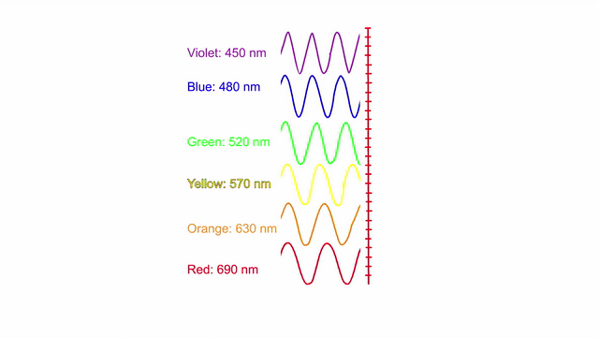
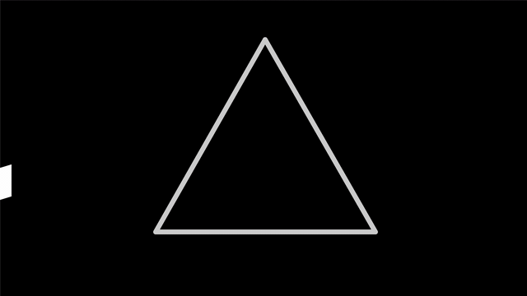
Refraction causes light to split into rainbow
Roy G. Biv

Slide 4
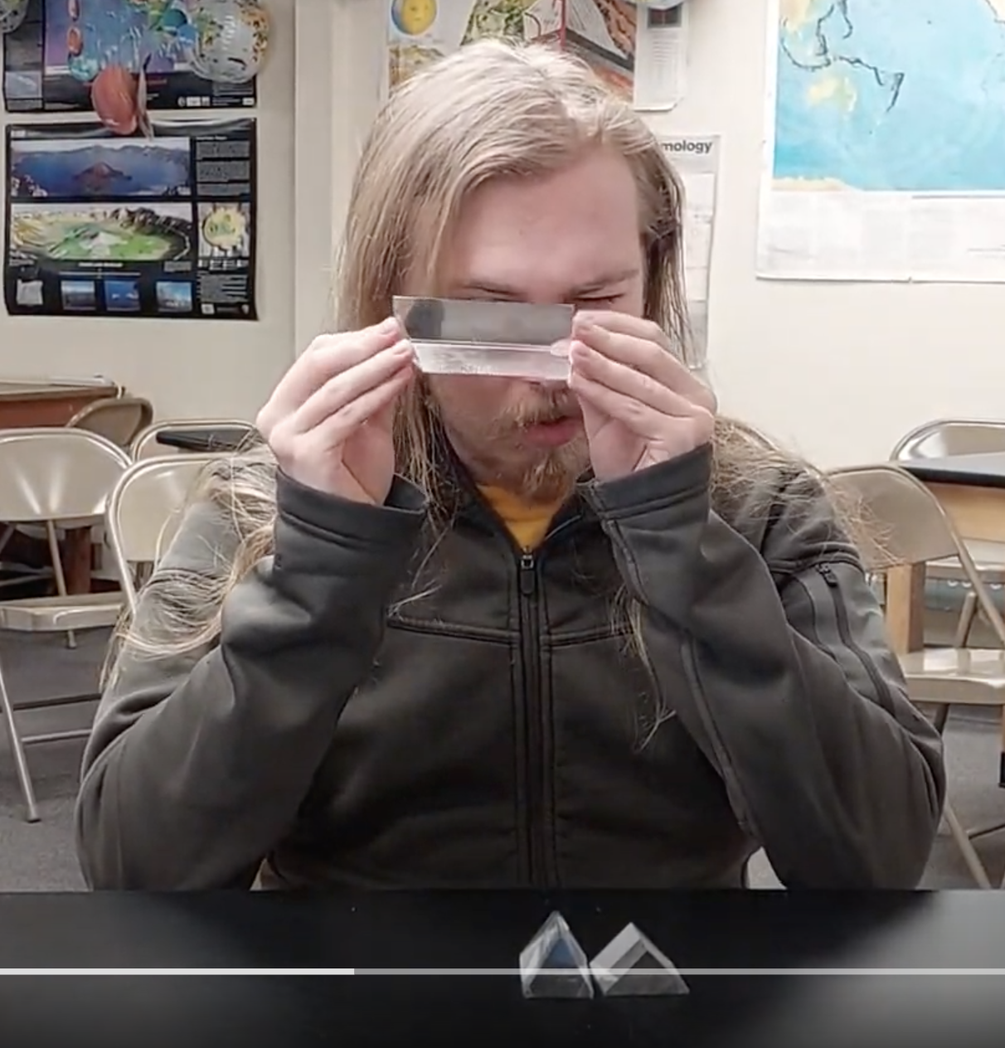
Experiment #1– prisms indoors
Look through the three prisms indoors.
Turn the prisms and look at the lights and the room.
You will see rainbow colors!

Slide 5
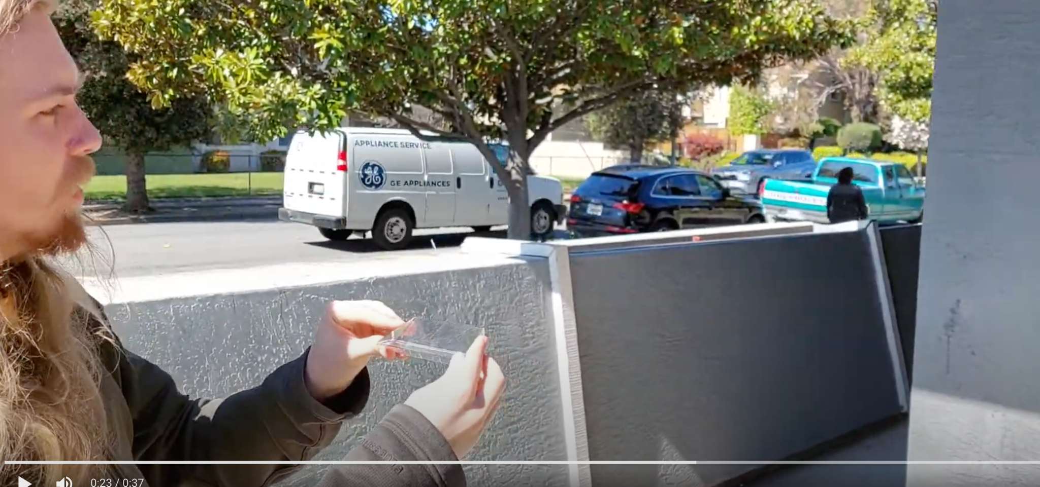
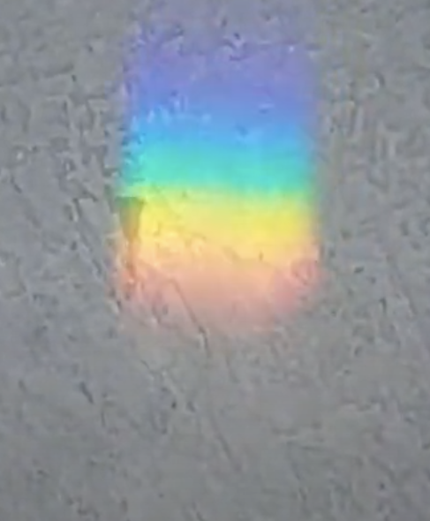
Experiment #2 – prisms outside
Go outside in the sun but DO NOT LOOK AT THE SUN!!
Hold the prims so the sunlight can go through the prism. Turn the prism until you can see a rainbow on the wall or the ground. If you turn the prism, the rainbow will move!

Slide 6
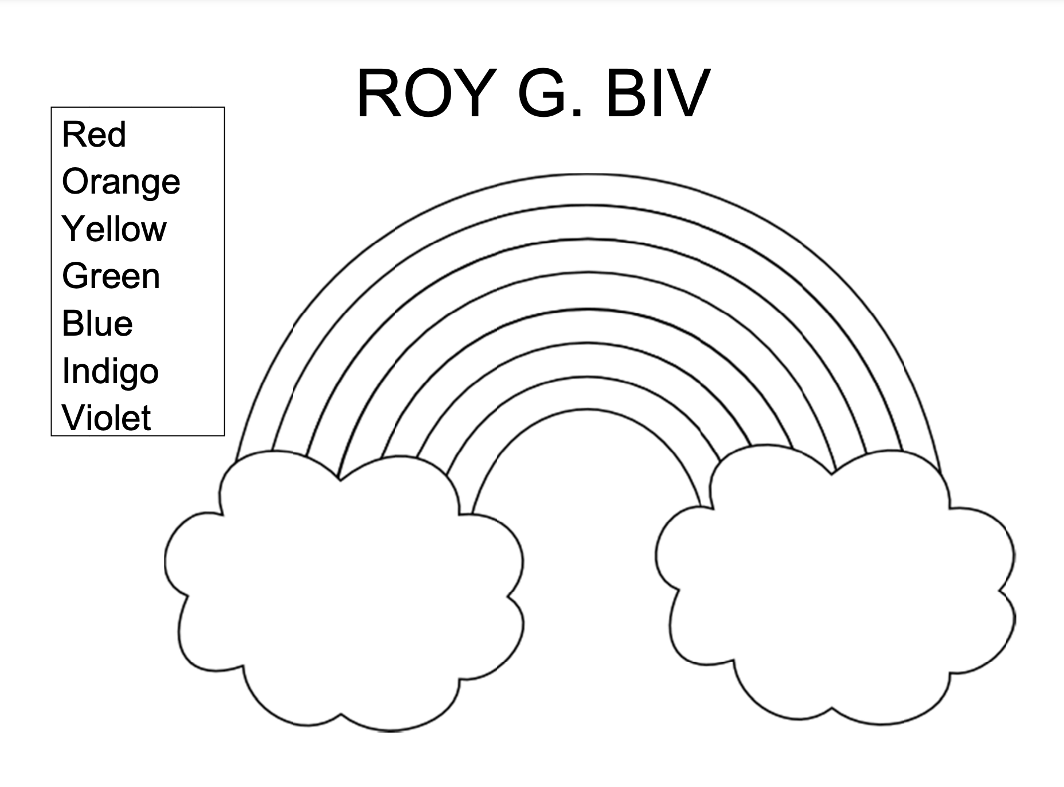
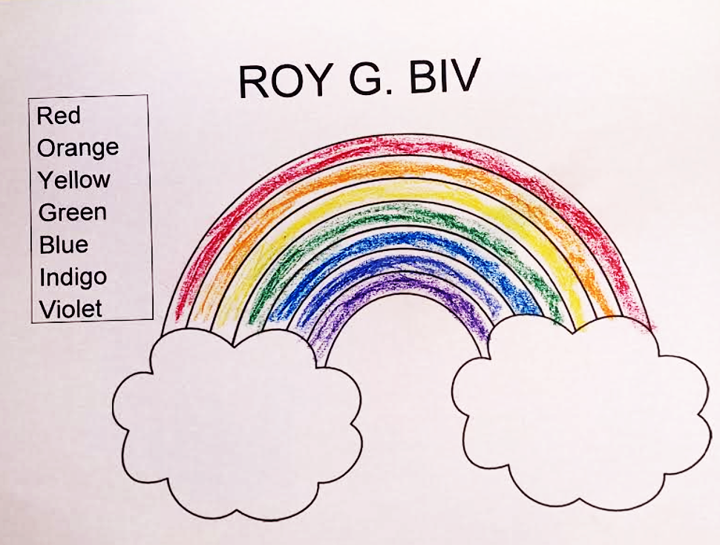
Activity- Color the rainbow
Color the rainbow in order, red on top, then orange, yellow, green, blue, indigo (blue-violet) with violet on the bottom

