Slide 1
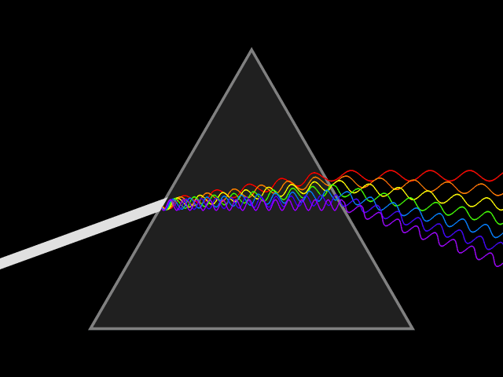
Mattos Science Magnet
Docent Program
First Grade
Lesson 2. Reflection and Refraction
Math Science Nucleus © 2024

Slide 2
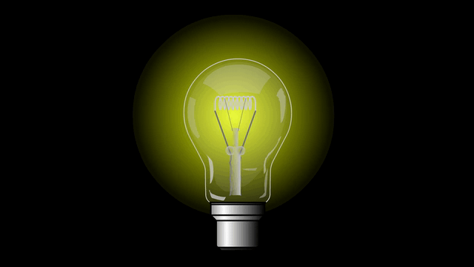
Light – First Grade
What is light?
How does light move?
How do we see objects in the dark?
What causes shadows?

Slide 3
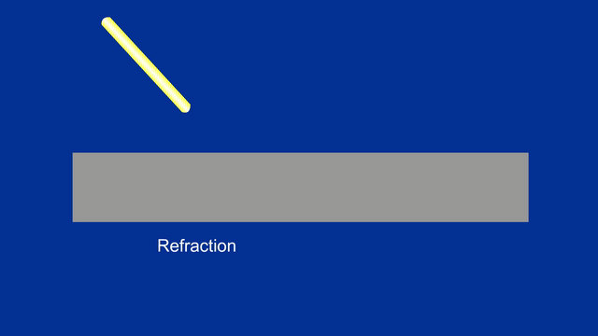
Refraction
Refraction is when light goes through different materials and there is a change in direction.
Light is made up of photons that move like anything else.

Slide 4
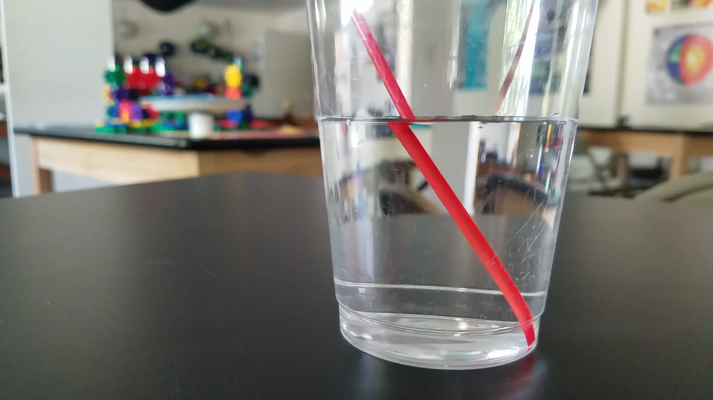
Magic or Refraction?

Slide 5
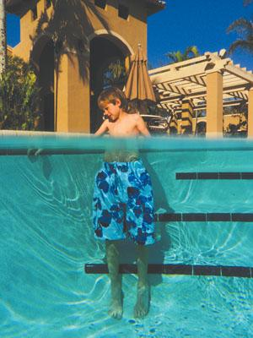
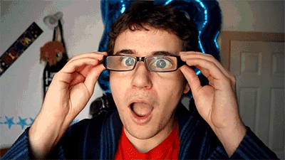
2
1

Slide 6
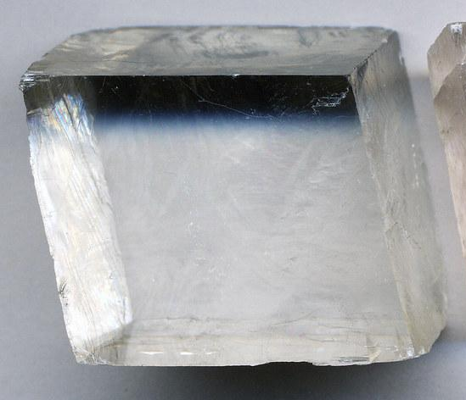
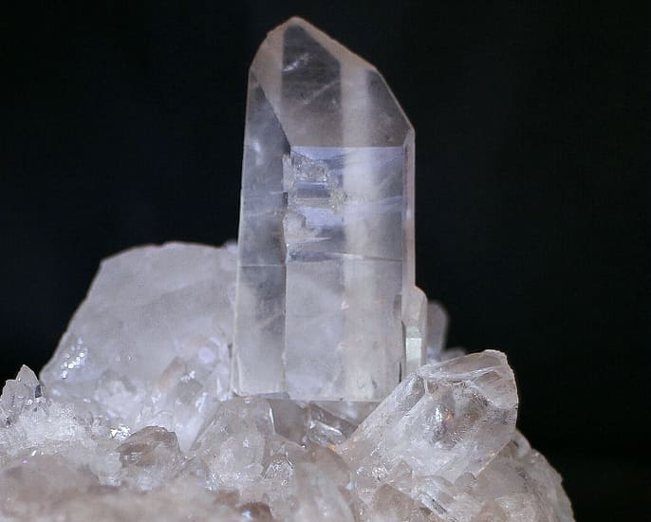
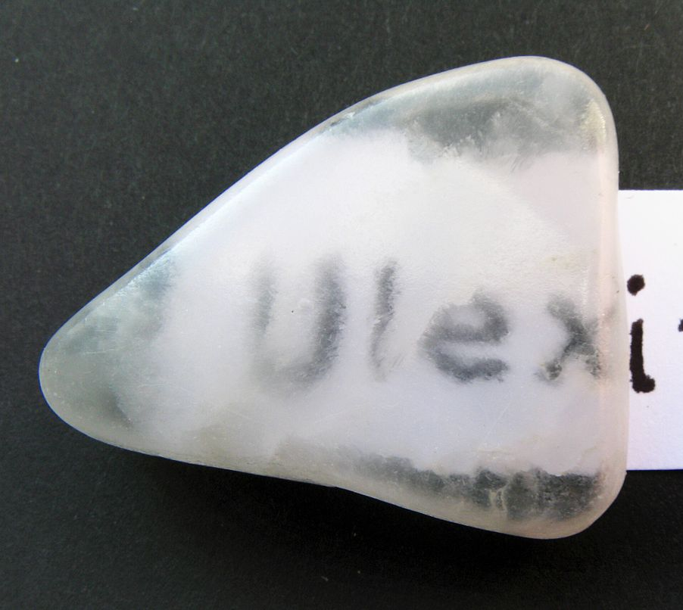
Refraction Experiment #1
Refraction–bending light. Look through three types of crystals. Each one bend light a different way. Put them on top of something with lines or pictures and turn them. What happens?
Ulexite is sort of cloudy. It is called the TV stone. It bends the light so images come to the surface
Calcite looks like a box that is leaning over. As you turn it, it makes lines look double
Quartz has 6 sides. As you turn it, lines can look straight or broken into pieces

Slide 7
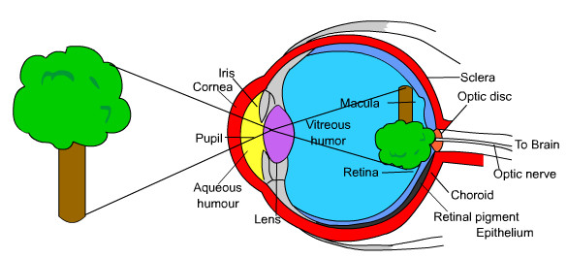
Eye Diagram

Slide 8
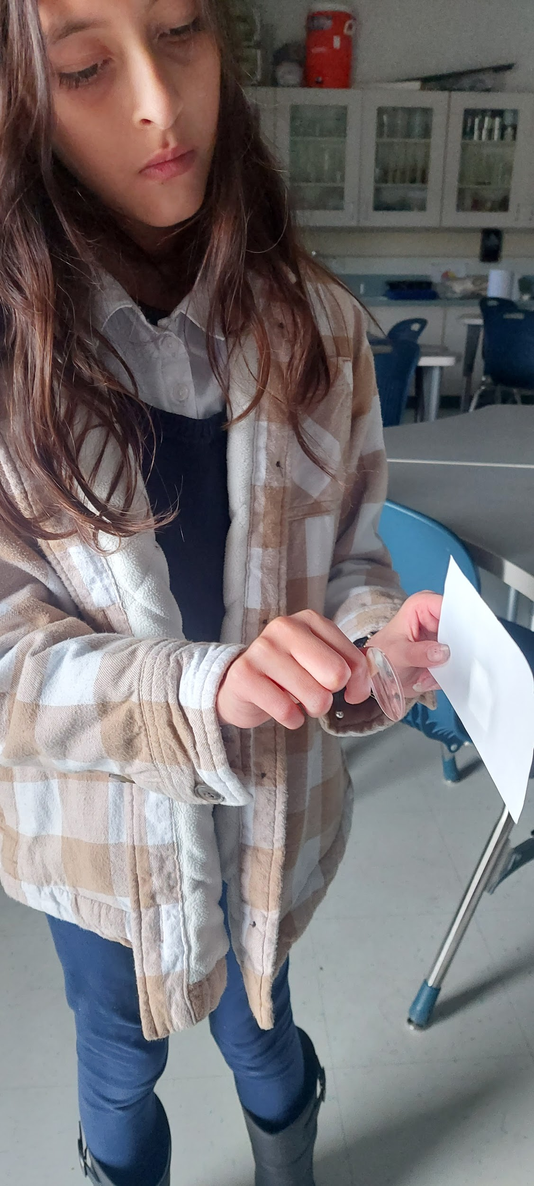
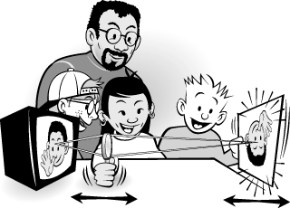
Refraction Experiment #2
Use a small lens and a 3 by 5 card to have an image show up on a card. Use the window as your light source.
The image will be upside down since the light is bent going through the lens.
© 1998, Exploratorium
Notes:
NOTE TO DOCENTS. FOR THIS WE RECOMMEND TURNING OFF THE LIGHTS AND HAVE STUDENTS USE THE WINDOW AS THEIR LIGHT SOURCE. THE LENS MUST BE BETWEEN THE LIGHT SOURCE (THE WINDOW) AND THE CARD. STUDENTS FREQUENTLY TRY TO PUT THE CARD IN FRONT OF THE LENS AND THEY WON’T SEE ANYTHING. YOU WILL HAVE TO HELP THEM MOVE THE LENS AND CARD BACK AND FORTH UNTIL THEY GET IT IN FOCUS.
The image needs to be replaced since it is copyrighted.,

Slide 9
Light – First Grade

Slide 10
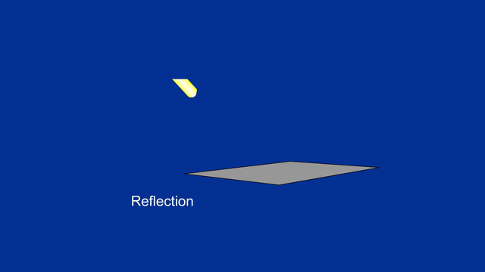
Reflection
Bounces off shiny surface including water, metal, mirror
Light is made up of photons that move like anything else

Slide 11
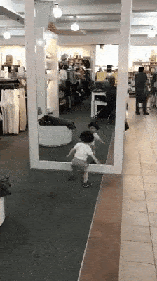
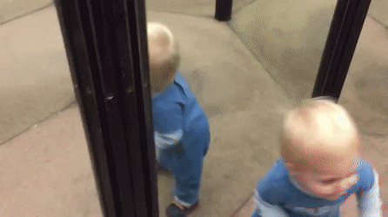
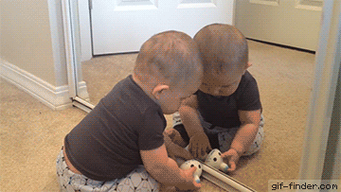
What are babies thinking?
1
3
2

Slide 12
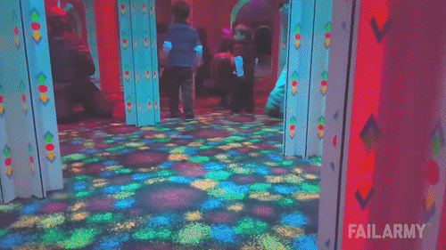
Where is the boy coming from?

Slide 13
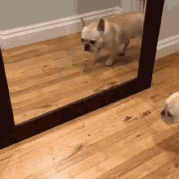
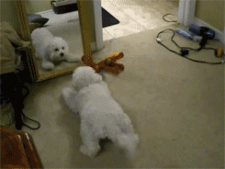
Dogs and Mirrors
1
2

Slide 14

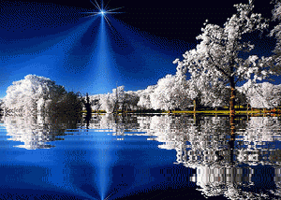
Reflection on water’s surface
1
2

Slide 15
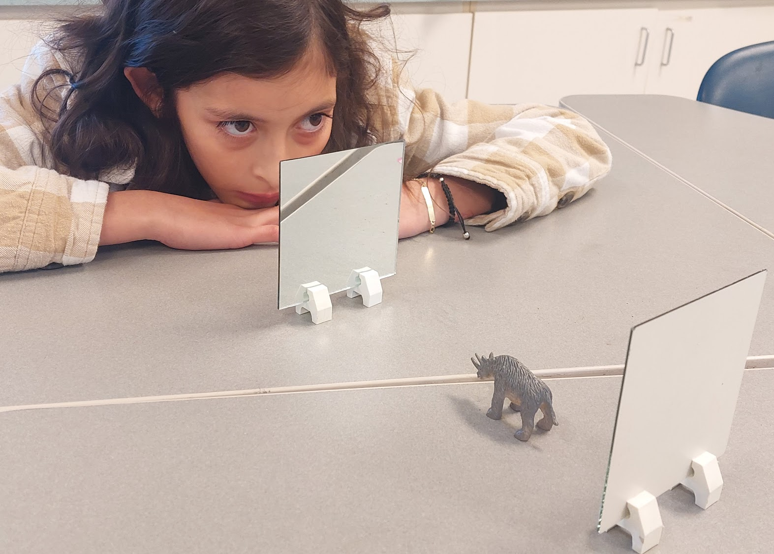
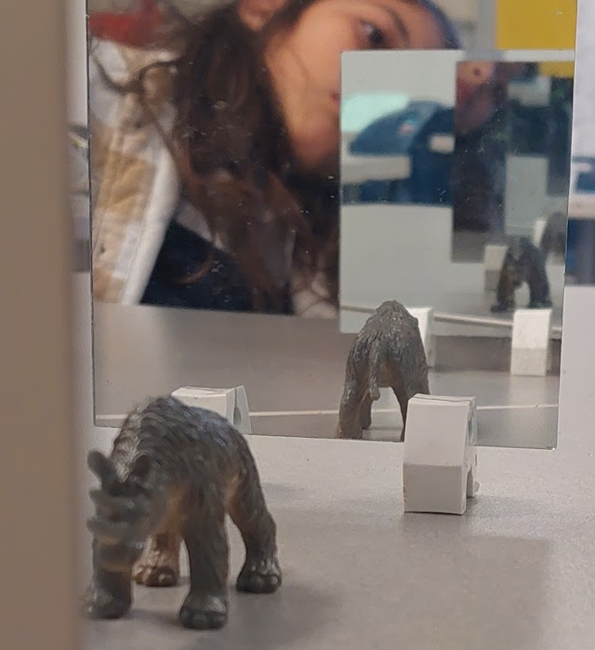
Reflection Experiment #1
Work with a partner. Put two mirrors facing each other and a toy in between them. Arrange the mirrors so you can see more than one toy in the mirror. Move the mirrors until you can see at least three toys.

Slide 16
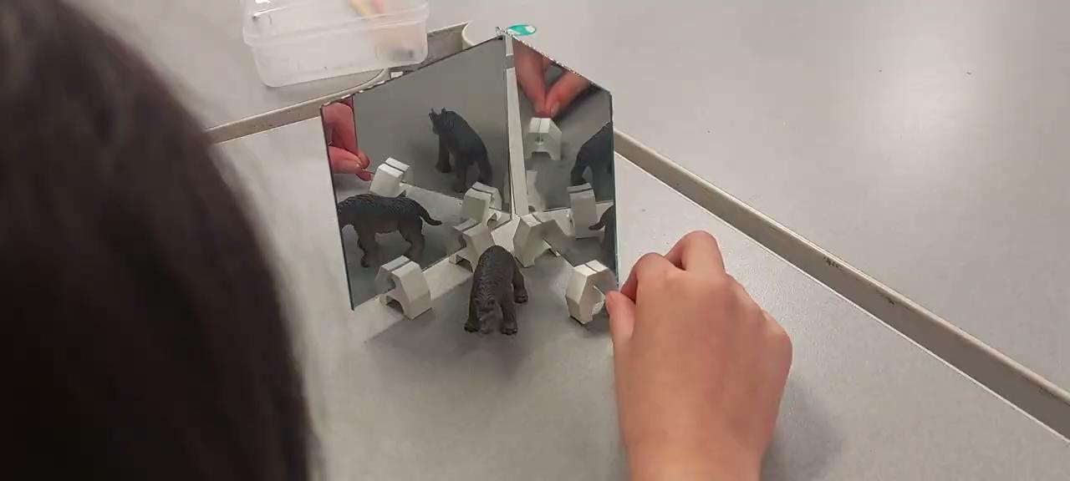
Reflection Experiment #2
Put the edges of the mirrors together with the toy between and open and close the mirrors like a book. How many toys can you see?

Slide 17
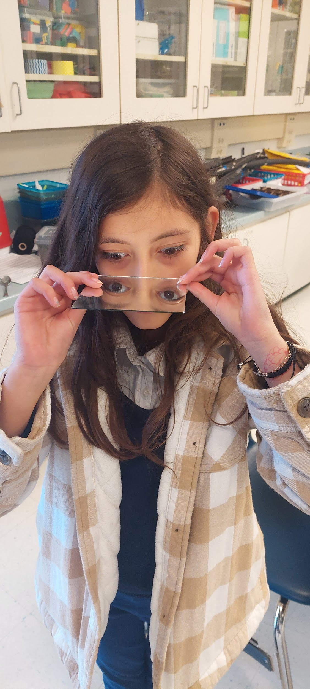
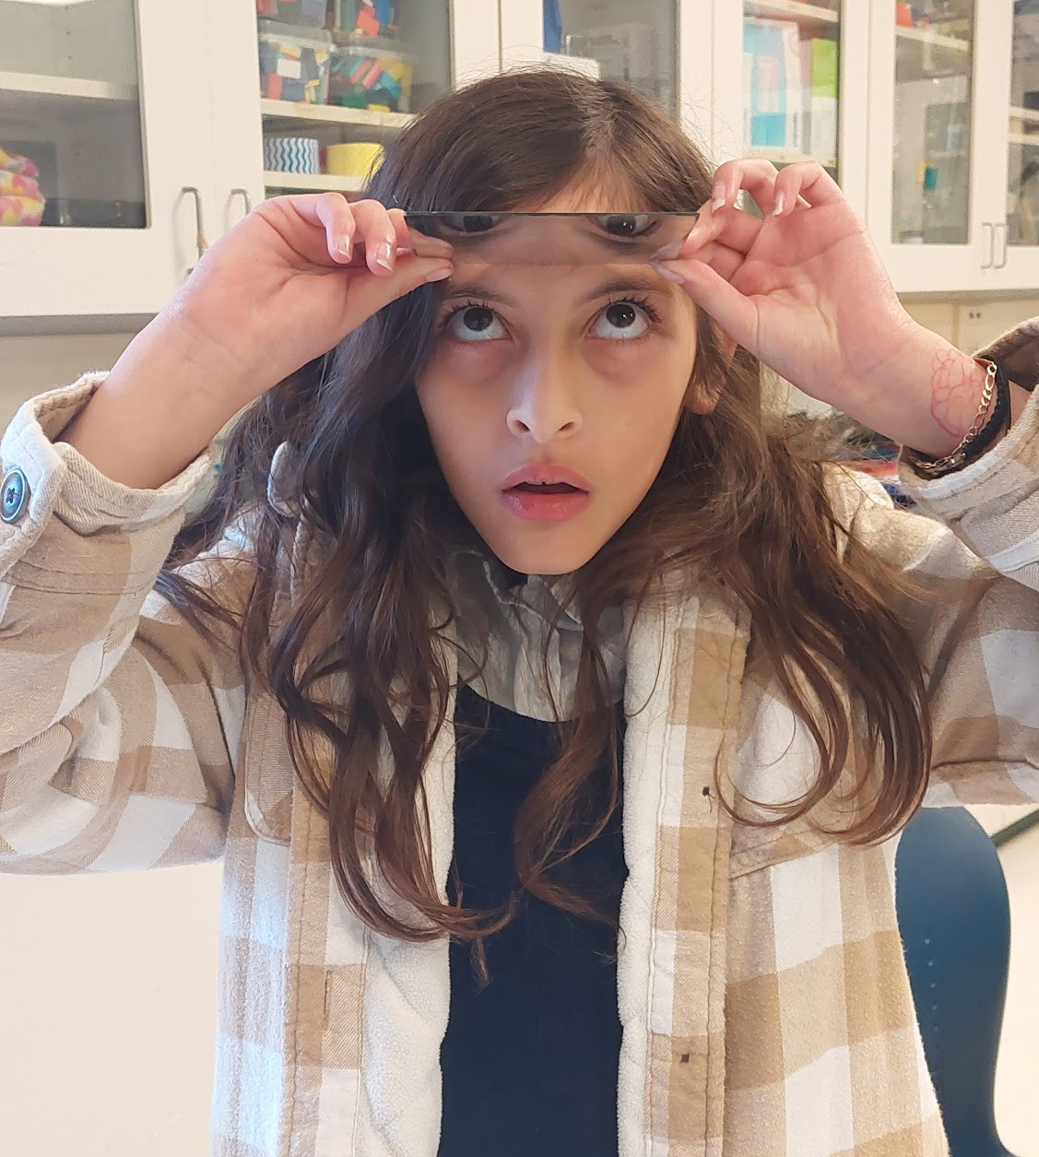
Reflection Experiment #3
Take your mirror and place it on the bridge of your nose. When they look down they will see up. Next try placing the mirror facing down on your forehead and look up. What do you see now?
Notes:
If possible, let students move around a bit while using the mirrors. They find this amazing.

