Slide 1
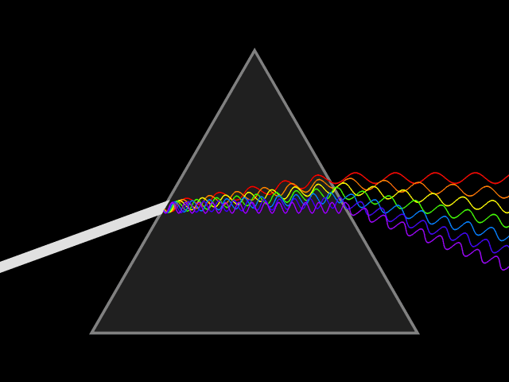
Mattos Science Magnet
Docent Program
First Grade
Lesson 1. Understanding Shadows
Math Science Nucleus © 2024

Slide 2
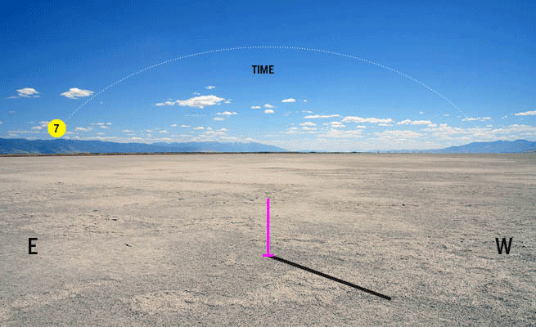
What is a Shadow?

Slide 3
Are there shadows in the classroom?
Why or why not?
Stand up and try to find your shadow.
Take Away:
Shadows change during the day if you are outside.

Slide 4
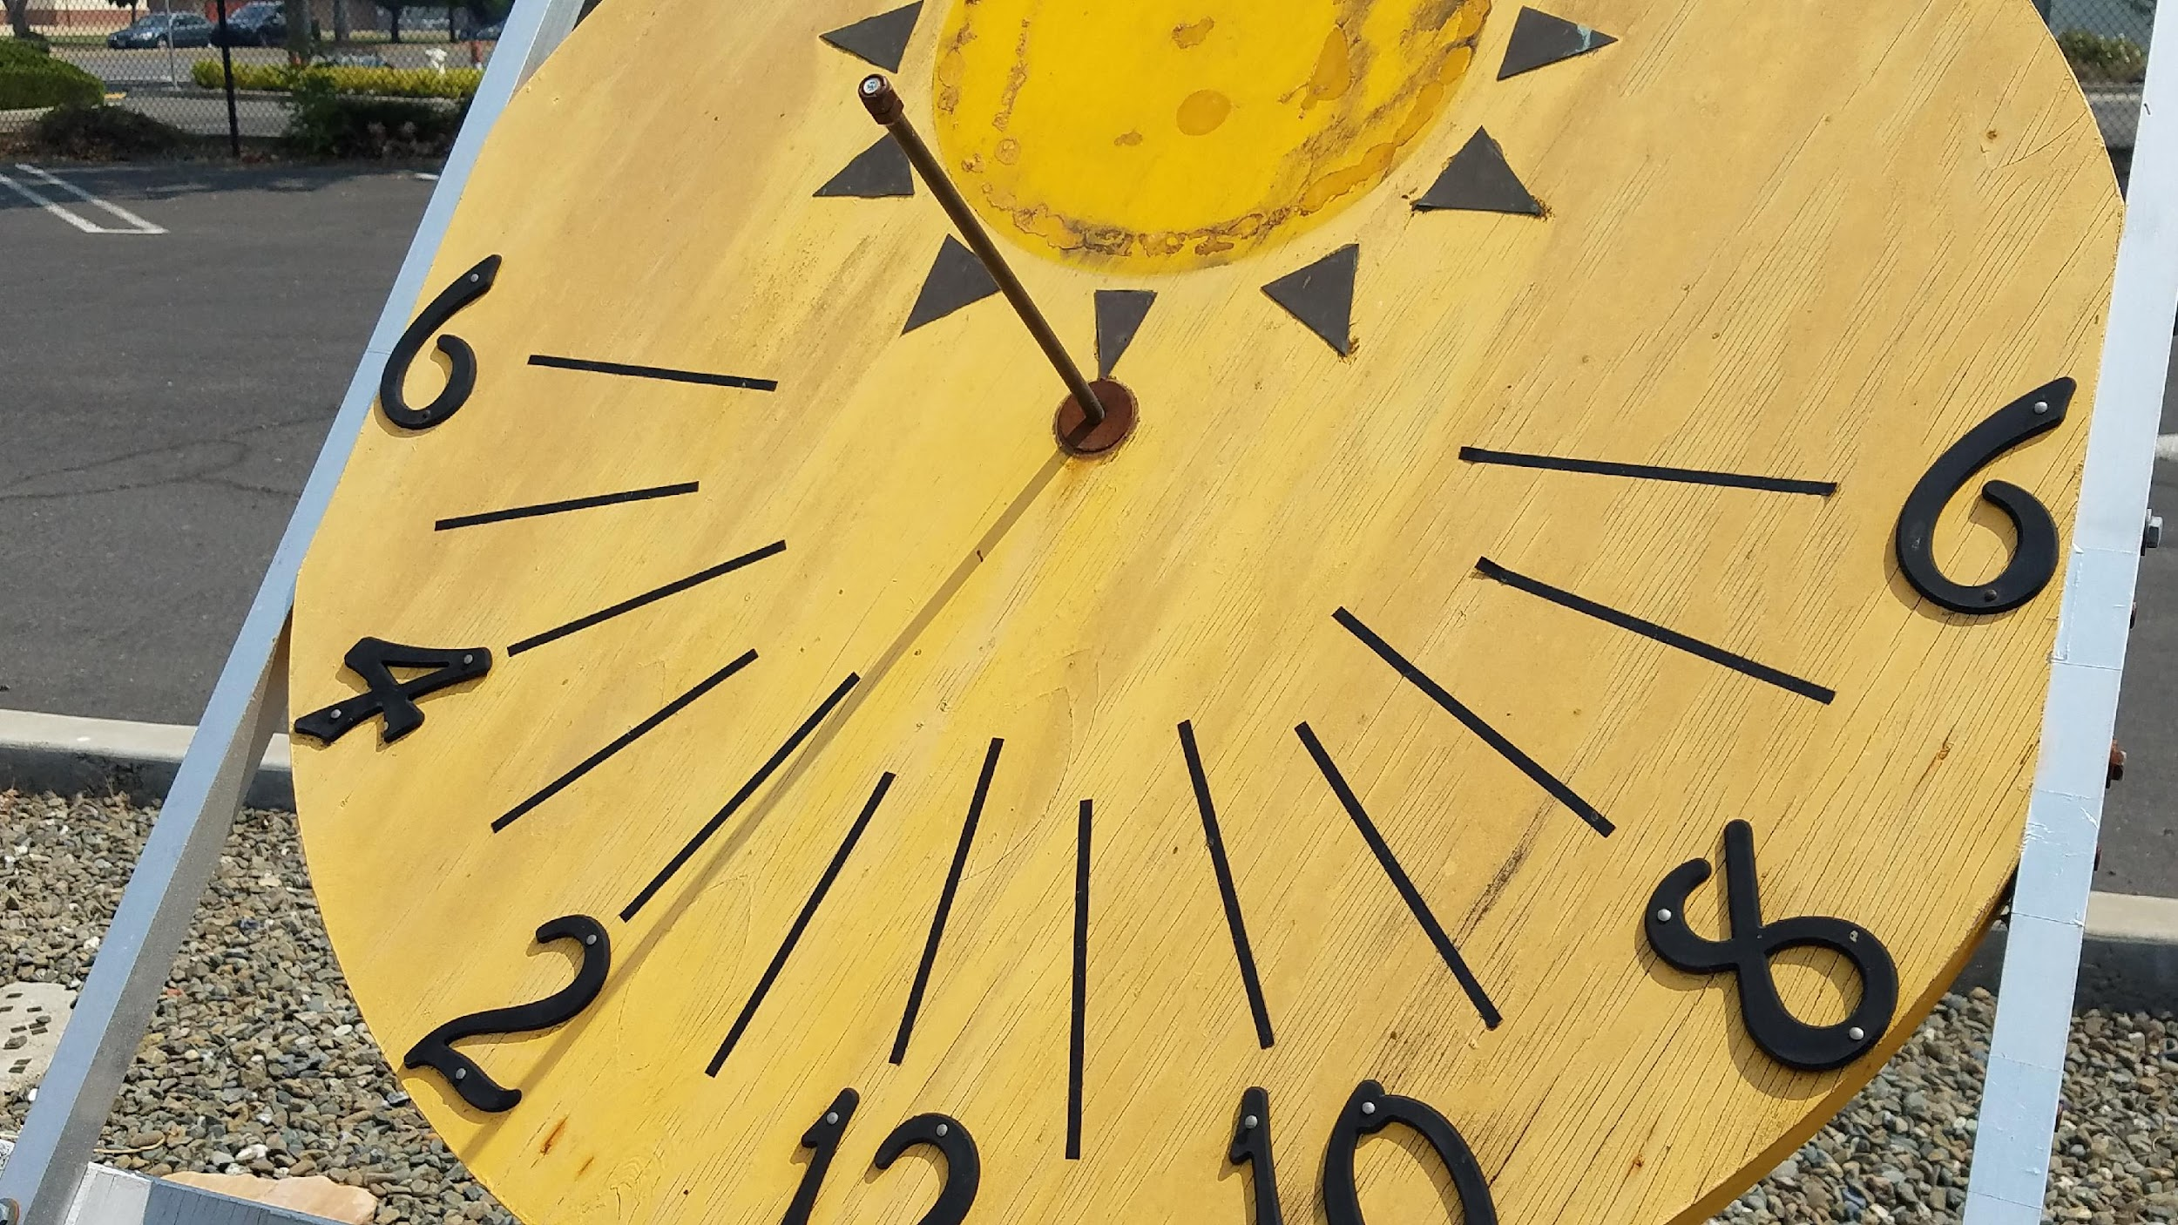
How can you tell time by shadows?

Slide 5
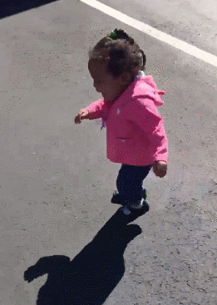
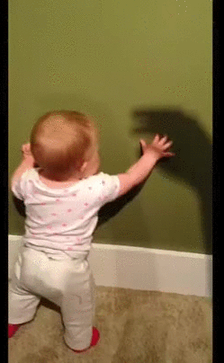
What did you think a shadow was when you were little?

Slide 6
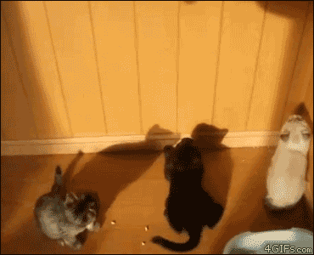
Cats and Shadows – Can you fool them?

Slide 7
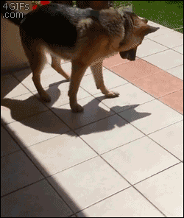
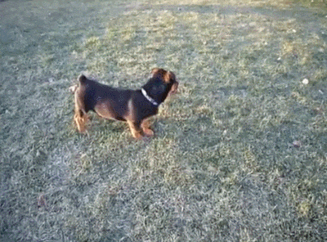
Dogs and their shadows
1
2

Slide 8
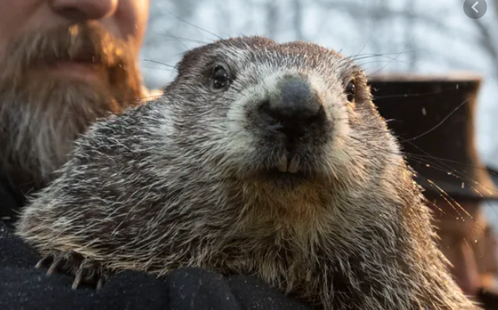

What animal has made shadows important?
Groundhog
Lives in the east
Considered a rodent
If it sees its shadow, there will be 6 more weeks of winter weather.
If it does not see its shadow, spring weather will be here soon.

Slide 9
Experiment
Use a flashlight to try to make long and short shadows. Where is the flashlight when the shadows are short? Where is the flashlight when the shadows are long?
Next, try to make the shadows point to the corners in the room. Listen for which corner to point to. Where was the light when you pointed it to a corner?

Slide 10
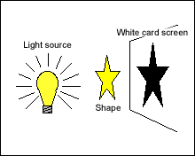
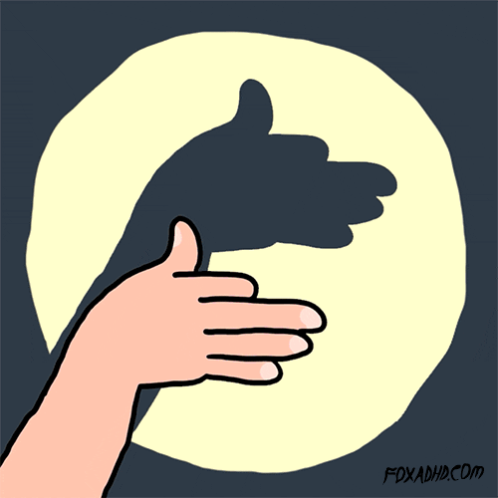
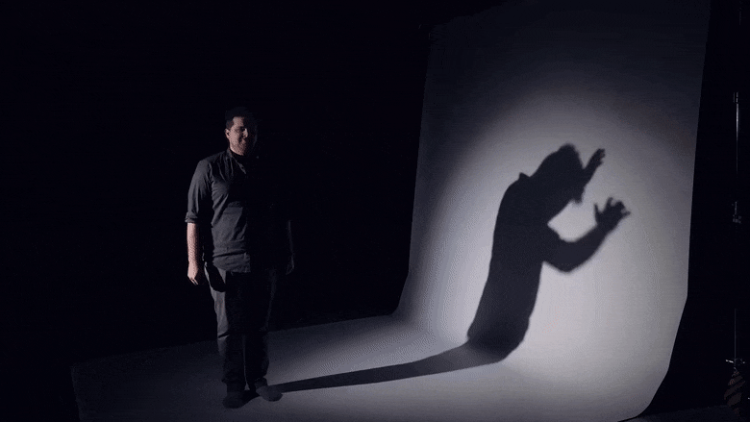
Making a shadow animal
2.
1.

Slide 11
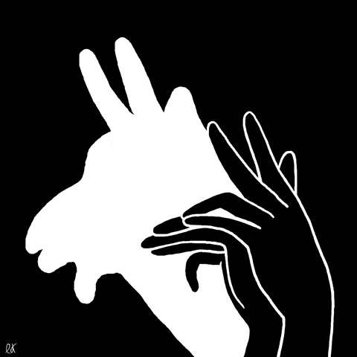
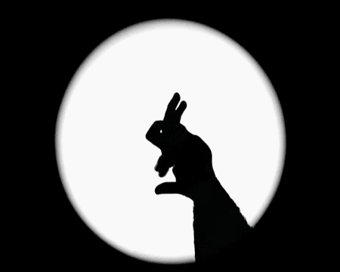
Making Shadows at Home
1.
2.

Slide 12
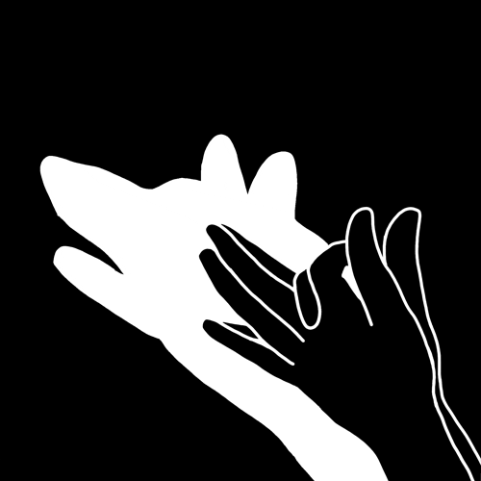
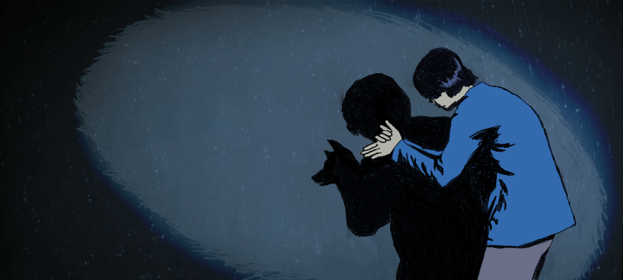
2.
1.

Slide 13
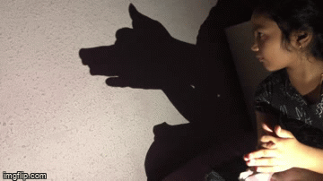
Experiment–Make a shadow animal
Find a partner. One person can hold a flashlight and the other can try to make a shadow animal. Then trade. Make sure the light source is in correct position.

Slide 14
I follow you around in the light, I say good bye to you in the night? Who am I?
A shadow!

Slide 15
Go outside and explore finding shadows!

Slide 16
WHAT IS A SHADOW?
BACKGROUND:
Have you ever noticed that your shadow is longest in the early morning and in the late afternoon?
To tell the time ancient people used the position of sun in the sky. At noon, when the sun is overhead there is little or no shadow at all. A long time ago people observed that about the sun and used this idea in making the world’s earliest clock, a sundial. Look at the illustration on the next slide and notice that the direction of the shadow is away from the light source. During midday it would be the shortest, and in the afternoon it would be on the opposite side.

