Slide 1
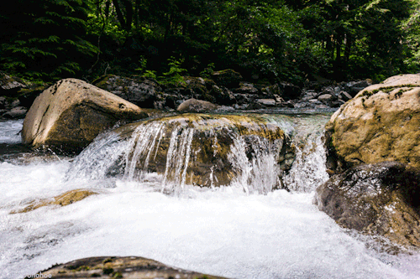
Mattos Science Magnet
Docent Program
Fifth Grade
Lesson 3. How substances dissolve in water
Math Science Nucleus © 2024

Slide 2
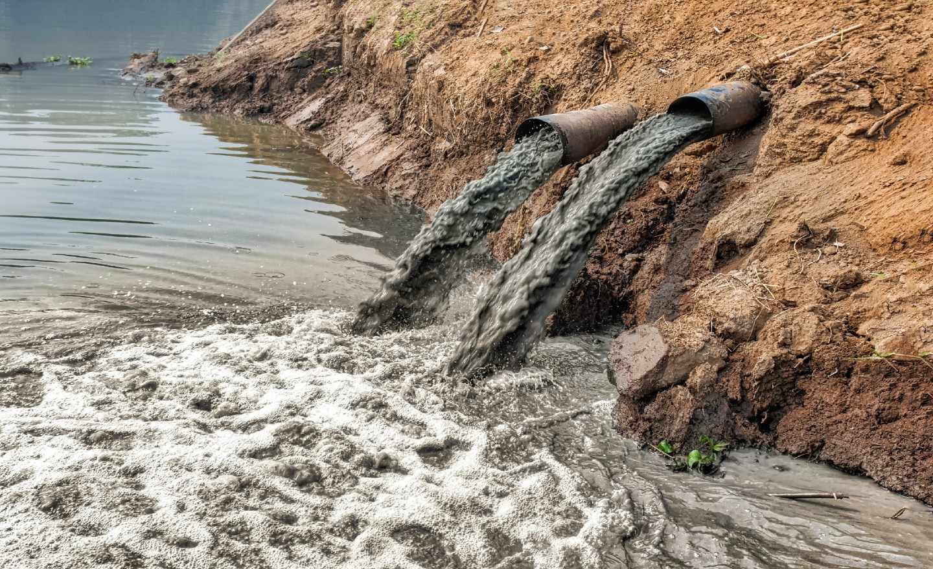
Today we focus on how pollutants get in water and what happens when they get there

Slide 3
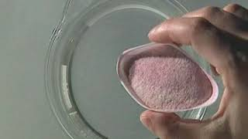
Solute and Solution

Slide 4
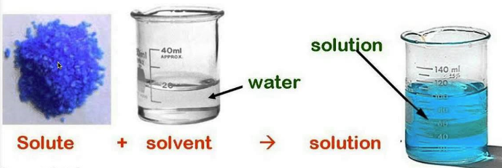
Review of terms: Solute, Solvent, and Solution
Solution is transparent and no crystals remain

Slide 5
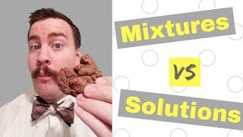
Notes:
I suggest ending the video at 1:55 or 2:08.

Slide 6
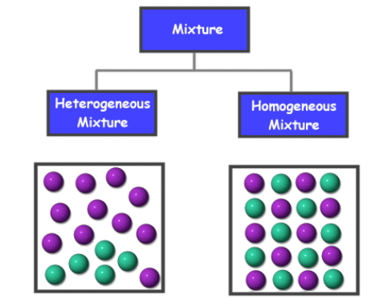
Mixtures–two or more substances that do
NOT combine chemically
Dissolved
Not Dissolved

Slide 7
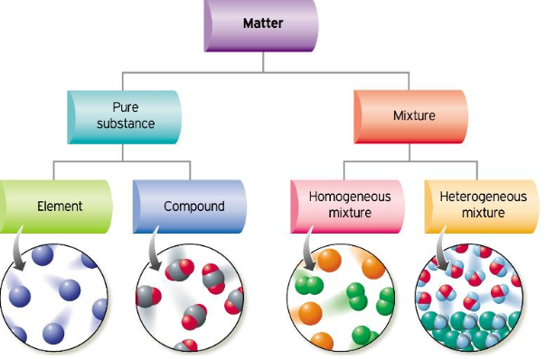
Notes:
You can skip this slide if you feel it is confusing. Basically it separates matter into two big categories: Pure substances and mixtures. We are only studying mixtures today to figure out the difference between those that do dissolve and those that do not. Mixtures do not react chemically. For instance if you mix vinegar and baking soda together you get a reaction and a new compound is formed. Mixtures do not react. They either dissolve and are homogenous throughout or they do not and mixture is heterogeneous. Pure substances are either a single type of atom (an element) or a single type of molecule (more than one element).

Slide 8
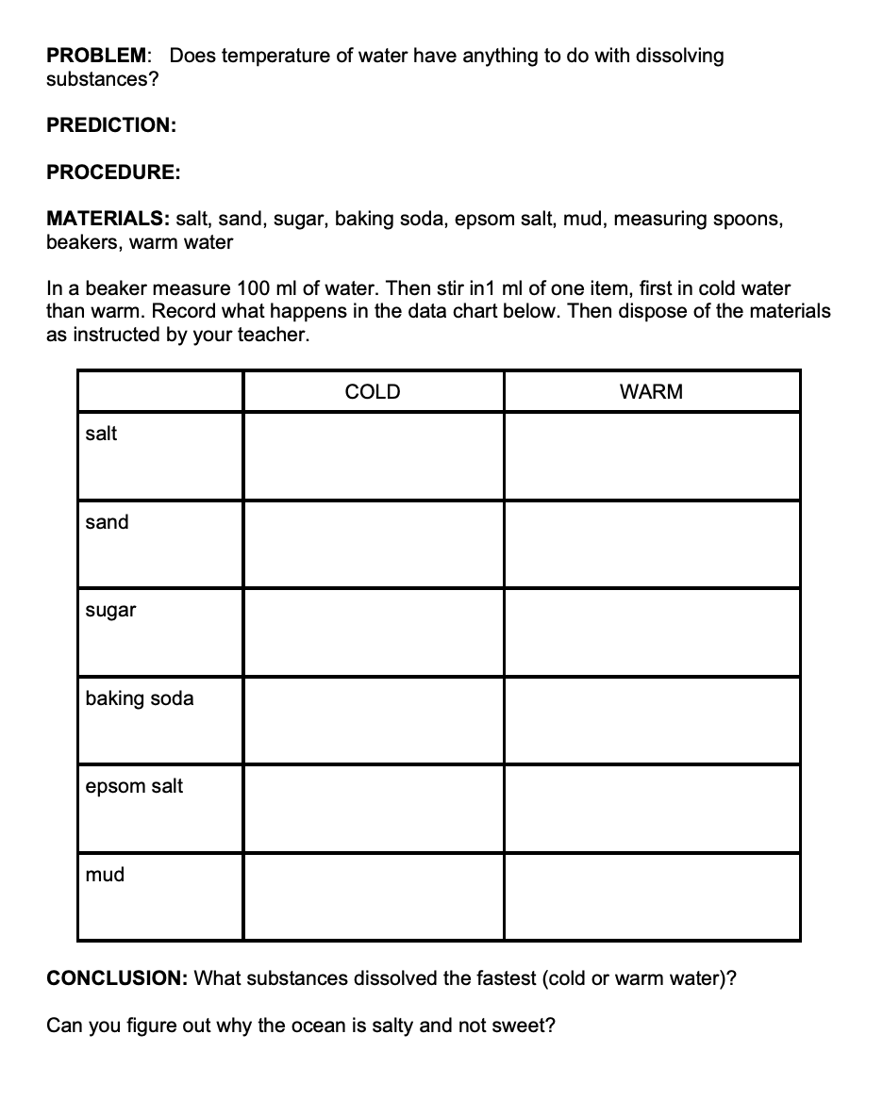
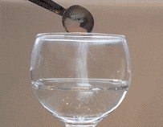
Experiment
Try to dissolve 6 substances in cold and warm water. Does water temperature affect dissolving?
PROCEDURE: Add a substance and start mixing. Time how long it takes by counting or watching the clock. If the substance does not dissolve (does not disappear), write Does Not Dissolve in the box. If it does dissolve write down the number of seconds it takes to dissolve.
Do all materials dissolve? Did temperature affect the speed of dissolving?
.

Slide 9
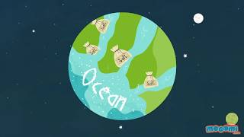
Why is the sea salty

