Slide 1

Mattos Science Magnet
Docent Program
Fifth Grade
Lesson 2. Elements, compounds, pollutants
Math Science Nucleus © 2024

Slide 2
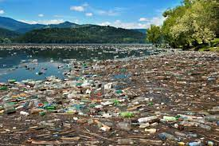
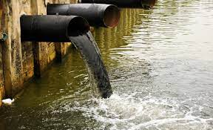
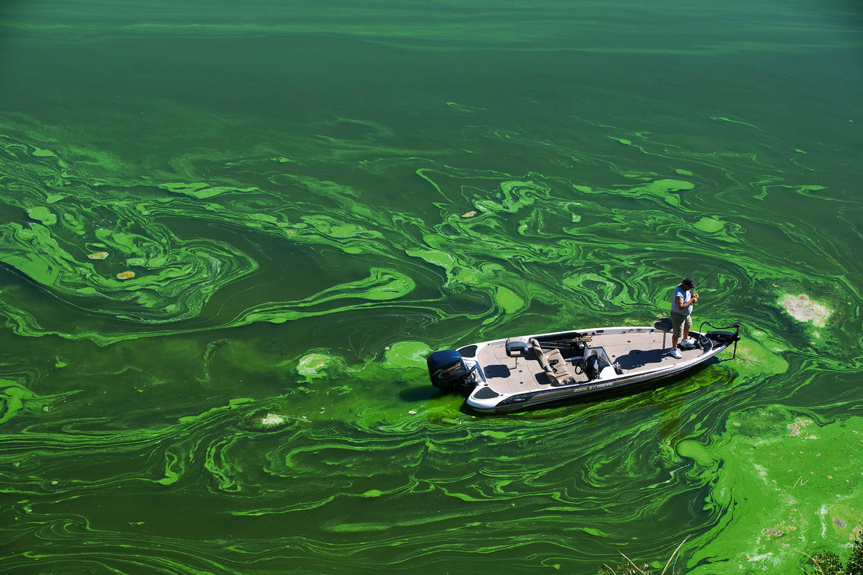
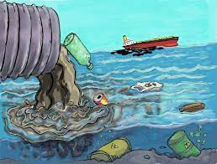
We are going to be looking at the chemical pollutants in water.

Slide 3
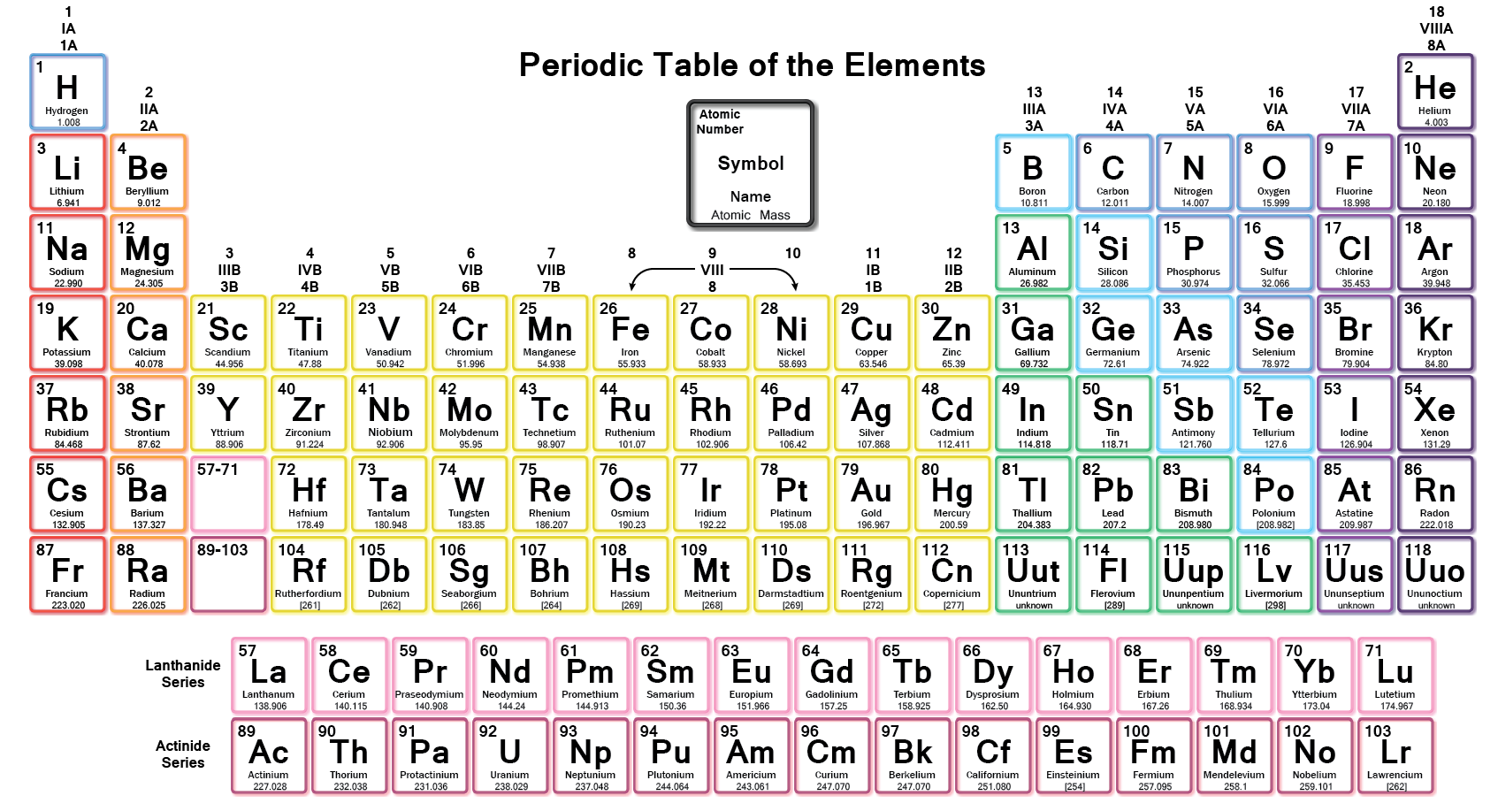
What is the Periodic Table?
A way to organize elements known in the Universe
A way to predict if new elements can be found naturally or produced artificially

Slide 4
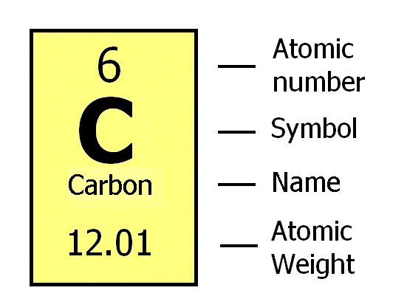
Reading the Elements on the
Periodic Table
Notes:
Atomic number = the number of protons in the nucleus of an atom, which determines the chemical properties of an element and its place in the periodic table.
Atomic Weight – for elementary definition number of protons and neutrons

Slide 5
Activity #1
Look at some elements.
Find them on the periodic table
Find the atomic symbol and atomic number
Find some characteristics of each.
Look at examples of each of these elements
  NICKEL
  SULFUR
  ALUMINUM
  IRON
  ZINC
  TIN
  Then look at these compounds
  Halite (NaCl) and Quartz (SiO2)

Slide 6
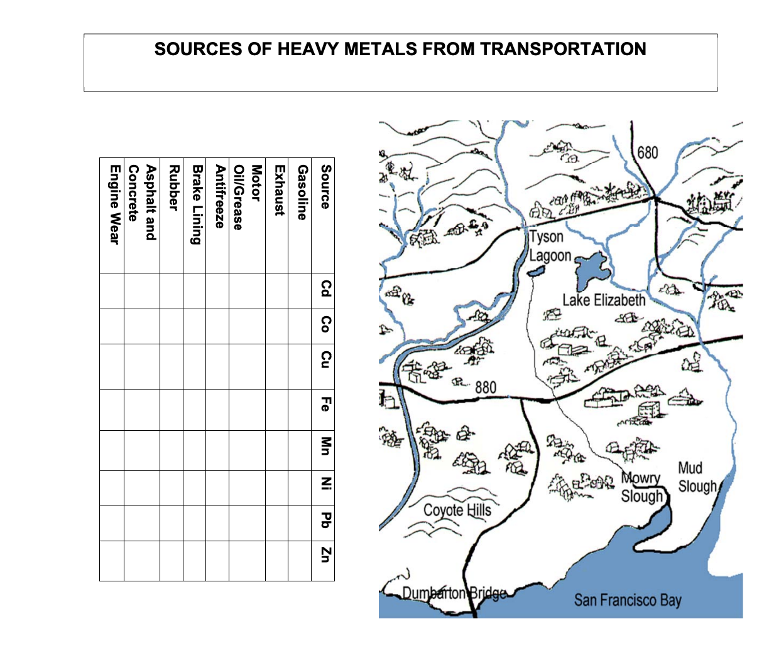
Activity #2
Look at this map of Fremont on your worksheet
On your worksheet circle
  Tyson Lagoon
  Mowry Slough
  Mud Slough
  San Francisco Bay
  Lake Elizabeth
Draw arrows showing which way the water is moving in the streams.
Try to figure out the watershed limits of the Mud Slough watershed and circle that area.

Slide 7
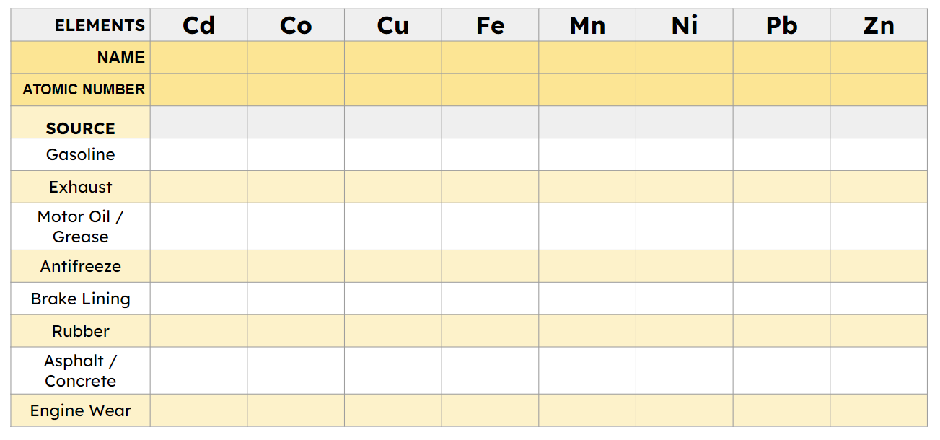
Activity #3a
Next, fill in the top part of this worksheet
Using your periodic table, find the atomic number and name for each of these elements. Write them below the Element symbols.

Slide 8
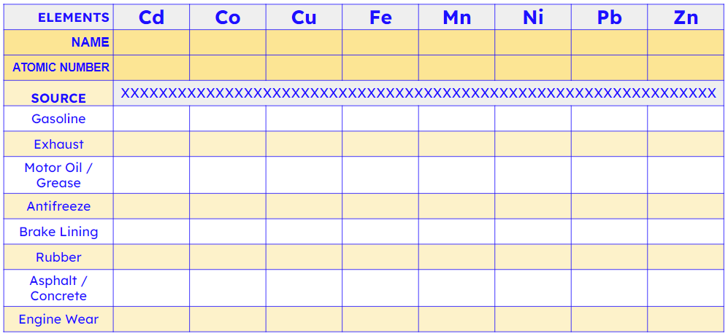
Activity #3b
Open the canisters that have the name of each pollutant.
Find the elements in each pollutant and check them off on the grid.
All of these pollutants are toxic (poisonous) like Pb or Cd or toxic in large doses (like Fe)

Slide 9
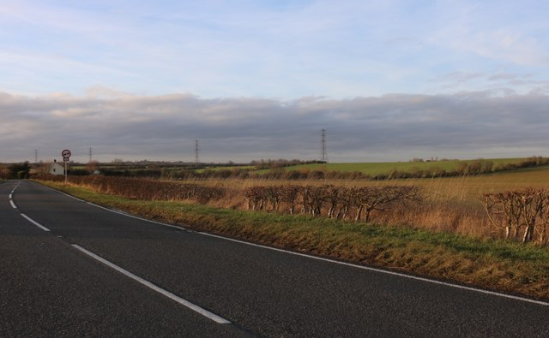







Cd
Cu
Mn
Pb
8. Engine wear & tear
Co
Fe
Ni
Zn
4. Antifreeze
5. Brake lining
1. Gasoline
2. Exhaust
3. Motor Oil / Grease
6. Rubber
7. Asphalt / concrete

Slide 10
Answer Key
ELEMENTS | Cd | Co | Cu | Fe | Mn | Ni | Pb | Zn
NAME | cadmium | cobalt | copper | iron | manganese | nickel | lead | zinc
ATOMIC NUMBER | 48 | 27 | 29 | 26 | 25 | 28 | 82 | 30
SOURCE
Gasoline | x |  | x
Exhaust |  |  |  |  |  | x | x
Motor Oil / Grease |  | x |  | x |  | x | x | x
Antifreeze |  |  |  | x |  |  |  | x
Brake Lining |  |  | x | x |  | x | x
Rubber | x |  | x |  |  |  | x | x
Asphalt / Concrete |  |  | x |  |  | x |  | x
Engine Wear |  |  |  | x | x | x | x | x
Notes:
*** Marks copied from MSNucleus, but seems to be inaccurate - NEED TO REVISE***

Slide 11
The End
Notes:
*** Marks copied from MSNucleus, but seems to be inaccurate - NEED TO REVISE***

Slide 12
ELEMENTS | Cd | Co | Cu | Fe | Mn | Ni | Pb | Zn
NAME
ATOMIC NUMBER
SOURCE | XXXXXXXXXXXXXXXXXXXXXXXXXXXXXXXXXXXXXXXXXXXXXXXXXXXXXXXXXXXXXXX
Gasoline
Exhaust
Motor Oil / Grease
Antifreeze
Brake Lining
Rubber
Asphalt / Concrete
Engine Wear
Notes:
*** Marks copied from MSNucleus, but seems to be inaccurate - NEED TO REVISE***

Slide 13
Activity #1 Docent Notes
At each table, set up a tub with the following:
  Worksheet #1 - Activity one, blank page with box in corner for element info
  4 samples of the same element, so one tub will have 4 bags of sulfur, the next tub will have 4 bags of zinc
  4 pencils/pens
  4 periodic table place cards
  Possibly tape an element bag to the worksheet
Using the element bags, they will first find the element on the periodic table, and right the symbol, name, and number.
  This lets the kids get more comfortable with the periodic table
  Some of them will be harder as the name won’t align with the simple, lead (Pb) is a good example
Under the box they should write ONE observation about the element
Complete everything above
Direct the kids to stand up
  Leave the paper on the table
  Lay the element bag on the sheet of paper
  Now they will walk around carrying their pencil, that’s the only thing they will carry
They will each go to a new table and write an additional observation on the paper that is there
  The goal is to end up with lots of unique observations for each element on each paper
  Good observation is good science

Slide 15

Ready to LOG?
ELEMENTS | Cd | Co | Cu | Fe | Mn | Ni | Pb | Zn
SOURCE
Gasoline
Exhaust
Motor Oil / Grease
Antifreeze
Brake Lining
Rubber
Asphalt / Concrete
Engine Wear
cadmium | cobalt | copper | iron | manganese | nickel | lead | zinc
x |  | x
 |  |  |  |  | x | x
 | x |  | x |  | x | x | x
 |  |  | x |  |  |  | x
 |  | x | x |  | x | x
x |  | x |  |  |  | x | x
 |  | x |  |  | x |  | x
 |  |  | x | x | x | x | x
Notes:
*** Marks copied from MSNucleus, but seems to be inaccurate - NEED TO REVISE***

Slide 16
Next, fill in the second part of your worksheet
Using your periodic table, find the atomic number and name for each of these elements (the source line) and write it above the Source

