Slide 1
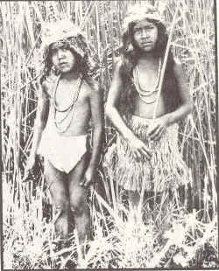
Growing up Ohlone

Slide 2
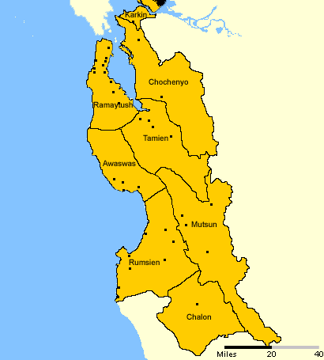
Sun and Moon lived in a village of Ohlone people near a river with fast running water, in an area called Tuibun. They were the children of Poylemja, a Bay Miwok and Jocbocme, an Ohlone. They were part of the Chochenya tribe.

Slide 3
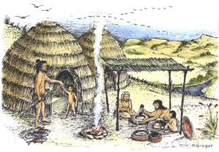
Sun and Moon were only 4 (katcoas) and 7 (tutur) so they still played together. Sun was the older boy. His father was teaching him to be a hunter. Moon would help her mother, especially when picking seeds, nuts, and blackberries (enesmin).

Slide 4
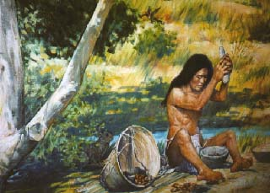
Sun and Moon loved summer because they could play in the water and eat fruit and nuts from nearby plants. During the summer the steelhead trout and coho salmon would run up the river to lay their eggs. It was easy to catch fish with just your bare hands.

Slide 5
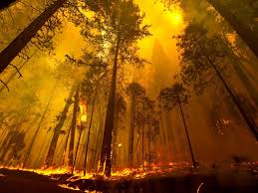
Autumn was now approaching. The trees along the river was changing. Some kept their leaves and others would turn colors, slowly falling to the ground. The nights were getting longer, and there was a chill in the air.

Slide 6
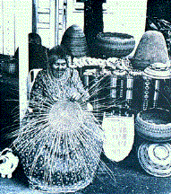
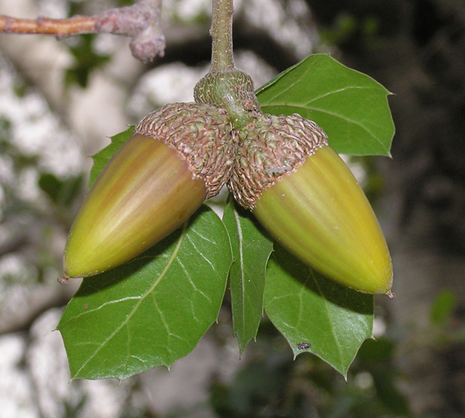
Plants were important to provide food while others would be used to make baskets. Tule (rookosh) would make a home (ruway) while coast live oak (yuukish) would make an acorn mush (paamon) to eat.

Slide 7
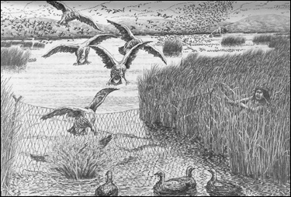
The elders knew it was getting colder because the Sun was lower in the sky. They had to prepare for the cold that would follow. On this warm day the men were fishing in the large river and women were collecting acorns from the oak trees.

Slide 8
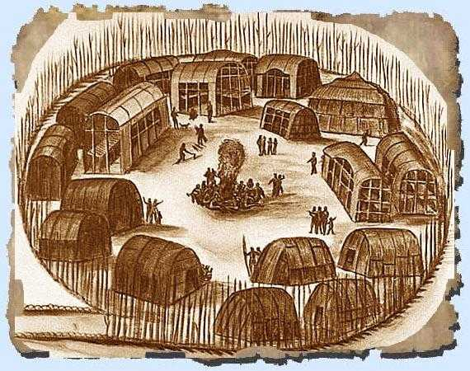
Many of the children were left in the village under the watchful eyes of the elders. Sun and Moon were being watched by their grandmother. She was distracted when two boys began to fight.

Slide 9
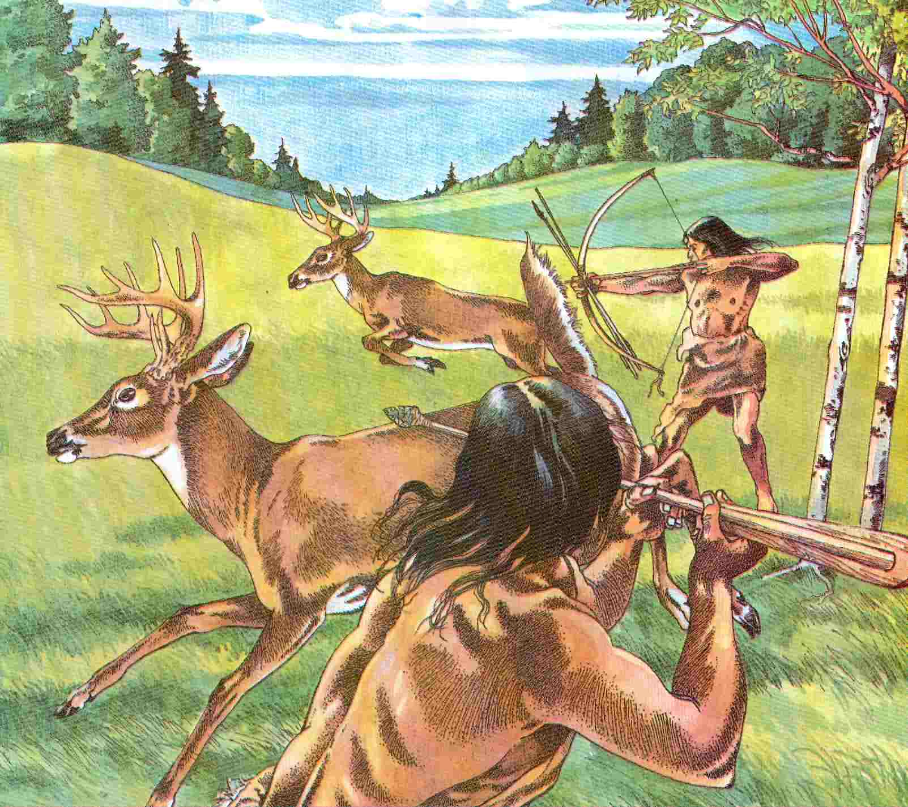
Sun saw a deer (troot) at the edge of the village. He thought his father would be proud, if he was able to bring home a deer. Sun had no fear and he found the spear his father was teaching him to make.

Slide 10
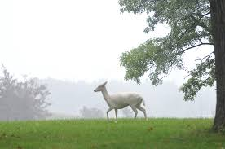
Sun concentrated on what he would do, and followed the deer without thinking where he was going. Moon saw Sun and followed him quietly. She was proud of her hunter brother.

Slide 11
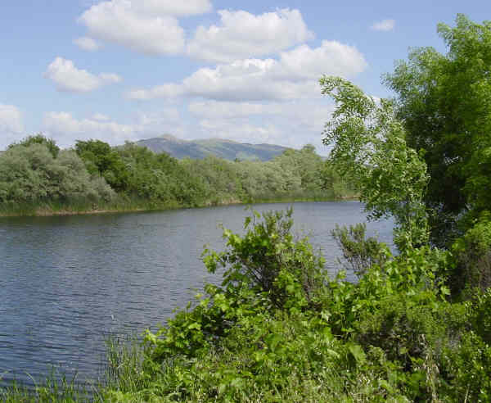
They followed the deer for a long time, and the familiar area around the river changed into a lagoon. There were tules and cattails along the edge with lots of trees creating a shady canopy.

Slide 12
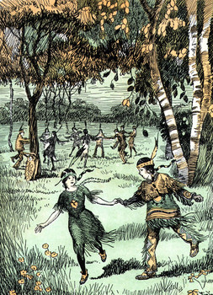
Sun could no longer see the deer and turned back to the village. He saw Moon under a small bush. “Moon what are you doing here?” Sun said surprisingly. Moon put her head down, “I just wanted to see what you were doing.”

Slide 13
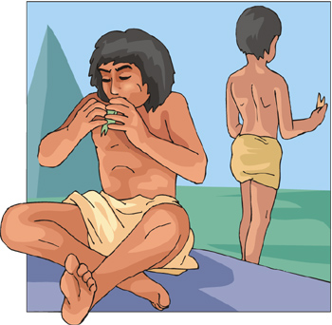
Moon started to sob, “Sun, I don’t know where we are and I am hungry. Grandmother is going to very mad at us.” Sun replied, “I will protect you. I am old enough to know how to get back.”

Slide 14
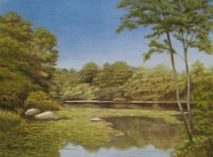
The days were getting shorter, so Sun knew they did not have much time to find their village. He looked in the sky at the sunset and he knew they would not make it to the village before it got dark.

Slide 15
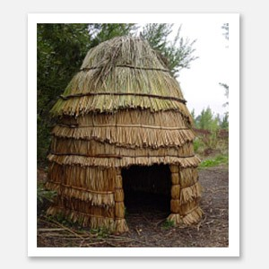
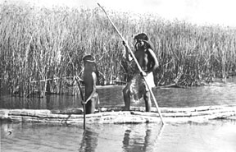
They saw an old Tule hut with a tule boat (walli) on the side. Sun was hoping that someone lived there and might help. But the hut was abandoned.

Slide 16
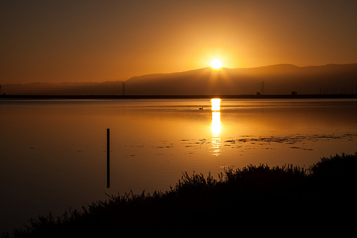
Sun thought he would find food and they would sleep there overnight. He remembered his father saying that if he ever got lost, walk toward where the Sun rises. He was named Sun because he was born at sunrise.

Slide 17
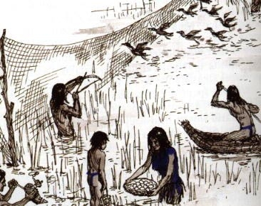
Sun tried to use his spear to catch fish, but it was too dark. He was disappointed.

Slide 18
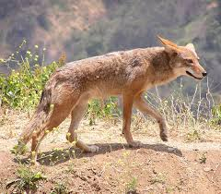
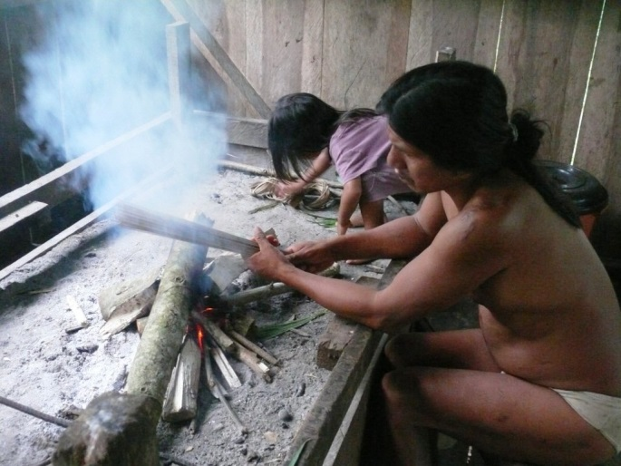
Sun found some tools to make fire. He could hear his father’s words, “Fire can keep you warm at night, but it can also protect you from wolves (huun), coyotes (mayyan) , and raccoons. Animals do not like fire.”

Slide 19
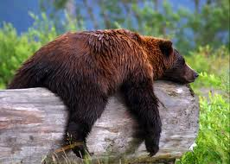
Sun was glad he would not have to worry about the bears. His father had just told him a story about how the bears during this time of the year eat so much salmon, they just lay down.

Slide 20
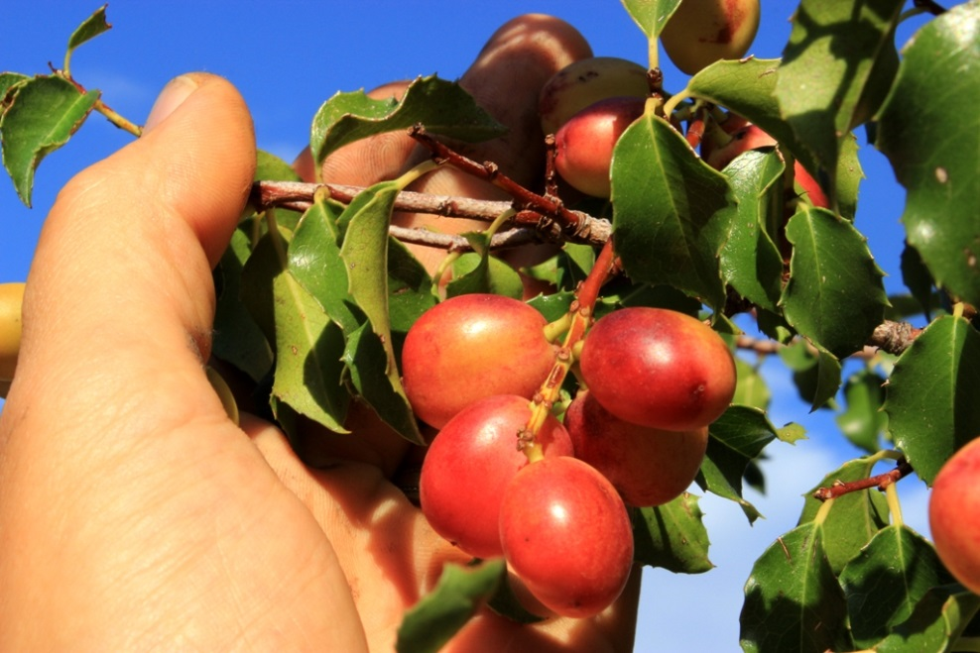
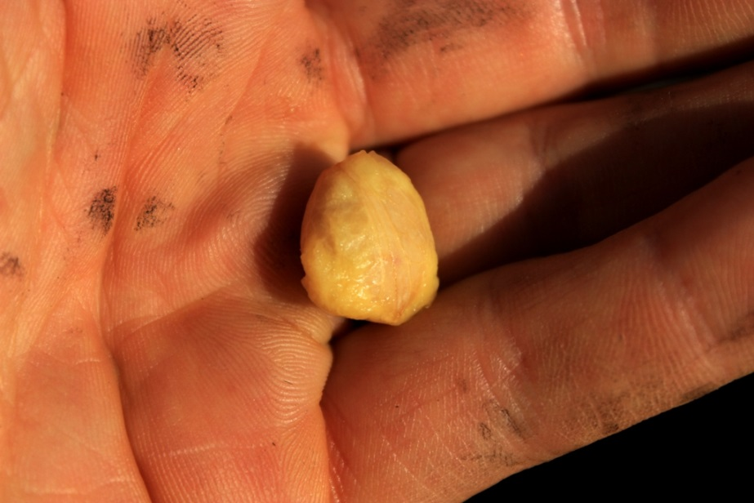
There was a holly-leaved cherry tree nearby. They picked the fruit which had a slightly sweet taste. The women in the village would roast the nut and make it into a sweet meal, which they would make into a bread to eat.

Slide 21
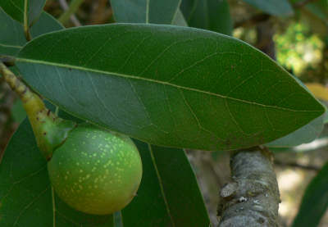
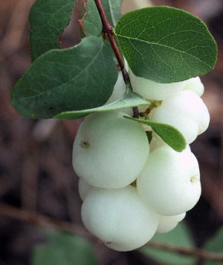
They found some peppernut from the bay laurel tree that was already shelled and roasted. These were good to eat, so Moon and Sun ate a few. Nearby were some snowberry, but Sun knew not to eat them because they would make you feel sleepy.

Slide 22
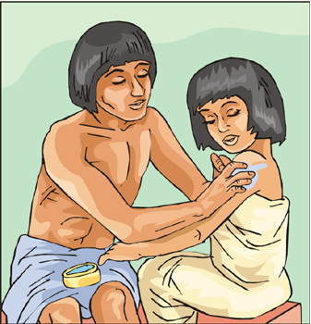
Moon felt safe with her big brother so she did not cry. This made Sun feel very important. In the distance he heard his father and uncle’s loud voice trying to find them. Sun at the top of his voice yelled, “Father we are at the Tule Hut.”

Slide 23
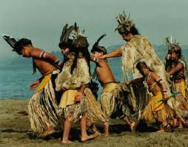
His father ran and picked up both his children and hugged them. Sun demanded that he let him down, as he exclaimed, ”Father I took care of Moon. I did everything you taught me. But I promise I will not try to get a big animal without you.”

Slide 24
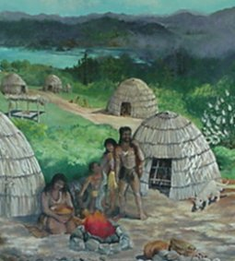
As they walked back to the village, Moon fell asleep in her father’s arms, but Sun walked the entire way to show his father and uncle that he would be a man soon.

Slide 25
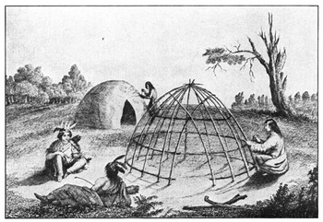
The End
Thanks to:
Vincent Medina Bringing back to life the Chochenyo language, spoken by the native people who lived in what we now call the East Bay.

