Slide 1
Mimicry
Bees and Flies
The imitating species is called the mimic, while the imitated species (protected by its toxicity or foul taste) is known as the model

Slide 2
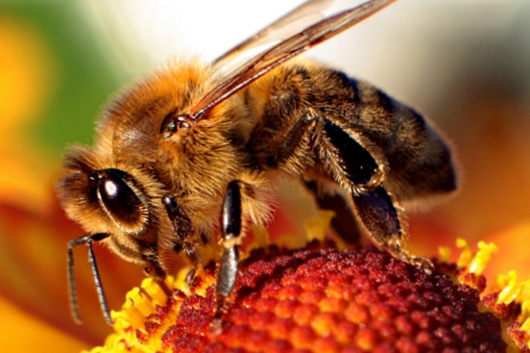
Do you get close to bees?
Why or why not?

Slide 3
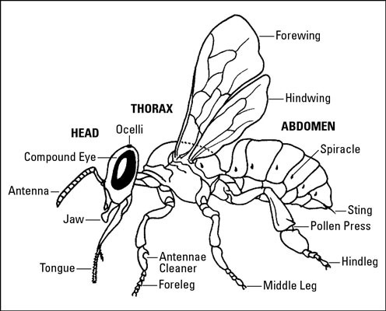
BEE
Long antenna, 4 wings

Slide 4
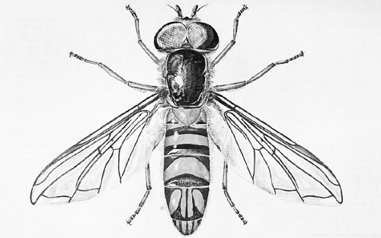
FLY
2 wings, small antenna, bigger eyes

Slide 5
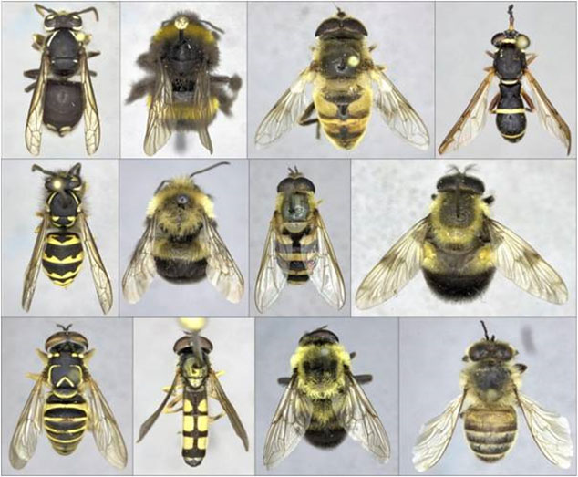
Find the 5 bees

Slide 6
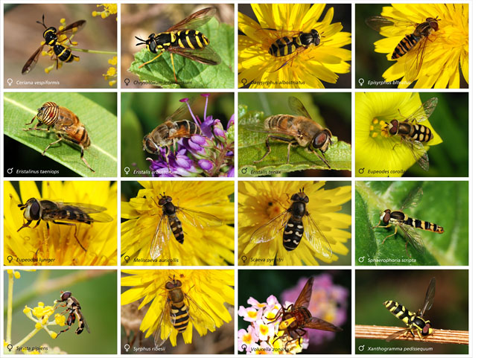
Are these flies or bees?

Slide 7
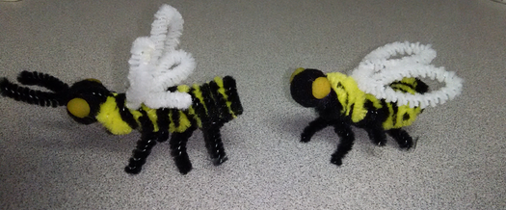
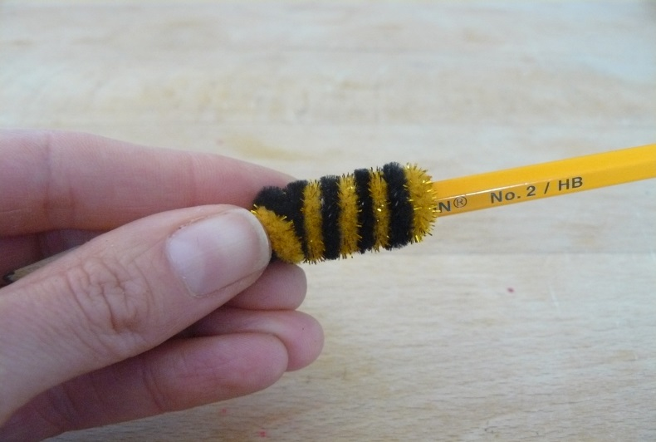
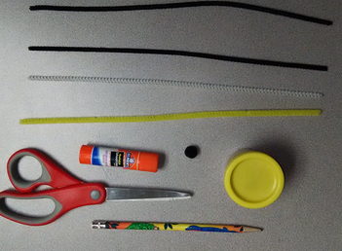
Bees and Flies - Activity

