Slide 1
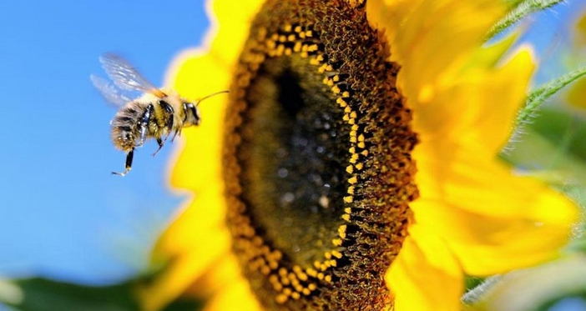
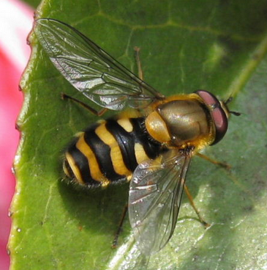
Bees, Flowers and Hoverflies co-evolution and mimicry

Slide 2
BEE Long antenna, 4 wings

Slide 3
Bees eyes are different. They do see ultraviolet light and don’t see red

Slide 5
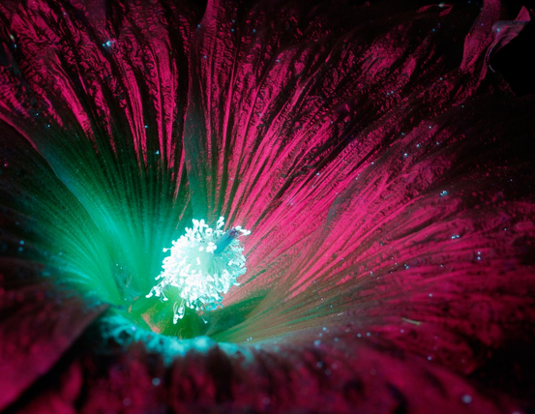
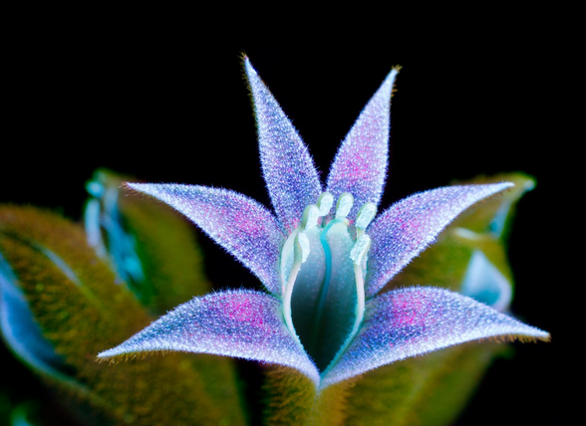
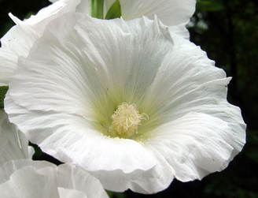
Flowers pollinated by bees often look different in ultraviolet light

Slide 6
The glowing dots are pollen

Slide 7
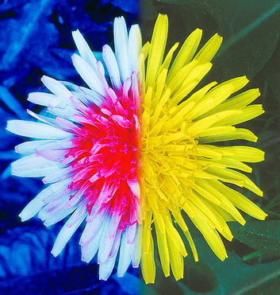
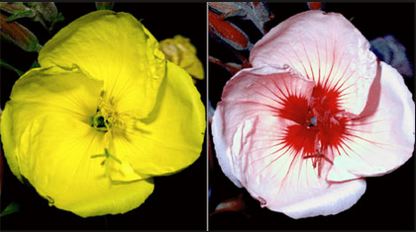
Regular light
Colors can change in UV light providing a bulls eye for bees
Ultraviolet light

Slide 8
Look at some flowers in regular and UV light Do you see a difference? What would the bees see with the UV light that would attract them?

Slide 9
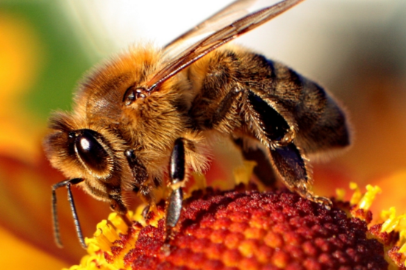
Mimicry
Bees and mimic flies
The imitating species is called the mimic, while the imitated species (protected by its toxicity or foul taste) is known as the model

Slide 10
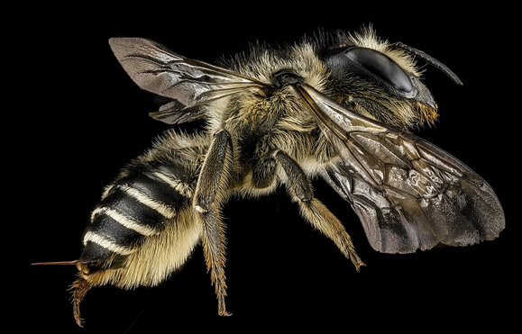
Do you get close to bees? Why or why not?

Slide 11
Some flies mimic bees in color, shape and sound. Why would it help flies to look like bees?
Let’s look at characteristics so you can tell them apart.

Slide 12
BEE Long antenna, 4 wings, stinger

Slide 13
FLY 2 wings, small antenna, bigger eyes, no stinger

Slide 14
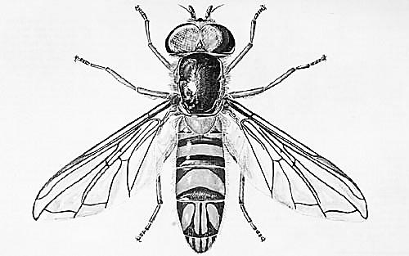
INSECT MIMICRY
Color the fly and the bee so they look similar
This is a _______________. It has ______ wings, bigger/smaller eyes, long/short antenna. Has/doesn’t have a stinger.
This is a _______________. It has ______ wings, bigger/smaller eyes, long/short antenna. Has/doesn’t have a stinger.

Slide 15
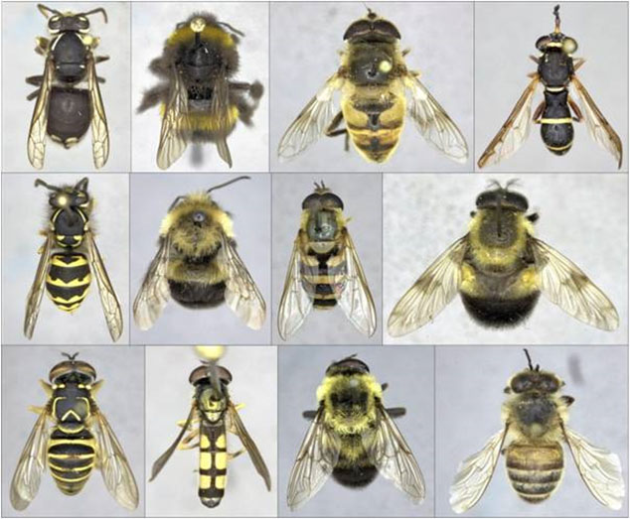
Find the 5 bees

Slide 16
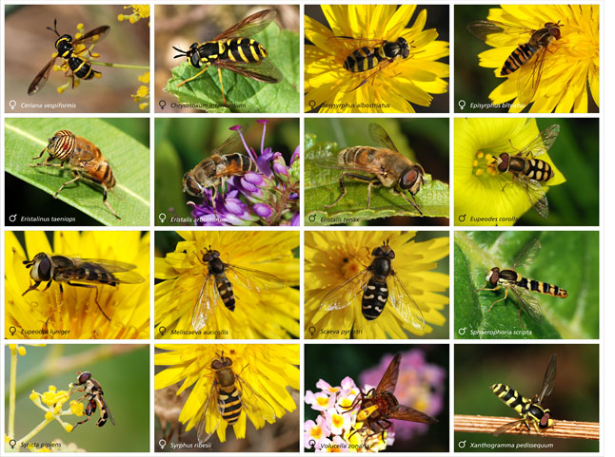
Are these flies, bees or wasps?

Slide 17
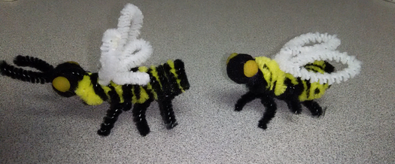
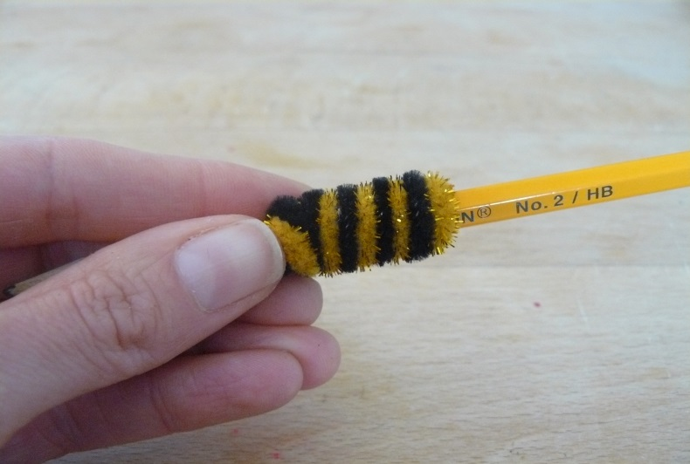
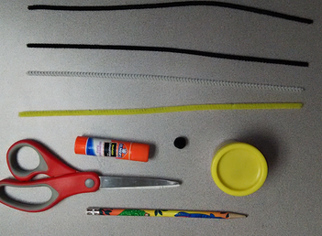
Bees and Flies - Activity

