Slide 1
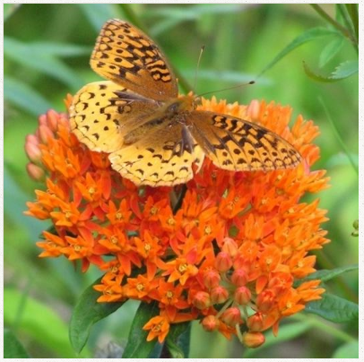
Milkweed!
Your second grade project will be measuring the growth of milkweed plants.
So let’s learn what is special about milkweed and milkweed diversity.

Slide 2
Why is milkweed called milkweed?

Slide 3
Milkweed has a white, milky thick sap.
Don’t eat it or get it near your mouth or eyes! It tastes bitter and is not good for you!

Slide 4
What insects only eat milkweed?

Slide 5
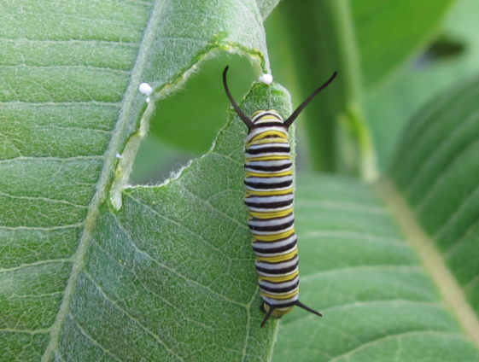
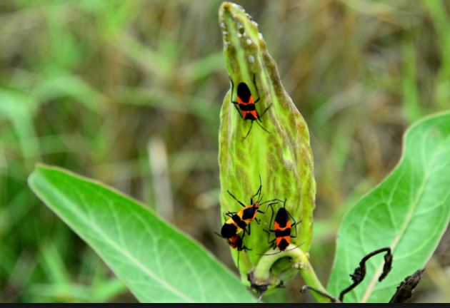
Monarch caterpillars and milkweed bugs only eat milkweed

Slide 6
How does milkweed help the monarch caterpillar?

Slide 7
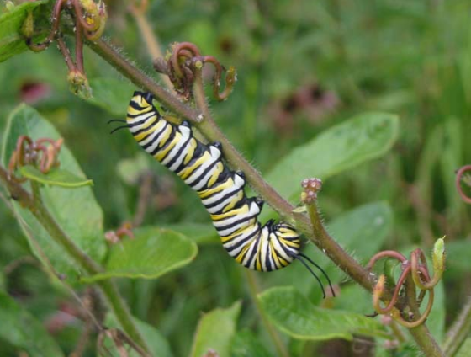
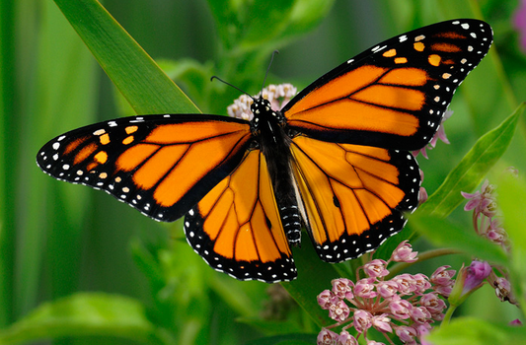
Milkweed sap makes the caterpillar taste bad so birds and other predators don’t eat them. The monarch butterflies taste bad to birds too.

Slide 8
Are there lots of types of milkweed?
Yes! There are over a 80 species of milkweed native to North America.
A few species come from Africa or South America.

Slide 9
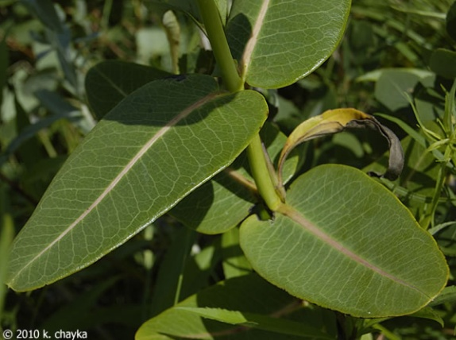
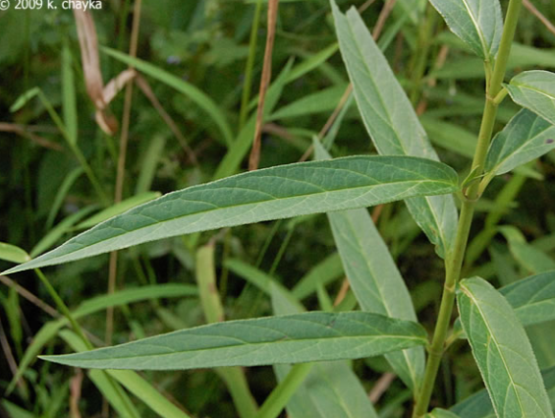
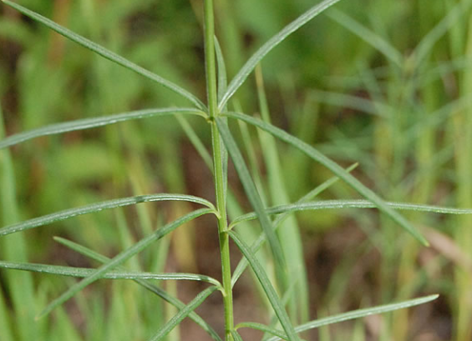
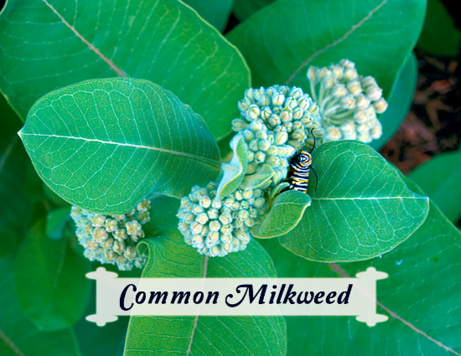
Milkweed has leaf diversity
What differences do you see in leaf shape and color?

Slide 10
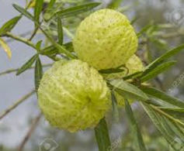
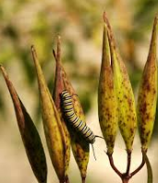
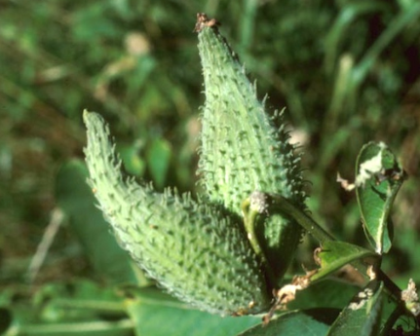
Milkweed has seed pod diversity
What differences do you see?

Slide 11
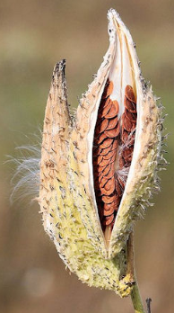
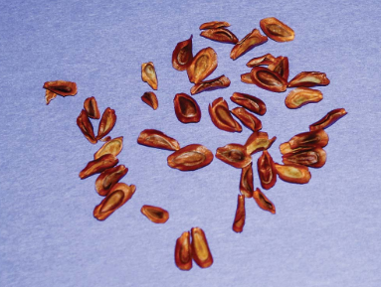
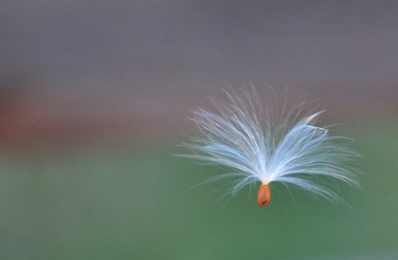
Milkweed seeds
The seeds are brown. Why do they have white hairy parts attached?

Slide 12
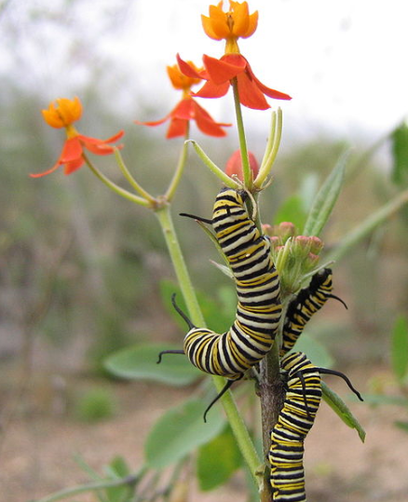
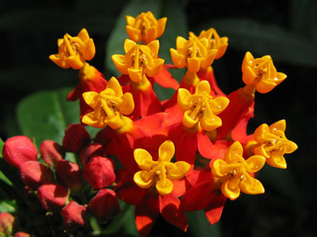
Milkweeds have flower diversity
What differences to you see?
What insects do you see?

Slide 13
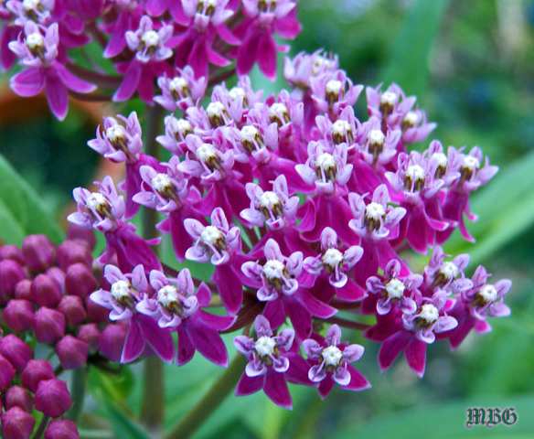
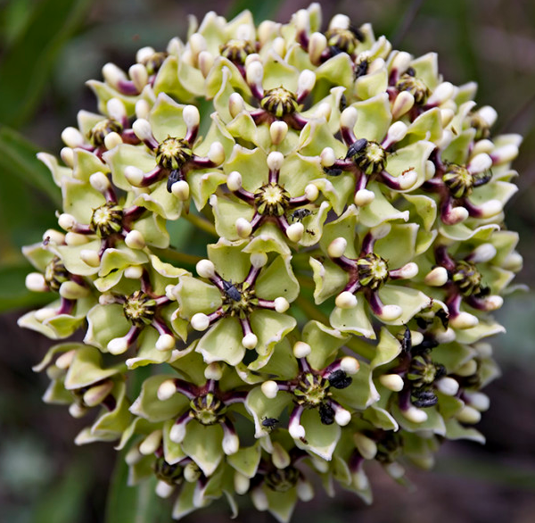

Slide 14
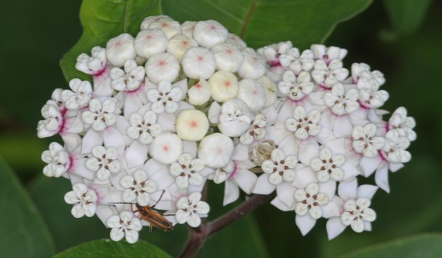
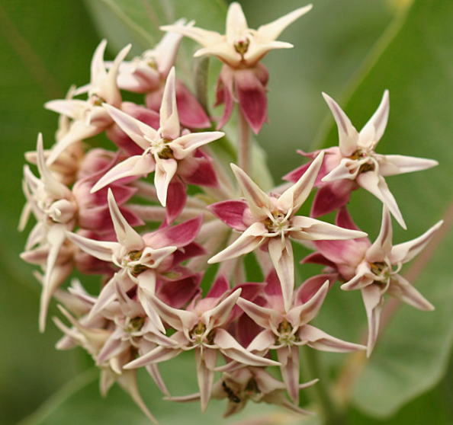
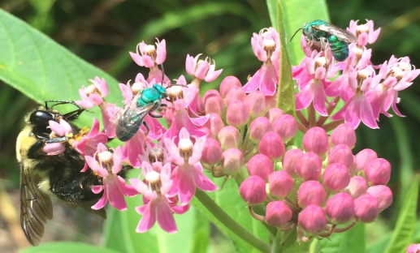

Slide 15
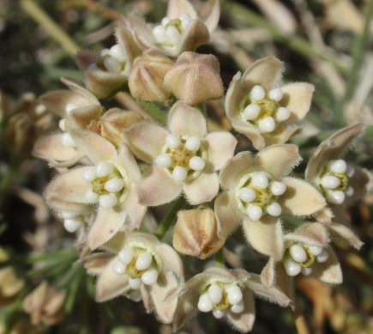
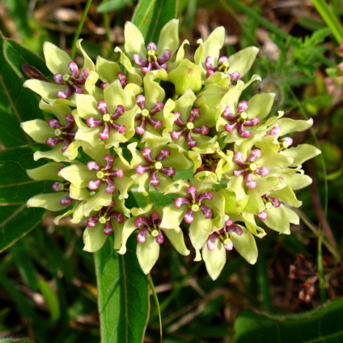
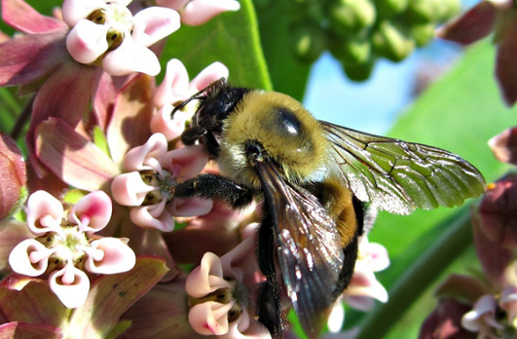

Slide 16
Even though there are differences, all milkweed flowers have the same flower structure
In the lab you will get to look at the flowers of some milkweed.

Slide 17
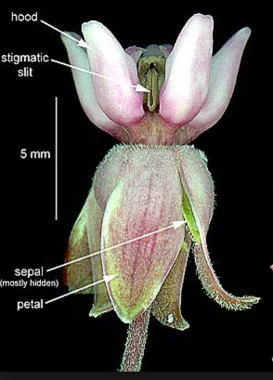
Unlike other flowers, milkweed petals are folded back. Can you find the petals?

Slide 18
Milkweed flowers have special parts called “hoods” and “horns” that other flowers do not have. Can you see them?

Slide 19
Let’s look at real milkweed

